Slide 1
Display to archives
SUNY Oswego Creative & Scholarly Works
Donated to Penfield Library
March 2018 – March 2019

Slide 2
Gonzalo Aguiar
Aguiar, Gonzalo. “Avatares de la Funcion Intelectual en el Pensamiento Democratico de Jose Enrique Rodo.” Lecturas Contemporaneas de Jose Enrique Rodo. Edited by Jose Ramiro Podetti, Sociedad Rodoniana, 2018, pp. 13-29.
Modern Languages & Literatures

Slide 3
Christopher Baltus
Baltus, Christopher. “Monge’s Descriptive Geometry in Three Examples.” Proceedings of the Canadian Society for History and Philosophy of Mathematics. Edited by Maria Zack and Dirk Schlimm, 2018, pp. 109-120.
Mathematics

Slide 4
Sandy Bargainnier
Bargainnier, Sandy, et al. “Socio-Cultural Factors that Support the Successful Transition of Refugees from Middle School to College.” Refugee Education: Integration and Acceptance of Refugees in Mainstream Society., Edited by Patrick Blessinger, Emerald Publishing Limited, vol. 11, 2018, pp. 125-137.
Health Promotion & Wellness

Slide 5
Kestutis Bendinskas
Gump, Brooks B., et al. “Background Lead and Mercury Exposures: Psychological and Behavioral Problems in Children.” Environmental Research, vol. 158, 2017, pp. 576-582.
Blodgett J., et al. “Both Hair Cortisol and Perceived Stress During Fall Exams Decrease After the Winter Break.” Austin Biochemistry, vol. 2, no. 1, 2017, pp. 1007-1010.
Chemistry

Slide 6
Sarah Berry
Baker, Clayton J, et al. “Listen to My Tale: Frankenstein and Physician-Patient Disagreements.” From Reading to Healing Teaching Medical Professionalism Through Literature. Edited by Susan Stagno and Michael Blackie, Kent State University Press, 2019, pp. 255-258.
English & Creative Writing

Slide 7
Marcia Burrell
Burrell, M. “Mission to Accomplish: A Journey to Math Democracy.” A paradise to regain: Post-Obama insights from women educators of the Black Diaspora. Edited by I. Harushimana, M. Alfred, & R.D. Davis, Myers Education Press, 2019.
Curriculum & Instruction

Slide 8
Indu Churchill
Churchill, Indu Raskia, et al. “The Cocycle Structure of the Alexander f-Quandles on Finite Fields.” Journal of Algebra and Its Applications, vol. 17, no. 10, 2018.
Churchill, Indu R. U., et al. “f-Racks, f-Quandles, their Extensions and Cohomology.” Journal of Algebra and Its Applications, vol. 16, no. 11, 2017.
Churchill, Indu R.U., et al. “Singular Knots and Involutive Quandles.” Journal of Knot Theory and Its Ramifications, vol. 26, no. 14, 2017.
Churchill, Indu R. U., et al. “Ternary and n-ary f-Distributive Structures.” Open Mathematics, vol. 16.1, 2018 pp. 32-45.
Mathematics

Slide 9
Fehmi Damkaci
Damkaci, Fehmi, et al. “N-Picolinamides as Ligands in Ullman type C-O Coupling Reactions.” Tetrahedron Letters, vol. 58, no 36, 2017, pp. 3559-3564.
Damkaci, Fehmi, et al. “Peer Mentor Program for the General Chemistry Laboratory Designed to Improve Undergraduate STEM Retention.” Journal of Chemical Education, vol. 94, no. 12, 2017, pp. 1873-1880. https://doi.org/10.1021/acs.jchemed.7b00340
Alp, Esma, et al. “Starch Nanoparticles for Delivery of the Histone Deacetylase Inhibitor CG-1521 in Breast Cancer Treatment.” International Journal of Nanomedicine, vol. 14, 2019, pp. 1335-1346.
Chemistry

Slide 10
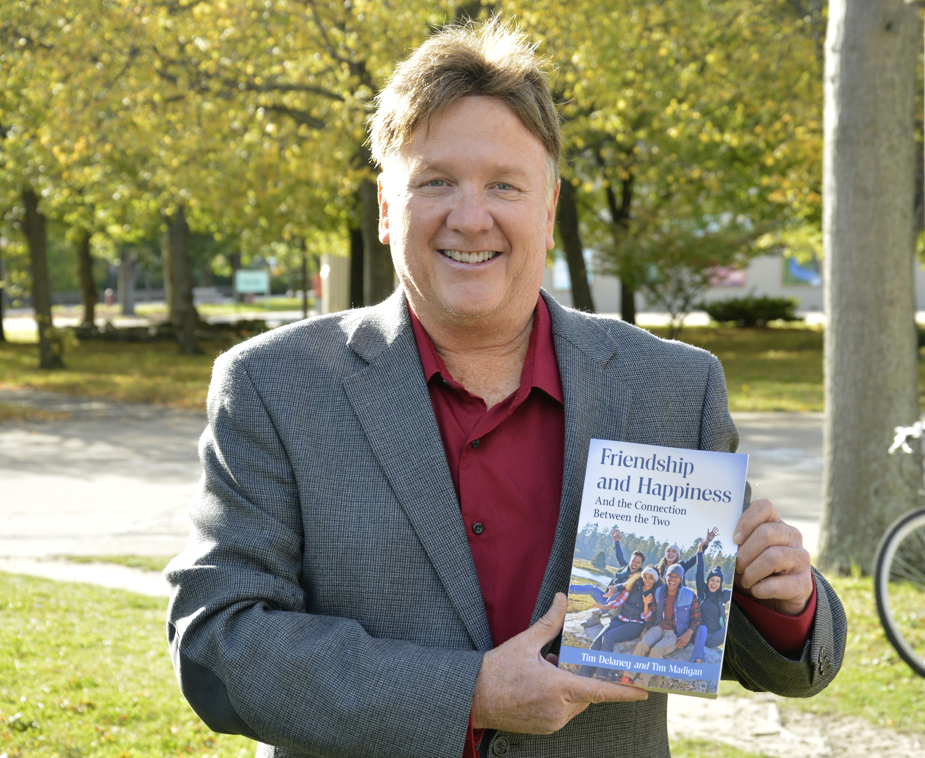
Tim Delaney
Delaney, Tim. “Anyone Who has Good Friends is a Success.” Philosophy Now, June/July 2018, p. 4.
Delaney, Tim. Common Sense as a Paradigm of Thought: an analysis of social interaction. Routledge, 2019.
Delaney, Tim and Anastasia Malakhova. “Contemporary Friendships.” Philosophy Now, June/July 2018, pp. 10-13.
Delaney, Tim and Tim Madigan. A Global Perspective on Friendship & Happiness. Vernon Press, 2018.
Sociology

Slide 11
Juan Denzer
Denzer, Juan. “How Our Institution Went from Most Hacked to Zero Breaches.” Computers in Libraries, vol. 38, no. 5, 2018, pp. 8-11.
Denzer, J. “Create a 3D Touch Display for the Library.” 63 Ready-to-Use Maker Projects. Edited by E. Kroski. American Library Association, 2018, pp. 333-340.
Denzer, J. “How to Add a High-Tech Twist to Your Escape Room.” Escape Rooms and Other Immersive Experiences in the Library. Edited by E. Kroski. American Library Association, 2018, pp. 145-153.
Gallant, Kristen and Juan Denzer. “Experiencing Medieval Manuscripts using Touch Technology.” Digital Humanities: Implications for Librarians, Libraries, and Librarianship. Edited by Christopher Millson-Martula and Kevin B. Gunn, Routledge, 2018, pp. 203-215.
Library

Slide 12
Matthew Dykas
Gump, Brooks B., et al. “Background Lead and Mercury Exposures: Psychological and Behavioral Problems in Children.” Environmental Research, vol. 158, 2018, pp. 576-582.
Psychology

Slide 13
Kristen Eichhorn
Byrnes-Loinette, K. and K.C. Eichhorn. “Attraction.” Macmillan Encyclopedia of Families, Marriages, and Intimate Relationships. Edited by James J. Ponzetti Jr., Maureen Blankemeyer, Sean M. Horan, Heidi Lyons, Ayo Shigeto, Cengage, 2019, pp. 64-69.
An Integrated Approach to Communication Theory and Research (3rd edition). Edited by D.W. Stacks, M.B. Salwen and K.C. Eichhorn. Routledge, 2019.
Communication Studies

Slide 14
Scott Furlong
Kraft, Michael, and Scott Furlong. Public Policy: Politics, Analysis, and Alternatives. Sage, 2017.
Office of the Provost

Slide 15
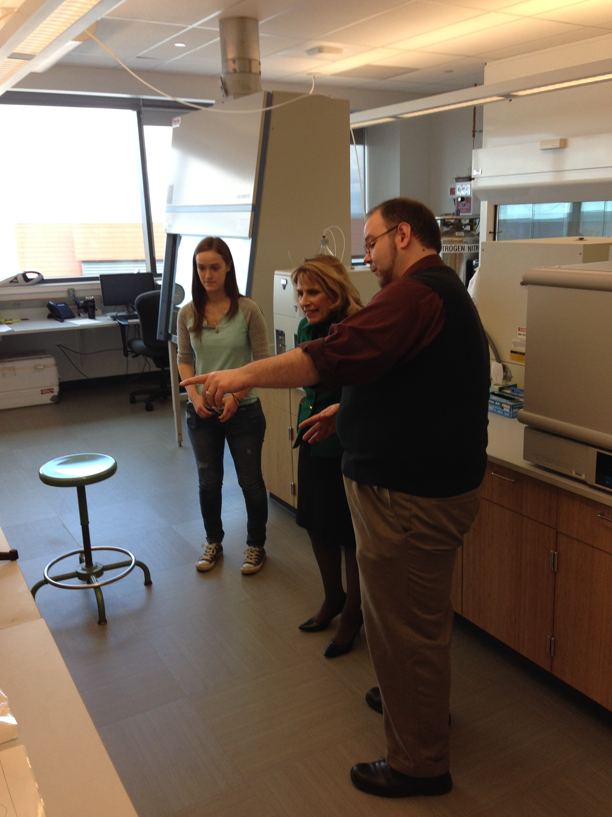
Andrew Garner
Garner, Andrew J. and James Pagano. “Trends of Polychlorinated Dioxins, Polychlorinated Furans, and Dioxin-like Polychlorinated Biphenyls in Chinook and Coho Salmonid Eggs from a Great Lakes Tributary.” Environmental Pollution, vol. 247, 2019, pp. 1039-1045.
Chemistry

Slide 16
Todd Graber
Graber, Todd and Juan Francisco La Manna. Winterreise. SUNY Oswego Music Department, 2017.
Music

Slide 17
Roger Guy
Chomczynski, Piotr A. and Roger Guy. “Flying Under the Radar: Low-Profile Drug Dealers in a Mexico City Neighborhood.” Journal of Drug Issues, vol. 49, no. 2, 2019, pp. 308-323.
Chomczynski, Piotr A., Roger Guy and Rodrigo Corina-Cortes. “Front Business-Back Business: The Social Anatomy of Small-Time Drug Dealing in a Mexico City Neighborhood.” Journal of Contemporary Ethnography, 2019. https://doi.org/10.1177/0891241619827633
Criminal Justice

Slide 18
Laura Harris
Harris, Laura. “How to use H5P Widgets for Literacy Instruction.” Computers in Libraries, vol. 38, no. 9, 2018, pp. 17-21.
Library

Slide 19
Deale Hutton
Hutton, Deale. Storm Warnings Artists Respond to Climate Change. July 20, 2018-July 29, 2018, Fair Haven Arts Center, Fair Haven, New York.
Library

Slide 20
Carolina Ilie
Ilie, Carolina C. and Zachariah S. Schrecengost. Electrodynamics: problems and solutions. Morgan and Claypool, 2018.
Ilie, CC, et al. “Inkjet Printable-Photoactive all Inorganic Perovskite Films with Long Effective Photocarrier Lifetimes.” Journal of Physics: Condensed Matter, vol. 20, 2018.
https://doi.org/10.1088/1361-648X/aab986
Richmond, Dylan, et al. “Inkjet Printing All Inorganic Halide Perovskite Inks for Photovoltaic Applications.” Journal of Visualized Experiments, January 2019. https://doi.org/10.3791/58760
Physics

Slide 21
Shashi Kanbur
Deb, Sukanta. “Geometry of the Large Magellanic Cloud using Multiwavelength Photometry of Classical Cepheids.” Monthly Notices of the Royal Astronomical Society, vol. 478, no. 2, 2018, pp. 2526-2540.
Das, Susmita, et al. “On the Variation of Light-curve Parameters of RR Lyrae Variables of Multiple Wavelengths.” Monthly Notices of the Royal Astronomical Society, vol. 481, no. 2, 2018, pp. 2000-2017.
Physics

Slide 22
Sharon Kane
Kane, S. Literacy and Learning in the Content Areas: Enhancing Knowledge in the Disciplines, 4th Edition. New York, NY: Routledge, 2019.
Kane, S. “Readers' Hearts Seek Connection: Transactional Theory Applied to The Heart Is a Lonely Hunter.” Critical Approaches to Teaching the High School Novel: Reinterpreting Canonical Literature. Edited by C. Hill and V. Malo-Juvera, Routledge, 2019, pp. 87-103.
Harrell, M., and S. Kane. “The Thing about Grieving: Intellectual and Emotional Work in Ali Benjamin's The Thing about Jellyfish.” When Loss Gets Personal: Discussing Death through Literature in the Secondary ELA Classroom. Edited by M.M. Falter and S.T. Bickmore, Rowman & Littlefield, 2018, pp. 71-82.
Curriculum & Instruction

Slide 23
Helen Knowles
Knowles, Helen. The Tie Goes to Freedom: Justice Anthony M. Kennedy on Liberty. Rowman & Littlefield, 2018.
Political Science

Slide 24
Aleksandra Kraszpulska
Kraszpulska, Aleksandra. “Lighting Design/Stage Management.” Program for The Bicentennial Canal Theatre Project at the H. Lee White Maritime Museum, Oswego, New York, Playbill, August 18, 2018, pp. 1-4.
Theatre

Slide 25
Daniel Kraus
Anco, Stephen and Daniel Kraus. “Hamiltonian Structure of Peakons as Weak Solutions for the Modified Camassa-Holm Equation.” Discrete and Continuous Dynamical Systems, vol. 38, no. 9, 2018, pp. 4449-4465.
Mathematics

Slide 26
Juan Francisco La Manna
Graber, Todd and Juan Francisco La Manna. Winterreise. SUNY Oswego Music Department, 2017.
Music

Slide 27
Tamara Lipke
Lipke, Tamara B. “Mentoring Processes Strengthening Women’s Relational Leadership: A Pilot Study.” Periferia, vol. 10, no. 2, 2018, pp. 80-102.
Educational Administration

Slide 28
James MacKenzie
Gump, Brooks B., et al. “Background Lead and Mercury Exposures: Psychological and Behavioral Problems in Children.” Environmental Research, vol. 158, 2018, pp. 576-582.
Biological Sciences

Slide 29
Jodi Ann Mullen
Mullen, Jodi Ann. Raising Freakishly Well Behaved Kids. Integrative Counseling Services, 2018.
Counseling & Psychological Services

Slide 30
John Myers
Myers, John. “Homological Criteria for Minimal Multiplicity.” Journal of Algebra, vol. 523, 2019, pp. 285-310.
Mathematics

Slide 31
Ampalavanar Nanthakumar
Nanthakumar, A. “On the Error Rate Comparison of the Quadratic Discriminant Function, Euclidean Distance Classifier, Fisher’s Linear Discriminant Function and the Vine Copulas.” International Journal of Statistics and Probability, vol. 8, no. 1, 2019, pp.113-119.
Mathematics

Slide 32
Peter Newell
Sommer, Andrew J. and Peter D. Newell. “Metabolic Basis for Mutualism Between Gut Bacteria and Its Impact on the Drosophila Melanogaster Host.” Applied and Environmental Microbiology, vol. 8, no. 2, 2019, pp. 1-15.
Biological Sciences

Slide 33
Benjamin Ogwo
Ogwo, Benjamin A. “Global Perspective and Trends in Work-based Learning of Technical and Vocational Education and Training (TVET) Programmes in Sub-Saharan Africa.” Work-based learning as a pathway to competence-based education - A UNEVOC Network contribution. Edited by Anke Bahl and Agnes Dietzen, 2018, pp. 147-161.
Career & Technical Educator Preparation

Slide 34
Alanna Ossa
Ossa, Alanna and Andrea Gregory. “Subsistence, Ceramic Production, and Exchange at Farmstead Sites on the Queen Creek Bajada.” Journal of Arizona Archaeology, vol. 6, no. 1, 2018, pp. 44-62.
Anthropology

Slide 35
James Pagano
Crimmins, Bernard S., et al. “Commentary: Integrating Non-Targeted and Targeted Chemical Screening in Great Lakes Fish Monitoring Programs.” Journal of Great Lakes Research, vol. 44, no. 5, 2018, pp. 1127-1135.
Zhou, Chuanlong, et al. “Polychlorinated Biphenyls and Organochlorine Pesticides Concentration Patterns and Trends in Top Predator Fish of Laurentian Great Lakes from 1999-2014.” Journal of Great Lakes Research, vol. 44, no. 4, 2018, pp. 716-724.
Garner, Andrew J. and James Pagano. “Trends of Polychlorinated Dioxins, Polychlorinated Furans, and Dioxin-like Polychlorinated Biphenyls in Chinook and Coho Salmonid Eggs from a Great Lakes Tributary.” Environmental Pollution, vol. 247, 2019, pp. 1039-1045.
Wu, Yan, et al. “Spatial and Temporal Trends (2004-2016) of Selected Alternative Flame Retardants in Fish of the Laurentian Great Lakes.” Environmental Science and Technology, vol. 53, no. 4, 2019, pp. 1786-1796.
Chemistry

Slide 36
Ritu Radhakrishnan
Radhakrishnan, R. ”Beyond Anne Frank: Exploring the Aesthetics in Children’s and Young Adult Literature to Develop Critical Literacy Practices in the Social Studies Classroom.” Critical Literacy Initiatives for Civic Engagements. Edited by A. Cartwright and E. Reeves, IGI-Global, 2019. Radhakrishnan, R. “The Earth Without Art is Just “eh”.” Racial Tensions and the Public Schools: What Should Educators Do?. Edited by S. Jones, E. Sheffield and J. Heybach, Academy for Educational Studies, 2019.
Curriculum & Instruction

Slide 37
Tania Ramalho
Ramahlo, Tania. “Paulo Friere and Communication Studies.” Oxford Research Encyclopedia of Communication, 2018.
Ramalho, Tania. “Vendo De Perto o Bicho na Toca: Expondo o Impostor Neoliberal na Educacao.” Revista Educacao e Emancipacao, vol, 11, no. 3, 2018, pp. 291-314.
Curriculum & Instruction

Slide 38
Allison Rank
Rank, Allison and Heather Pool. “Exposing the War on Women: The Limits of Law and Power of Care to Address Sexual Violence in Contemporary Crime Drama.” New Political Science. vol. 41, no. 1, 2019, pp. 36-54. https://doi.org/10.1080/07393148.2018.1558036
Political Science

Slide 39
Mary Rodgers
Rodgers, Mary T. and James E. Payne. “Monetary Policy and Copper Price Bust: A Reassessment of the Causes of the 1907 Panic.” Research in Economic History, vol. 34, 2018, pp. 99-133.
Business

Slide 40
Beatriz Salcedo-Strumpf
Salcedo-Strumpf, Beatriz. “An American Affaire.” 20 anos de cuentos alrededor de la Mesa Literaria. Antologia. Edited by Alondra Jcobo Torres, La Mesa Literaria, 2017, pp. 169-172.
Salcedo-Strumpf, Beatriz. “La incertidumbre.” Lo Dulce Y Lo Amargo De La Palabra. Edited by Alondra Jcobo Torres, 2017, pp. 153-156
Salcedo-Strumpf, Beatriz. “En Ithaca, New Yok.” 20 anos de cuentos alrededor de la Mesa Literaria. Antologia. Edited by Alondra Jcobo Torres, La Mesa Literaria, 2017, pp. 165-169.
Salcedo-Strumpf, Beatriz. “Julio de 1811.” 20 anos de cuentos alrededor de la Mesa Literaria. Antologia. Edited by Alondra Jcobo Torres, La Mesa Literaria, 2017, pp. 159-164.
Modern Languages & Literatures

Slide 41
Margaret Schmuhl
Schmuhl, Margaret, et al. “Gender Equality and State Execution Within and Across 100 Countries from 1997-2010.” International Criminal Justice Review, vol. 28, no. 2, 2018, pp. 97-117.
Schmuhl, Margaret and Chongmin Na. “Globalization and Sofware Piracy Within and Across 103 Countries.” Crime, Law, and Social Change, 2018. https://doi.org/10.1007/s10611-018-9805-8
Adamczyk, Amy, et al. “Newspaper Presentations of Homosexuality Across Nations: Examining Difference by Religion, Economic Development, and Democracy.” Sociological Perspectives, vol. 61, no. 3, 2018, pp. 399-425.
Natarajan, Mangai, et al. “Sexual Victimization of College Students in Public Transport Environments: A Whole Journey Approach.” Crime Prevention Community Safety, vol. 19, 2017, pp. 168-182.
Kim, Chunrye and Margaret Schmuhl. “Understanding Intimate Partner Violence in the Asian Communities in America: A Systematic Review.” Trauma, Violence and Abuse, vol. 19, August 2018, pp. 1-9.
Criminal Justice

Slide 42
Damian Schofield
Schofield, Damian. Courting the Visual Image: The Ability of Digital Graphics and Interfaces to Alter the Memory and Behavior of the Viewer, HCI 2018. Edited by M. Kurosu. 2018, pp. 325-344.
Schofield, D. and M. Canale. “Cross Cultural Web Design: An Examination of User Attitudes.” Journal of Management and Marketing Research, vol. 22, 2018, pp. 1-19.
Schofield, Damian. “Guidelines for Using Game Technology as Educational Tools.” Journal of Education and Learning (EduLearn), vol. 12, no. 2, 2018, pp. 101-113.
Schofield, D. “Mass Effect: Game Technology in Educational Contexts.” International Education and Research Journal, vol. 4, no. 1, 2018, pp. 62-67.
Schofield, Damian and Noelle C. L. LeRoy. “Representing Robots: The Appearance of Artificial Humans in Cinematic Media.” Journal of Arts & Humanities, vol. 7, no. 5, 2018, pp. 12-28.
Graham, Kevin and Damian Schofield. “Rock God or Game Guru: Using Rocksmith to Learn to Play a Guitar.” Journal of Music Technology and Education, vol. 11, no 1, 2018, pp. 65-82.
Computer Science

Slide 43
Namrata Sharma
Sharma, Namrata. Value-Creating Global Citizenship Education: Engaging Gandhi, Makiguchi, and Ikeda as Examples. Palgrave Macmillan, 2018.
Curriculum & Instruction

Slide 44
Steven Smith
Smith, Steven. “Fear.” Poetrybay- an Online Poetry Magazine for the 21st Century, Winter 2018/19. Smith, Steven. “For All My Friends Who Moved on.” Ibbetson Street 44. Edited by Lawrence Kessenich and Emily Pineau, Ibbetson Street Press Boston, 2018, p. 11. Smith, Steven. “In Memory of Allie Caulfield and His Fielder’s Mitt.” Plainsongs. Edited by Eric R. Tucker, Hastings College Press, Summer 2018, vol. 38, no. 2, p. 27. Smith, Steven. “Middle Finger Wood Carving.” Old Red Kimono, vol. 47, Spring 2018, p. 21.
Office of Learning Services

Slide 45
Lyudmyla Sonchak
Chorniy, Anna, et al. “Exploding Asthma and ADHD Caseloads: The Role of Medicaid Managed Care.” Journal of Health Economics, vol. 60, 2018, pp. 1-15.
Economics

Slide 46
Scott Steiger
Steiger, Scott M., et al. “Thunderstorm Characteristics During the Ontario Winter Lake-Effect Systems Project.” Journal of Applied Meteorology and Climatology, vol. 57, 2018, pp. 853-874.
Atmospheric & Geological Sciences

Slide 47
Bastian Tenbergen
Cook, W., et al. AirborneCPS: A Simulator for Functional Dependencies in Cyber Physical Systems – A Traffic Collision Avoidance System Implementation. Proceedings of the 4th International Workshop on Requirements Engineering for Self-Adaptive, Collaborative, and Cyber Physical Systems (RESACS), 2018, pp. 32-35.
Tenbergen, B. and M. Daun: Industry Projects in Requirements Engineering Education: Application in a University Course in the US and Comparison with Germany. Proceedings of the 52nd Hawaii International Conference on System Sciences (HICSS-52), 2019, pp. 7671-7680.
Bandyszak, T., et al. Model-Based Documentation of Context Uncertainty for Collaborative Cyber- Physical Systems – an Approach and Application to an Industry Automation Case Example. Proceedings of the IEEE International Conference on Automation Software Engineering (CASE), 2018, pp. 1087-1092.
MacCreery, J. and Bastian Tenbergen. On the Syntactic, Semantic, and Pragmatic Quality of Students’ Conceptual Models. Proceedings of the 52nd Hawaii International Conference on System Sciences (HICSS-52), 2019, pp. 7711-7720.
Shuto, M., et al. Personality and Learning Effectiveness of Teams in Information Systems Education Courses. EAI Endorsed Transactions on e-Learning, Vol. 18 no. 17, 2018. doi: 10.4108/eas.25-9-2018.155572
Tenbergen, B., et al. View-Centric Context Modeling to Foster the Engineering of Cyber-Physical System Networks. Proceedings of the IEEE International Conference on Software Architecture (ICSA), 2018, pp. 206-215.
Computer Science

Slide 48
Lewis Turco, Emeritus
Turco, Lewis. The Sonnetarium. Bordighera Press, New York, 2018.
English & Creative Writing

Slide 49
Dave Valentino
Valentino, Dave, et al. “Spatial and Temporal Links Between Shawinigan Accretionary Orogenesis and Massif Anorthosite Intrusion, Southern Grenville Province, New York, USA.” Journal of Geodynamics, 2018.
Valentino, Dave, et al. Tectonic Evolution of the Western Hudson Highlands, New York. New York State Geological Association 88th Annual Meeting, 2016.
Atmospheric & Geological Sciences

Slide 50
Dan Witmer
Witmer, Dan. …and Piles to go Before I Sleep – The Book of Wit. 2018.
Witmer, Dan. The Best of Road Trip Dad the Laker Lacrosse Collection. 2018.
Intercollegiate Athletics

Slide 51
Jason Zenor
Zenor, Jason. “Endowed by Their Creator with Certain Unalienable Rights: The Future Rise of Civil Rights for Artificial Intelligence?” Savannah Law Review, vol. 5, no. 1, 2018, pp. 115-132.
Zenor, Jason. “If it’s in the Game: Is There Liability for User-Generated Characters that Appropriate a Player’s Likeness?” The John Marshall Review of Intellectual Property Law, vol. 291, 2017, pp. 291-305.
Zenor, Jason. “The Meme Made me do it! The Future of Immersive Entertainment and Tort Liability.” Sports & Entertainment Law Journal Arizona State University, vol. 7, no. 1, 2017, pp. 93-126.
Zenor, Jason. “Viewpoint Endorsement Equals Viewpoint Neutrality? The Circular Logic of Government Speech Doctrine.” Capital University Law Review, vol. 46, no. 1, 2018, pp. 2-21.
Communication Studies

Slide 52
View current and past Display to Archives slide shows and bibliographies at:
https://www.oswego.edu/library/display-archives

