Slide 1
Display to archives
SUNY Oswego Creative & Scholarly Works
Donated to Penfield Library
March 2020- March 2021

Slide 2
Steven Abraham
Sotak, Kristin Lee, and Steven E. Abraham. “Negotiate to Survive: An Exercise to Help Develop Students’ Understanding of Negotiations.” Journal of Education for Business, Sept. 2020, pp. 1–5. DOI:10.1080/08832323.2020.1812488.
Management and Marketing

Slide 3
David Andrews
Andrews, David. “John Maynard Keynes as Theologian *.” The Routledge Handbook of Economic Theology, edited by Stefan Schwarzkopf, 1st ed., Routledge, 2020, pp. 358–66 DOI:10.4324/9781315267623-44.
Andrews, David. “The Reception of Malthus’s Essay on Population in the United States.” Malthus Across Nations, by Gilbert Faccarello et al., Edward Elgar Publishing, 2020, pp. 53–82 DOI:10.4337/9781788977579.00007.
Andrews, David. “Error or Absurdity? A Non-Cognitive Approach to Commodity Fetishism.” Marx at 200 New Developments on Karl Marx’s Thought and Writings, edited by Gilbert Faccarello and Heinz-Dieter Kurz, 1st ed., Routledge, Taylor & Francis Group, 2020.
Economics

Slide 4
Jean Ann
Nonaka, Angela M., et al. “Linguistic and Cultural Design Features of the Manual Syllabary in Japan.” Visible Language, vol. 54, no. 1/2, 2020, pp. 30–65.
Curriculum & Instruction

Slide 5
Kestutis Bendinskas
Gump, Brooks B., et al. “Dietary Contributions to Increased Background Lead, Mercury, and Cadmium in 9–11 Year Old Children: Accounting for Racial Differences.” Environmental Research, vol. 185, June 2020, p. 109308. DOI:10.1016/j.envres.2020.109308.
Bendinskas, Kestutis G., et al. “The Case for Undergraduate Research Journals.” Bulletin of Mathematical Biology, vol. 82, no. 8, July 2020, p. 100. DOI:10.1007/s11538-020-00775-2.
Gump, Brooks B., et al. “Vacation’s Lingering Benefits, but Only for Those with Low Stress Jobs.” Psychology & Health, Routledge, Sept. 2020, pp. 1–18. DOI:10.1080/08870446.2020.1814958.
Chemistry

Slide 6
Rebecca Burch
Burch, Rebecca L., and David R. Widman. “The Point of Nipple Erection 1: The Experience and Projection of Perceived Emotional States While Viewing Women with and without Erect Nipples.” Evolutionary Behavioral Sciences, Aug. 2020. DOI:10.1037/ebs0000244.
Burch, Rebecca L., et al. “The Reproductive Priming Effect Revisited: Mate Poaching, Mate Copying, or Both?” Evolutionary Behavioral Sciences, June 2020. DOI:10.1037/ebs0000232.
Fisher, Maryanne L., et al. “Evolutionary Psychology: Thoughts on Integrating Feminist Perspectives.” The Cambridge Handbook of Evolutionary Perspectives on Human Behavior, edited by Lance Workman et al., 1st ed., Cambridge University Press, 2020, pp. 378–92. DOI:10.1017/9781108131797.032.
Fisher, Maryanne L., and Rebecca L. Burch. “Evolutionary Psychology and Gender Studies.” The SAGE Handbook of Evolutionary Psychology, by Todd Shackelford, SAGE Publications Ltd, 2021, pp. 350–76. DOI:10.4135/9781529739435.n18.
Salmon, Catherine, and Rebecca L. Burch. “I’m with You Till the End of the Line: The Romanticization of Male Bonds.” Evolutionary Perspectives on Imaginative Culture, edited by Joseph Carroll et al., Springer International Publishing, 2020, pp. 291–305. DOI:10.1007/978-3-030-46190-4_15.
Salmon, Catherine, et al. “The Internet Is for Porn: Evolutionary Perspectives on Online Pornography.” The Cambridge Handbook of Evolutionary Perspectives on Human Behavior, edited by Lance Workman et al., 1st ed., Cambridge University Press, 2020, pp. 548–57. DOI:10.1017/9781108131797.046.
Burch, Rebecca. “Captain Dorito and the Bombshells: Hypersexuality in Marvel Comic Characters.” Juniata Voices, vol. 19, Sept. 2018, pp. 6–22. https://www.juniata.edu/offices/juniata-voices/past-version/media/volume-19/Burch_Captain_Doritoand_the_Bombshells_Juniata_Voices_vol_19_pgs_6_22.pdf.
Human Development

Slide 7
Victoria Chiu
Liu, Qi, et al. “Bringing Scholarly Data Analytics Knowledge Using Emerging Technology Tools in Accounting into Classrooms: A Bibliometric Approach.” Issues in Accounting Education, Aug. 2020, p. ISSUES-19-079. DOI:10.2308/ISSUES-19-079.
Accounting, Finance, and Law

Slide 8
Gregory Churchill
Churchill, Gregory, and Brendan Nagle. “Bipartite Hansel Results for Hypergraphs.” European Journal of Combinatorics, vol. 89, Oct. 2020, p. 103136. DOI:10.1016/j.ejc.2020.103136.
Mathematics

Slide 9
Indu Raskia Churchill
Churchill, Indu Rasika, et al. “On the Classification of F-Quandles.” Algebraic Structures and Applications, edited by Sergei Silvestrov et al., vol. 317, Springer International Publishing, 2020, pp. 359–69. DOI:10.1007/978-3-030-41850-2_14.
Mathematics

Slide 10
David Crider
Crider, David. “‘Great Sounds and Wonderfulness’: KMPX and the Birth of Freeform Radio.” Journal of Radio & Audio Media, vol. 27, no. 2, July 2020, pp. 319–33. DOI:10.1080/19376529.2020.1743996.
Crider, David. “The Shrinking Electronic Town Square.” Radio’s Second Century: Past, Present, and Future Perspectives, edited by John Allen Hendricks, Rutgers University Press, 2020, pp. 67–81.
Communication Studies

Slide 11
Craig DeLancey
DeLancey, Craig. “Camus’s Absurd and the Argument against Suicide.” Philosophia. DOI:10.1007/s11406-021-00333-7.
Philosophy

Slide 12
Jacob Dodd
Dodd, Jacob. 16mm and 8mm Filmmaking : An Essential Guide to Shooting on Celluloid. 2021.
English & Creative Writing

Slide 13
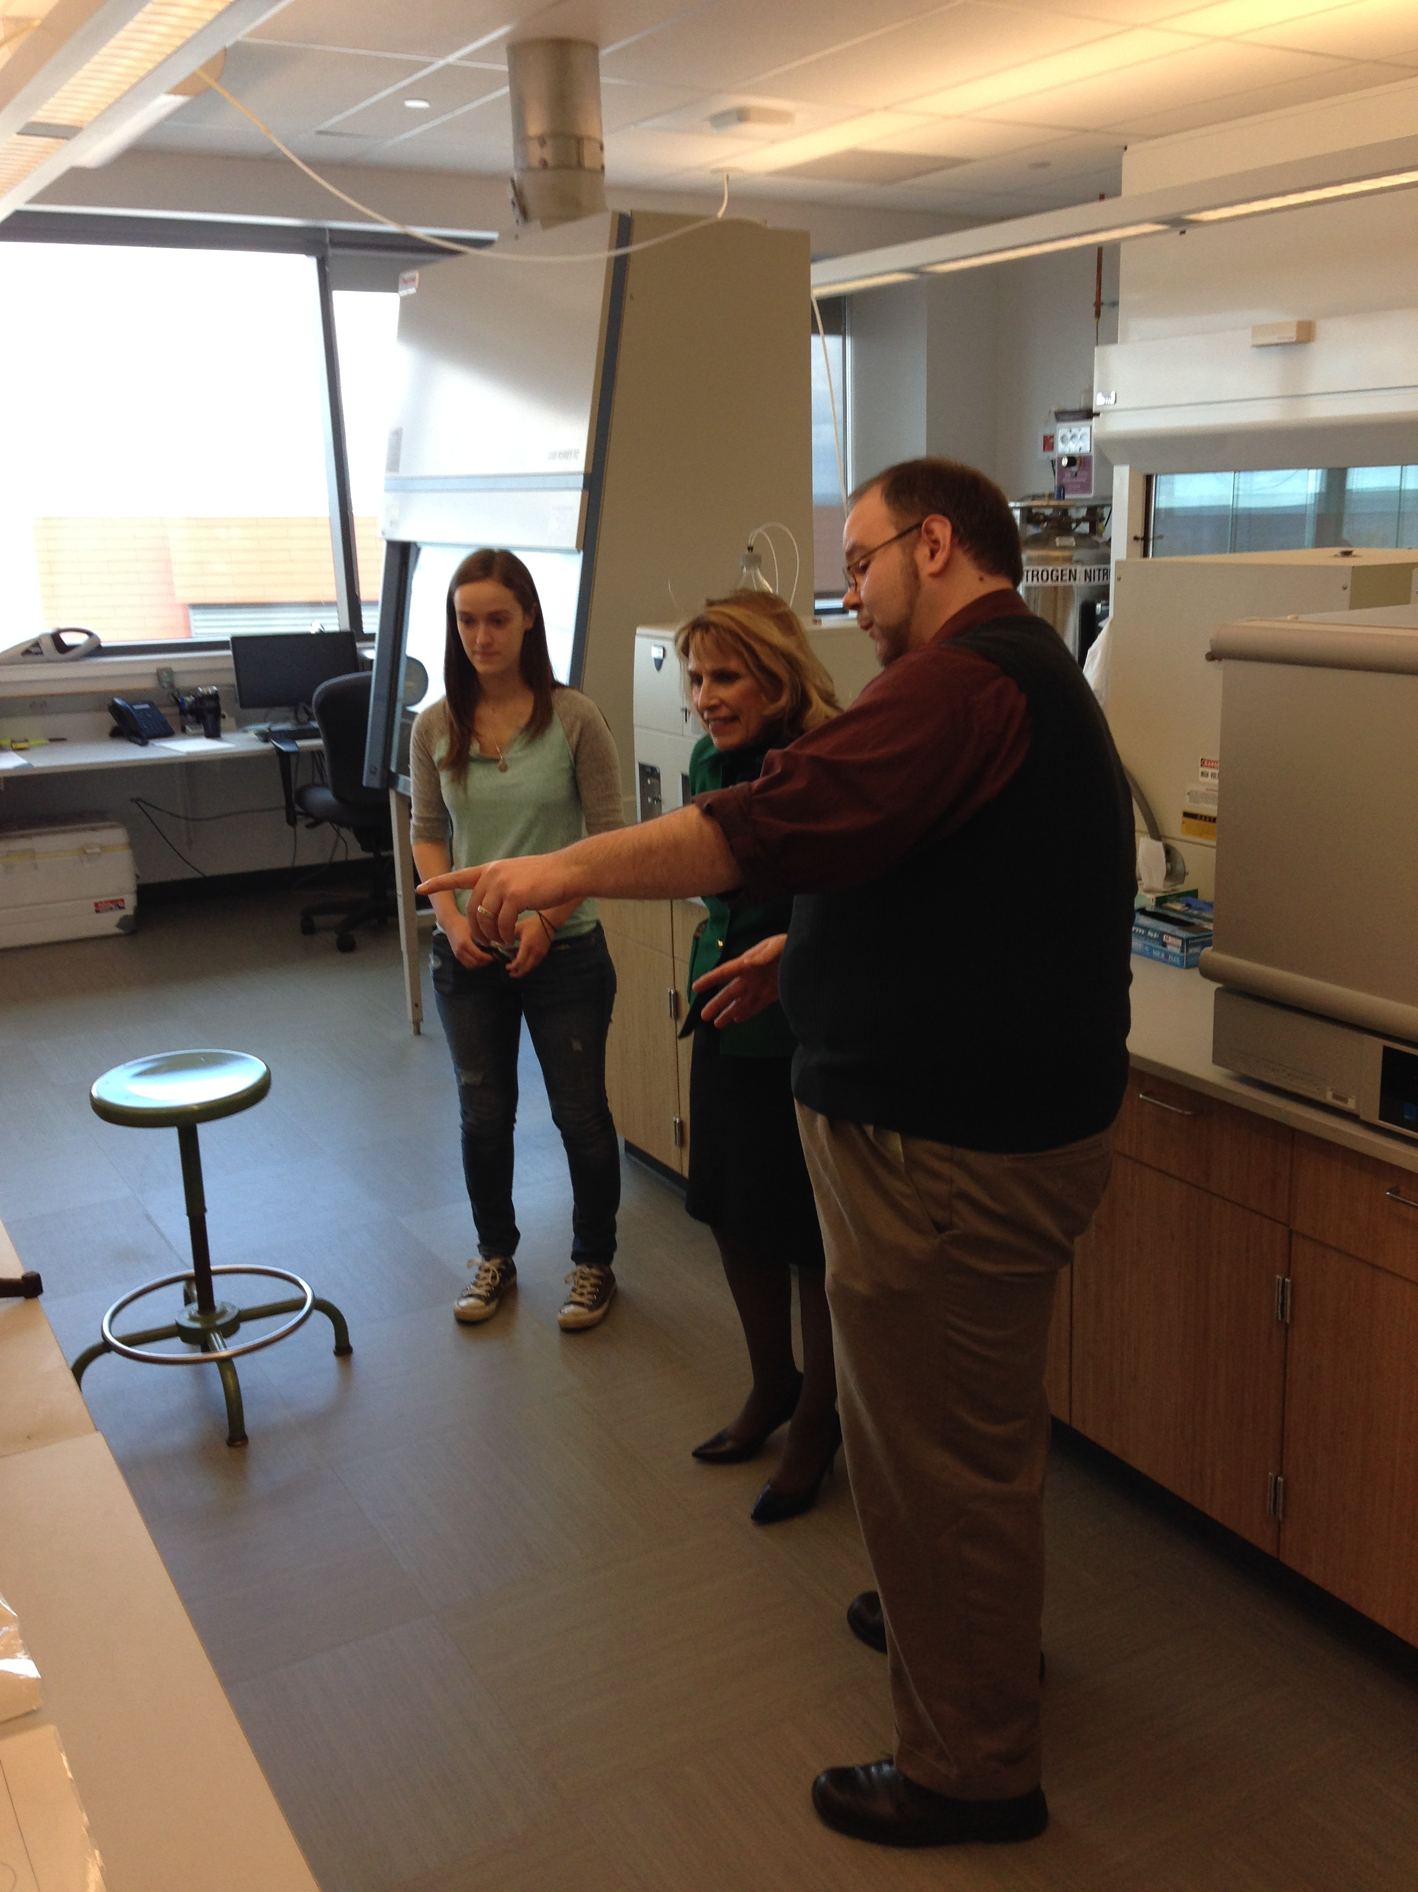
Andrew Garner
Pagano, James J., and Andrew J. Garner. “Polychlorinated Naphthalenes across the Great Lakes: Lake Trout and Walleye Concentrations, Trends, and TEQ Assessment—2004–2018.” Environmental Science & Technology, Feb. 2021, p. acs.est.0c07507. DOI:10.1021/acs.est.0c07507.
Chemistry

Slide 14
Jinyan Guo
Guo, Jinyan, and Chad T. Halson. “Stigma, Pollen Tube Transmitting Tract, and Epidermal Micromorphology of the Style of Sarracenia Purpurea (Sarraceniaceae).” Botany, vol. 98, no. 4, Apr. 2020, pp. 209–29. DOI:10.1139/cjb-2019-0189.
Guo, Jinyan, and Chad T. Halson. “Developmental Sequence of the Syncarpous Gynoecium of Sarracenia Purpurea (Sarraceniaceae) with Flattened and Broadened Carpels and an Umbrella-Shaped Style.” Botany, vol. 98, no. 8, Aug. 2020, pp. 401–23. DOI:10.1139/cjb-2020-0011.
Biological Sciences

Slide 15
Roger Guy
Chomczyński, Piotr A., and Roger Guy. “‘Our Biographies Are the Same’: Juvenile Work in Mexican Drug Trafficking Organizations from the Perspective of a Collective Trajectory.” The British Journal of Criminology, Jan. 2021, p. azaa092. DOI:10.1093/bjc/azaa092.
Criminal Justice

Slide 16
Sarah Hanusch
Hanusch, Sarah. “Summative Portfolios in Undergraduate Mathematics Courses.” PRIMUS, vol. 30, no. 3, Mar. 2020, pp. 274–84. DOI: 10.1080/10511970.2019.1566185.
Mathematics

Slide 17
Roberta Hurtado
Hurtado, Roberta, and Omara Rivera-Vázquez. “De-Naturalizing Surviving: Domestic Violence, Narrative, and Social Justice in the Aftermath of Hurricane Maria.” Label Me Latina/o, vol. 10, no. [Supplement], Label Me Latina/o, 2020 2020, pp. 1–16. https://labelmelatin.com/wp-content/uploads/2020/07/Hurtado-Rivera-V%C3%A1zquez-De-Naturalizing-Survival-final-version.pdf.
Hurtado, Roberta. “DUSMIC POETIC OF THE FLESH: Decolonial Shifts in Puerto Rican Women’s Fiction.” Chicana/Latina Studies: The Journal of Mujeres Activas En Letras y Cambio Social, vol. 20, no. 1, 2020, pp. 84–107.
English and Creative Writing

Slide 18
Catalina Iannone
Iannone, Catalina. “Visualizing Blackness in Contemporary Spain: Race and Representation in Juan Valbuena’s Salitre.” Hispania, vol. 103, no. 3, 2020, pp. 357–72. DOI:10.1353/hpn.2020.0084.
Modern Languages and Literatures

Slide 19
Webe Kadima
Kadima, Webe, et al. “Estimating the Prevalence of Asymptomatic Type 2 Diabetes in Kinshasa, Democratic Republic of Congo.” East African Journal of Public Health, pp. 1–11.
Chemistry, Emeritus

Slide 20
John Kane
Spizman, Lawrence M., and John Kane. “Update of Educational Attainment Model for a Minor Child: Round 18 of NLSY (1997).” Journal of Forensic Economics, vol. 29, no. 1, Sept. 2020, pp. 131–41. DOI:10.5085/JFE-465.
Economics

Slide 21
Marthinus Koen
Koen, Marthinus C., et al. “Body-Worn Cameras: Technological Frames and Project Abandonment.” Journal of Criminal Justice, vol. 72, Jan. 2021, p. 101773. DOI:10.1016/j.jcrimjus.2020.101773.
Criminal Justice

Slide 22
Linda Rae Markert
Markert, Linda Rae. You Can’t Make This up! : Stories from the Field - Resolving Educational Leadership Dilemmas. Brill Sense, 2020.
Educational Administration

Slide 23
Toby Malone
Malone, Toby, and Aili Huber. “Cutting and Adapting Text for the Virtual Performing Landscape.” New & Noteworthy: The LMDA Newsletter, vol. 6, no. 4, Dec. 2020.
Malone, Toby, and Meg Logue. “Not Really (Little Star).” MarshStream International Solo Fest, 11 Oct. 2020.
Young, TJ, and Liz Fisher. The Inseparables. Pittsburgh Public Theatre, 21 Jan. 2021.
Theatre

Slide 24
Joshua McKeown
McKeown, Joshua S., et al. “Academic Development: The Impact of Education Abroad on Students as Learners.” Education Abroad: Bridging Scholarship and Practice, edited by Anthony C. Ogden et al., Routledge, 2021, pp. 77–91.
McKeown, Joshua S. “Wasted Talents? China’s Higher Education Reforms Experienced through Its Visiting Scholars Abroad.” Journal of Contemporary China, Feb. 2021, pp. 1–18. DOI:10.1080/10670564.2021.1884961.
Office of International Education and Programs

Slide 25
Ampalavanar Nanthakumar
Kadima, Webe, et al. “Estimating the Prevalence of Asymptomatic Type 2 Diabetes in Kinshasa, Democratic Republic of Congo.” East African Journal of Public Health, pp. 1–11.
Mathematics

Slide 26
James Pagano
Pagano, James J. “Concentrations, Toxic Equivalence, and Age-Corrected Trends of Legacy Organic Contaminants in Lake Champlain Lake Trout_ 2012–2018.” Environmental Research, 2020, p. 12.
Pagano, James J., and Andrew J. Garner. “Polychlorinated Naphthalenes across the Great Lakes: Lake Trout and Walleye Concentrations, Trends, and TEQ Assessment—2004–2018.” Environmental Science & Technology, Feb. 2021, p. acs.est.0c07507. DOI:10.1021/acs.est.0c07507.
Chemistry

Slide 27
Casey Raymond
Ayudhya, Theppawut, et al. “Synthesis and Structure of a 1:1 Co-Crystal of Hexamethylenetetramine Carboxyborane and Acetaminophen.” Acta Crystallographica Section E Crystallographic Communications, vol. 76, no. 12, Dec. 2020, pp. 1854–58. DOI: 10.1107/S2056989020015327.
Cleaver, Robert J., and Casey C. Raymond. “Carboxyborate: A Main Group Inorganic Laboratory Experience.” Advances in Teaching Inorganic Chemistry Volume 2: Laboratory Enrichment and Faculty Community, vol. 1371, American Chemical Society, 2020, pp. 13–20, DOI: 10.1021/bk-2020-1371.ch002.
Chemistry

Slide 28
Mary. T. Rodgers
Rodgers, Mary T., and James E. Payne. “Post‐financial Crisis Changes in Financial System Structure: An Examination of the J.P. Morgan & Co. Syndicates after the 1907 Panic.” Review of Financial Economics, vol. 38, no. S1, Mar. 2020, pp. 226–41. DOI: 10.1002/rfe.1084.
Accounting, Finance, and Law

Slide 29
Damian Schofield
Adams, Joshua H., and Damian Schofield. It’s The End Of The World And You Watch It: A Brief History Of Disaster Themed Media. no. 1, 2020, p. 35.
Adams, Joshua H., and Damian Schofield. It’s the End of the World and You Watch It: Media Consumption in the Time of COVID-19. no. 1, 2020, p. 42.
Bartlett, Christopher, et al. “Assessing the Feasibility of Using Augmented Reality to Visualize Interventional Radiology Imagery:” Proceedings of the 15th International Joint Conference on Computer Vision, Imaging and Computer Graphics Theory and Applications, SCITEPRESS - Science and Technology Publications, 2020, pp. 169–76. DOI: 10.5220/0008947701690176.
McClure, Coleen, and Damian Schofield. “Running Virtual: The Effect of Virtual Reality on Exercise.” Journal of Human Sport and Exercise, vol. 15, no. 4, 2019, pp. 861–70. https://doi.org/10.14198/jhse.2020.154.13.
Panchal, Khushboo, et al. “Cultural Impact on Website Design: A Study in India and USA.” American Journal of Humanities and Social Sciences Research, vol. 4, no. 5, 2020, pp. 19–24. https://www.ajhssr.com/wp-content/uploads/2020/05/C20451924.pdf.
Schofield, Damian, and Robert LeDone. “The Motivations of a Video Game Streamers and Their Viewers.” Screen Thought, vol. 3, no. 1, 2019. https://55fe5255-a4d9-45fa-8d5c-c7dcac88eadf.filesusr.com/ugd/0d1f4b_563669e161254ff09a15262ec47cd97c.pdf.
Computer Science

Slide 30
Margaret Schmuhl
Kim, Chunrye, and Margaret Schmuhl. “Assessment of Research on Intimate Partner Violence (IPV) Among Sexual Minorities in the United States.” Trauma, Violence, & Abuse, Oct. 2019, p. 152483801988173 DOI:10.1177/1524838019881732.
Mills, Colleen E., et al. “Far-Right Violence as Backlash against Gender Equality: A County-Level Analysis of Structural and Ideological Gender Inequality and Homicides Committed by Far-Right Extremists.” Journal of Crime and Justice, vol. 43, no. 5, Oct. 2020, pp. 568–84 DOI:10.1080/0735648X.2020.1738261.
Schmuhl, Margaret, and Joel A. Capellan. “Gendered Massacres: Examining the Effects of Cultural and Structural Gender Inequality on the Incidence of Mass Public Shootings.” Violence and Victims, vol. 35, no. 6, Dec. 2020, pp. 885–905 DOI:10.1891/VV-D-18-00184.
Criminal Justice

Slide 31
Richard Skolnik
Zhang, Huiyi, et al. “The Impacts of China’s Shadow Banking Credit Creation on the Effectiveness of Monetary Policy.” International Journal of Finance & Banking Studies (2147-4486), vol. 9, no. 4, Oct. 2020, pp. 33–46. DOI:10.20525/ijfbs.v9i4.899.
Wu, Xiancong, et al. “Institutional Investors and Blockholder Tunneling in China: The Impact of Firm Characteristics and Institutional Investor Centrality.” International Review of Accounting, Banking and Finance, vol. 12, no. 2, 2020, pp. 35–55.
Accounting, Finance, and Law

Slide 32
Kristen Lee Sotak
Sotak, Kristin Lee, and Steven E. Abraham. “Negotiate to Survive: An Exercise to Help Develop Students’ Understanding of Negotiations.” Journal of Education for Business, Sept. 2020, pp. 1–5. DOI:10.1080/08832323.2020.1812488.
Management and Marketing

Slide 33
Donna Steiner
Steiner, Donna. Lost and Found in Ocean County, New Jersey. Tolsun Books, 2020.
English and Creative Writing

Slide 34
Bastian Tenbergen
Bandyszak, Torsten, et al. “Orthogonal Uncertainty Modeling in the Engineering of Cyber-Physical Systems.” IEEE Transactions on Automation Science and Engineering, 2020, pp. 1–16 DOI:10.1109/TASE.2020.2980726.
Daun, Marian, and Bastian Tenbergen. “Teaching Requirements Engineering with Industry Case Examples.” Tagungsband Des 17. Workshops “Software Engineering Im Unterricht Der Hochschulen” 2020 Innsbruck, Österreich, 26. - 27.02.2020, vol. 2531, 2020, pp. 49–50. Zotero, http://ceur-ws.org/Vol-2531/paper08.pdf.
Department of Computer Science, State University of New York at Oswego, Oswego, NY 13126, United States, et al. “Smart Home Voice Assistants: A Literature Survey of User Privacy and Security Vulnerabilities.” Complex Systems Informatics and Modeling Quarterly, no. 24, Oct. 2020, pp. 15–30. DOI:10.7250/csimq.2020-24.02.
S. Krusche, et al. “Welcome from the Conference Chairs.” 2020 IEEE 32nd Conference on Software Engineering Education and Training (CSEE&T), 2020, pp. 1–2 DOI:10.1109/CSEET49119.2020.9206203.
Madala, Kaushik, et al. “SACC - A Property Driven Approach to Expose Undesired Behaviors among System’s Components.” 2020 IEEE 31st International Symposium on Software Reliability Engineering (ISSRE), IEEE, 2020, pp. 380–90. DOI:10.1109/ISSRE5003.2020.00043.
Tenbergen, Bastian, and Thorsten Weyer. “Generation of Hazard Relation Diagrams: Formalization and Tool Support.” Software and Systems Modeling, June 2020. DOI:10.1007/s10270-020-00799-1.
Computer Science

Slide 35
Andrea Vickery
Vickery, Andrea J., and Sabrina Ventrano. “Listening Goals and Parasocial Relationships: How Listening Styles Impact the Development of Parasocial Relationships with Media Personas.” International Journal of Listening, June 2020, pp. 1–17. DOI:10.1080/10904018.2020.1781637.
Communication Studies

Slide 36
Hong Wan
Liu, Duan, et al. “Capital Market Access and Innovation Efficiency: A Natural Experiment from China’s Pilot VAT Reform in 2012.” International Review of Economics & Finance, vol. 71, Jan. 2021, pp. 549–66. DOI:10.1016/j.iref.2020.09.026.
Wu, Xiancong, et al. “Institutional Investors and Blockholder Tunneling in China: The Impact of Firm Characteristics and Institutional Investor Centrality.” International Review of Accounting, Banking and Finance, vol. 12, no. 2, 2020, pp. 35–55.
Accounting, Finance, and Law

Slide 37
Jinpei Wu
Zhang, Huiyi, et al. “The Impacts of China’s Shadow Banking Credit Creation on the Effectiveness of Monetary Policy.” International Journal of Finance & Banking Studies (2147-4486), vol. 9, no. 4, Oct. 2020, pp. 33–46. DOI:10.20525/ijfbs.v9i4.899.
Management and Marketing

Slide 38
View current and past Display to Archives slide shows and bibliographies at:
https://www.oswego.edu/library/display-archives

