Slide 1
Display to archives
SUNY Oswego Creative & Scholarly Works
Donated to Penfield Library
March 2022- March 2023

Slide 2
Gonzalo Aguiar Malosetti
Aguiar Malosetti, Gonzalo. “Call for Papers MACLAS 2023.” The Afro- Americas: A Hemispheric Conversation (blog), 2022. http://www.maclas.org/maclas-2023.
Aguiar Malosetti, Gonzalo. “Necropaisajes del nordeste brasileño: cuerpos racializados y fantasías asesinas de la ultraderecha en Bacurau.” In Partera de la historia. Violencia en literatura, performance y medios audiovisuales en Latinoamérica, edited by Chrystian Zegarra and Osvaldo Sandoval-Leon, 1st ed., 281–99. Editora Nómada, 2022. https://doi.org/10.47377/parterahist-cap15.
Modern Languages & Literatures

Slide 3
Robert Auler
Auler, Robert. "Ballad Melody and Variations I-VII." Composed by Eric Schmitz. Ace Composers II: Further Developments by Alan, Christopher, and Eric Schmitz. Audio CD. Ravello Records, 2023.
Music

Slide 4
Kestutis Bendinskas
Hill, Dustin T., Vikrant Jandev, Michael Petroni, Nader Atallah-Yunes, Kestas Bendinskas, Lynn S. Brann, Kevin Heffernan, et al. “Airborne Levels of Cadmium Are Correlated with Urinary Cadmium Concentrations among Young Children Living in the New York State City of Syracuse, USA.” Environmental Research 223 (April 2023): 115450. https://doi.org/10.1016/j.envres.2023.115450.
Chemistry

Slide 5
Robert Card
Card, Robert F. A New Theory of Conscientious Objection in Medicine : Justification and Reasonability. First Edition. Routledge Annals of Bioethics. New York: Routledge, Taylor & Francis Group, 2020.
Philosophy

Slide 6
Victoria Chiu
Chiu, Victoria, Qi Liu, and Amelia Baldwin. “A Bibliometric Analysis of the Journal of Information Systems.” In 31st Annual Research Strategic and Emerging Technologies Research Workshop of the 2022 American Accounting Association Annual Meeting, 1–36. San Diego, CA: American Accounting Association, 2022.
Wang, Yunsen, Tiffany Chiu, Victoria Chiu, and Miklos A Vasarhelyi. “Does Your Spaghetti Look Different? Detecting Suspicious Transactions Using Deep Learning-Based Process Mining.” In The 2022 International Symposium on Accounting Information Systems (ISAIS), 1–26. Melbourne, Australia and Online, 2022.
Wang, Chiu, Yi-Ying Li, Victoria Chiu, and Hong-Dar Lin. “Incorporating an Outsourcing Strategy and In-House Quality Assurance into the Production-Shipment Decision Making.” Journal of Applied Engineering Science 20, no. 1 (2022): 212–20. https://doi.org/10.5937/jaes0-31313.
Chiu, Tiffany, Victoria Chiu, Tawei Wang, and Yunsen Wang. “Using Textual Analysis to Detect Initial Coin Offering Frauds.” Journal of Forensic Accounting Research 7, no. 1 (December 1, 2022): 165–83. https://doi.org/10.2308/JFAR-2021-001.
Accounting, Finance, and Law

Slide 7
Cynthia Clabough
Clabough, Cynthia. Allowing Nature to Break Through. 2022.
Art

Slide 8
David Crider
Crider, David. “A Dose of Public Health and Community Pride: American Local Radio at the Outset of the COVID-19 Pandemic.” Radio Journal: International Studies in Broadcast & Audio Media 20, no. 2 (October 1, 2022): 209–26. https://doi.org/10.1386/rjao_00060_1.
Crider, David. “Listening, but Not Being Heard: Young Women, Popular Music, Streaming, and Radio.” Popular Music and Society 45, no. 5 (October 20, 2022): 600–616. https://doi.org/10.1080/03007766.2022.2111513.
Crider, David. “Talk and News Radio.” The SAGE Encyclopedia of Journalism, edited by Gregory A. Borchard, 2nd ed., 2022. https://doi.org/10.4135/9781544391199.
Communication Studies

Slide 9
Sari Fordham
Fordham, Sari. Wait for God to Notice. 1st Edition. Wilkes-Barre, PA: Etruscan Press, 2021.
English & Creative Writing

Slide 10
Barry Friedman
Moehl, Suhana, and Barry A. Friedman. “Consumer Perceived Authenticity of Organizational Corporate Social Responsibility (CSR) Statements: A Test of Attribution Theory.” Social Responsibility Journal, July 8, 2021. https://doi.org/10.1108/SRJ-07-2020-0296.
Marketing & Management

Slide 11
Juliet Giglio
Giglio, Juliet, and Keith Giglio. The Summer of Christmas. Naperville, Illinois: Sourcebooks Casablanca, 2022.
English & Creative Writing

Slide 12
Joan Gujarati
Gujarati, Joan. “Disrupting Their Histories: Preservice Teachers’ Mathematics Autobiographies as Catalysts for Change.” In Global Perspectives and Practices for Reform-Based Mathematics Teaching, edited by Ozgul Kartal, Gorjana Popovic, and Susie Morrissey, 209–28. IGI Global, 2022. https://doi.org/10.4018/978-1-7998-9422-3.ch010.
Curriculum & Instruction

Slide 13
Carolina Ilie
Ekanayaka, Thilini K., Dylan Richmond, Mason McCormick, Shashank R. Nandyala, Halle C. Helfrich, Alexander Sinitskii, Jon M. Pikal, Carolina C. Ilie, Peter A. Dowben, and Andrew J. Yost. “Surface Versus Bulk State Transitions in Inkjet-Printed All-Inorganic Perovskite Quantum Dot Films.” Nanomaterials 12, no. 22 (November 10, 2022): 3956. https://doi.org/10.3390/nano12223956.
Physics

Slide 14
Shashi Kanbur
Bhardwaj, A., S. M. Kanbur, M. Rejkuba, M. Marconi, M. Catelan, V. Ripepi, and H. P. Singh. “Near-Infrared Observations of RR Lyrae and Type II Cepheid Variables in the Metal-Rich Bulge Globular Cluster NGC 6441.” Astronomy & Astrophysics 668 (December 2022): A59. https://doi.org/10.1051/0004-6361/202244728.
Deka, Mami, Shashi M. Kanbur, Sukanta Deb, Susmita Das, Kerdaris Kurbah, Earl P. Bellinger, and Anupam Bhardwaj. “Period-Colour and Amplitude-Colour Relations for OGLE-δ Scuti Stars in the Galactic Bulge and LMC.” Monthly Notices of the Royal Astronomical Society 517, no. 2 (October 18, 2022): 2251–63. https://doi.org/10.1093/mnras/stac2457.
Physics

Slide 15
John Kane
Spizman, Lawrence M., Kevin E. Cahill, and John Kane. “The Impact of Using a Race-Neutral Model to Predict the Educational Attainment and Income of a Child in Personal Injury Litigation.” Journal of Forensic Economics 30, no. 1 (2022): 10. https://doi.org/10.5085/JFE-485.
Economics

Slide 16
Doreen Mazzye
Mazzye, Doreen L, Michelle Duffy, and Richard Lamb. “Teacher Candidate Self-Efficacy and Ability to Teach Literacy: A Comparison of Residency and Traditional Teacher Preparation Models.” Journal of Global Education and Research 7, no. 2 (July 2023): 146–65. https://doi.org/10.5038/2577-509X.7.2.1230.
Curriculum & Instruction

Slide 17
Rebecca Mushtare
Thornton, Michele, Rebecca Mushtare, Francesca Rescigno, and Kaitlin Brightman. “Accessibility of the Affordable Care Act (ACA) Marketplace Websites.” Journal of Communication in Healthcare 15, no. 4 (October 2, 2022): 316–23. https://doi.org/10.1080/17538068.2022.2046899.
Art and Design

Slide 18
Bruce Peng
Peng, Long. Teaching English Through ELA, Mathematics, Science, and Social Studies : A Content-Based Language Teaching Approach. First Edition. New York: Routledge, 2023.
Curriculum & Instruction

Slide 19
Tania Ramalho
Mikulec, Erin, and Tania Ramalho, eds. Enacting Critical Pedagogy Online. First Edition. New York: Peter Lang, 2022.
Curriculum & Instruction

Slide 20
Eric Schmitz
Schmitz, Alan, et al. Ace Composers II: Further Developments by Alan, Christopher, and Eric Schmitz. Audio CD. Ravello Records, 2023.
Music

Slide 21
Damian Schofield
Croyle, Anna, Fatemeh Askarinejad, Damian Schofield, and Jorge Abreu. “Concurrent Distractions: A Cross-Cultural Study of Media Multitasking Behavior.” American Journal of Humanities and Social Sciences Research 6, no. 1 (2022): 143–54.
Dethridge, Lisa, and Damian Schofield. “Sci-Fi Movies 101: An International Online Collaboration and Research-Led Production (Starring Robots).” In The Big Question, ASPERA 2016 Conference, University of Canberra, July 6-8 2016. Australian Screen Production Education and Research Association, 2016.
Schofield, Damian, and Fabian Stelzer. “SALT (2023) – Would you watch an AI-produced synthetic movie?” Screen Thought 6, no. 1 (2022).
Computer Science

Slide 22
Damian Schofield
Wilson, Benjamin, Joshua Hull, and Damian Schofield. “An Evaluation of the Use of Audio Guidance in Augmented Reality Systems Implemented at Sites of Cultural Heritage.” The International Journal of Multimedia & Its Applications 14, no. 02 (April 30, 2022): 1–23. https://doi.org/10.5121/ijma.2022.14201.
Wypyski, Christopher, Ronald Throop, and Damian Schofield. “No Longer Stuck (IST) in Two Dimensions: Evaluating Augmented Reality Art Experiences.” Journal of Arts and Humanities 11, no. 03 (2022).
Computer Science

Slide 23
Laura Spenceley
Lovett, Benjamin J., Laura M. Spenceley, Theresa M. Schaberg, and Haley Best. “Response Validity in Psychoeducational Evaluations: Results from a National Survey of School Psychologists.” Psychology in the Schools, April 13, 2022, pits.22696. https://doi.org/10.1002/pits.22696.
School of Education

Slide 24
Steven Smith
Smith, Steven M. “At the Poets’ Picnic.” Offcourse, no. 87 (December 2021). https://www.albany.edu/offcourse/issue87/smith_steven.html.
Smith, Steven M. “Dead Man’s Bowling Shoes.” Third Wednesday: A Quarterly Journal of Literary and Visual Arts, no. Spring (2022). https://thirdwednesdaymagazine.org/2022/02/15/dead-mans-bowling-shoes-steven-smith/.
Smith, Steven M. “For Now.” Offcourse, no. 87 (December 2021). https://www.albany.edu/offcourse/issue87/smith_steven.html.
Smith, Steven M. “Hardware Department.” Offcourse, no. 87 (December 2021). https://www.albany.edu/offcourse/issue87/smith_steven.html.
Office of Learning Services

Slide 25
Steven Smith
Smith, Steven M. “Mailman of Songs.” Offcourse, no. 87 (December 2021). https://www.albany.edu/offcourse/issue87/smith_steven.html.
Smith, Steven M. “The Spanking Lady.” THE BIG WINDOWS REVIEW, March 22, 2022. https://www.thebigwindowsreview.com/2022/03/22/steven-m-smith-the-spanking-lady/.
Smith, Steven M. “Wearing Glasses.” Book of Matches: A Literary Journal, no. 4 (2022): 46. https://www.bookofmatcheslitmag.com/post/issue-4-has-arrived
Smith, Steven M. “What He Shared at His Mother’s Funeral.” Book of Matches: A Literary Journal, no. 7 (2023): 65. https://www.bookofmatcheslitmag.com/post/issue-7-is-here-and-hungry
Office of Learning Services

Slide 26
Lawrence Spizman
Spizman, Lawrence M., Kevin E. Cahill, and John Kane. “The Impact of Using a Race-Neutral Model to Predict the Educational Attainment and Income of a Child in Personal Injury Litigation.” Journal of Forensic Economics 30, no. 1 (2022): 10. https://doi.org/10.5085/JFE-485.
Economics, Emeritus

Slide 27
Bastian Tenbergen
Daun, Marian, and Bastian Tenbergen. “Context Modeling for Cyber-Physical Systems.” Journal of Software: Evolution and Process, April 8, 2022, e2451. https://doi.org/10.1002/smr.2451.
Daun, Marian, Alicia M. Grubb, Viktoria Stenkova, and Bastian Tenbergen. “A Systematic Literature Review of Requirements Engineering Education.” Requirements Engineering, May 19, 2022. https://doi.org/10.1007/s00766-022-00381-9.
Computer Science

Slide 28
Michele Thornton
Thornton, Michele, Rebecca Mushtare, Francesca Rescigno, and Kaitlin Brightman. “Accessibility of the Affordable Care Act (ACA) Marketplace Websites.” Journal of Communication in Healthcare 15, no. 4 (October 2, 2022): 316–23. https://doi.org/10.1080/17538068.2022.2046899.
Management and Marketing

Slide 29
Erik Wade
Wade, Erik. “Anglo-Saxon(Ist) Pasts, PostSaxon Futures . Donna Beth Ellard. Earth [New York]: Punctum Books, 2019. Pp. 420.” Modern Philology, November 16, 2022, E000–E000. https://doi.org/10.1086/722836.
Rambaran-Olm, Mary, and Erik Wade. “What’s in a Name? The Past and Present Racism in ‘Anglo-Saxon’ Studies.” The Yearbook of English Studies 52, no. 1 (2022): 135–53. https://doi.org/10.1353/yes.2022.0010.
English & Creative Writing

Slide 30
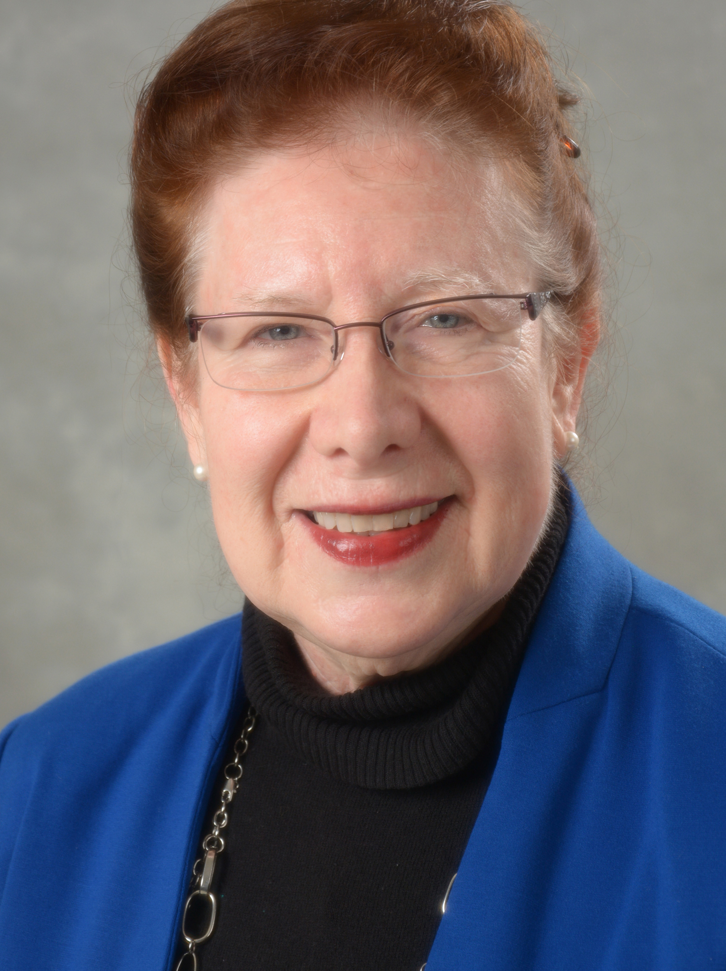
Georgina Whittingham
Salcedo, Hugo. Bárbara Gandiaga : crimen y condena en la Misión de Santo Tomás = Barbara Gandiaga : crime and condemnation in Mission Santo Tomas. Translated by Carolyn Malloy and Georgina J. Whittingham. Edición bilingüe (español-Inglés). Primera edición. Ciudad de México: Universidad Iberoamericana, 2022.
Modern Languages & Literatures

Slide 31
Daniel Wood
Wood, Daniel. "Ballad Melody and Variations I-VII." Composed by Eric Schmitz. Ace Composers II:
Further Developments by Alan, Christopher, and Eric Schmitz. Audio CD. Ravello Records, 2023.
Music

Slide 32
View current and past Display to Archives slide shows and bibliographies at:
https://www.oswego.edu/library/display-archives

