Slide 1
Display to Archives
Celebrating 25 Years of Scholarly & Creative Activity

Slide 2
Accounting, Finance & Law
Thomas Tribunella
Art
Rebecca Mushtare
Biological Sciences
Anthony Contento
C. Eric Hellquist
John Laundre

Slide 3
Chemistry
James Pagano
Communication Studies
Kristen Campbell Eichhorn
Ulises Mejias
Jason Zenor
Computer Science
Damian Schofield
Counseling & Psychological Service
Eugene Perticone, Emeritus
Barbara Streets

Slide 4
Curriculum & Instruction
Marcia Burrell
Jean Hallagan
Faith Maina
Harrison Yang
Earth Sciences
Brett Rathbun
Alfred Stamm
Scott Steiger
Paul Tomascak

Slide 5
Economics
Valentina Kozlova
English
Jacob Dodd
Bennet Schaber
Lewis Turco, Emeritus
Lewis Turco, Writing as Wesli Court
Experience-Based Education
Paul Roodin
Health Promotion & Wellness
Cheryl Wilkins-Mitchell

Slide 6
History
Mark Kulikowski
Library
Kathryn Johns-Masten
Emily Thompson
Marketing & Management
Nergis Aziz
Pamela Cox
Barry Friedman
Sarfraz Mian

Slide 7
Mathematics
Ampalavanar Nanthakumar
Modern Languages and Literatures
Otilia Cortez
Music
Robert Auler
Marilynn Smiley
Philosophy
Robert Card
Craig DeLancey
K. Brad Wray

Slide 8
Physics
Carolina Ilie
Political Science
Miriam Jiménez
Sociology
Evelyn Benavides
Tim Delaney
Theatre
Kitty Macey

Slide 9
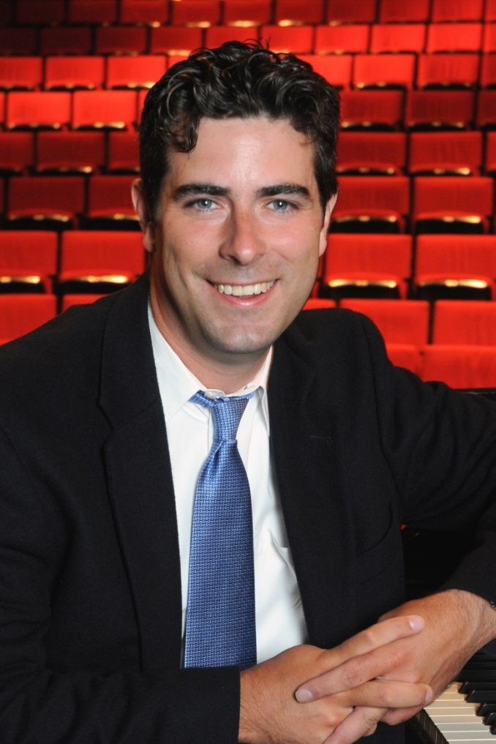
Robert Auler
Music
Department
Auler, Robert, perf. John Cage: Sonatas and Interludes Choreographed. Waterman Theatre, Tyler Hall, Oswego. 27 Oct. 2012. Performance.

Slide 10
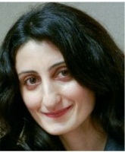
Nergis Aziz
Marketing & Management
Department
Aziz, Nergis, et al. "Entrepreneurial Motives and Perceived Problems: An Empirical Study of Entrepreneurs in Kyrgyzstan." International Journal of Business 18.2 (2013): 163-76. Print.
1of4

Slide 11
Nergis Aziz
Marketing & Management
Department
Friedman, Barry A., et al. "Predictors of Students' Desire to Be an Entrepreneur: Kyrgyzstan, Georgia, and the United States." Eurasian Journal of Business and Economics 5.9 (2012): 129-40. Print.
2of4

Slide 12
Nergis Aziz
Marketing & Management
Department
Aziz, Nergis, and Barry A. Friedman. "The Role of Nonprofits in the Process of Place Branding: A Case Study of Turkish Cultural Centers." Dumlupinar Universitesi Sosyal Bilimler Dergisi 38 (2013): 87-96. Print.
3of4

Slide 13
Nergis Aziz
Marketing & Management
Department
Aziz, Nergis, Efstathios Kefallonitis, and Barry A. Friedman. "Turkey as a Destination Brand: Perceptions of United States Visitors." American International Journal of Contemporary Research 2.9 (2012): 211-21. Print.
4of4

Slide 14
Evelyn Benavides
Sociology Department
Clark, Evelyn A. Victims of Time, Warriors for Change: Chilean Women in a Global, Neoliberal Society. Newcastle upon Tyne: Cambridge Scholars, 2013. Print.

Slide 15
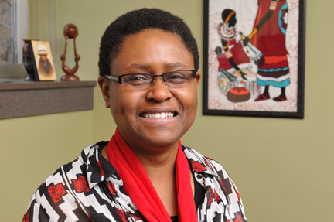
Marcia Burrell
Curriculum & Instruction Department
Maina, Faith, and Marcia M. Burrell. Attitudes towards Diverse Leaders: A Hybrid Technology Course for Secondary School Mathematics Pre / In-Service Teachers. Cases on Online Learning Communities and Beyond: Investigations and Applications. By Harrison Hao Yang and Shuyan Wang. Hershey: Information Science Reference, 2013. 113-33. Print.

Slide 16
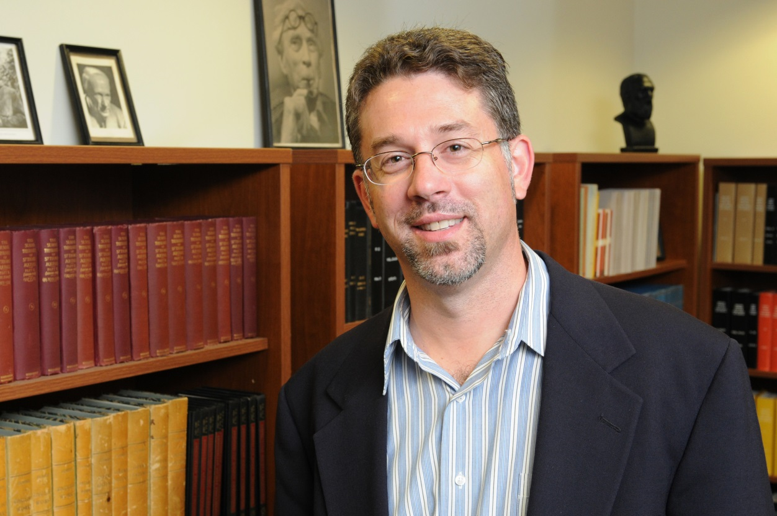
Robert Card
Philosophy Department
Card, Robert. Gender, Justice within the Family, and the Commitments of Liberalism. Sex, Love, and Friendship: Studies of the Society for the Philosophy of Sex and Love: 1993-2003. Ed. Adrianne Leigh McEvoy. New York: Editions Rodopi, 2011. 197-210. Print. Value inquiry book series 232.

Slide 17
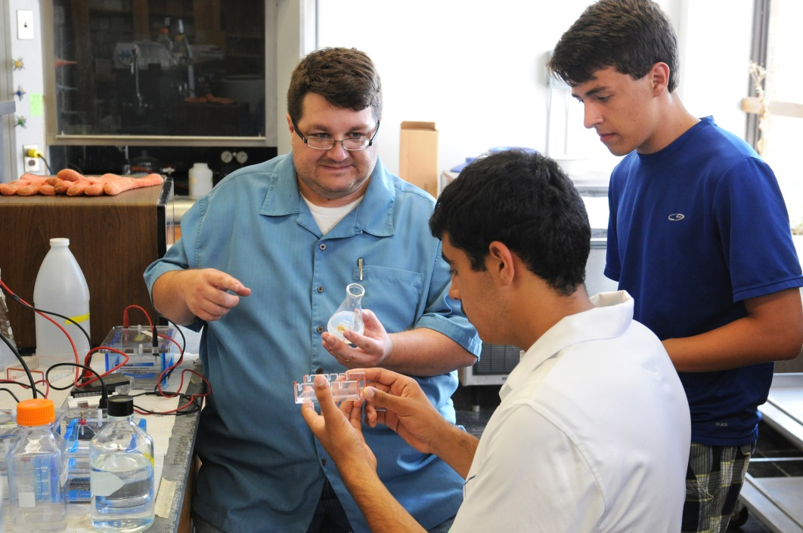
Anthony Contento
Biological Sciences Department
Contento, Anthony. Laboratory Exercises & Techniques in Cellular Biology. Hoboken: Wiley, 2013. Print.

Slide 18
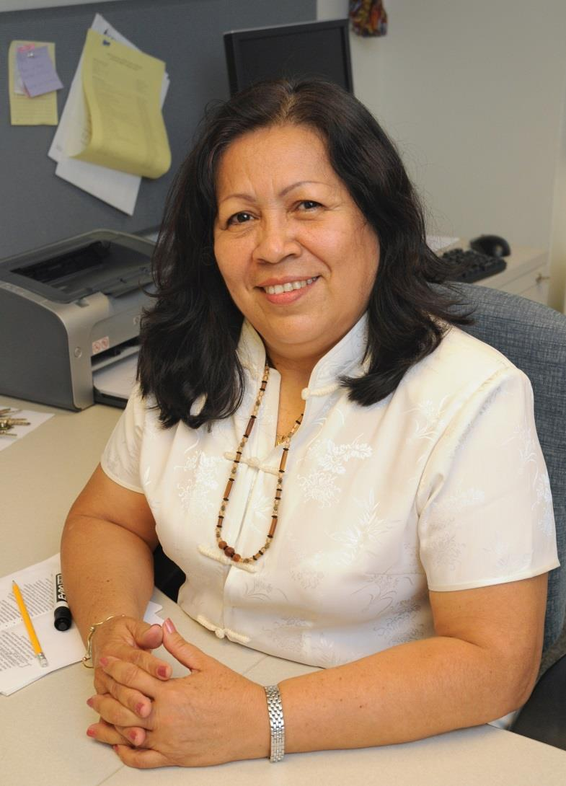
Otilia Cortez
Modern Languages
and Literatures
Department
Cortez, Otilia. El Infinito Andar: Poemas y Ensayos. Managua: PAVSA, 2013. Print.

Slide 19
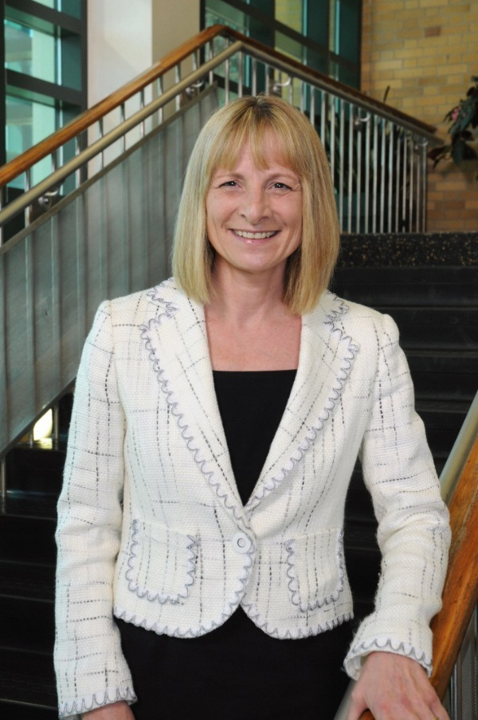
Pamela Cox
Marketing & Management
Department
Tribunella, Thomas, Barry Friedman, and Pamela Cox. "Balancing Environmental Sustainability with Economic Productivity." The BRC Academy Journal of Business 3.1 (2013): 183-214. Print.

Slide 20
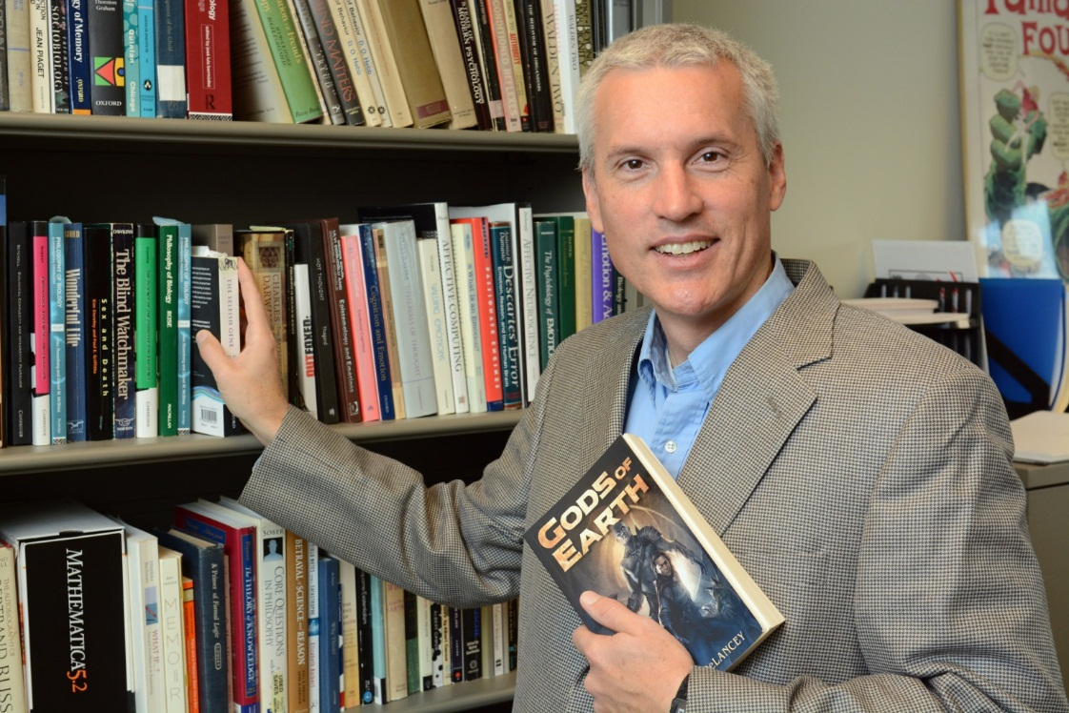
Craig Delancey
Philosophy Department
DeLancey, Craig. Gods of Earth. North Seattle: 47North, 2013. Print.

Slide 21
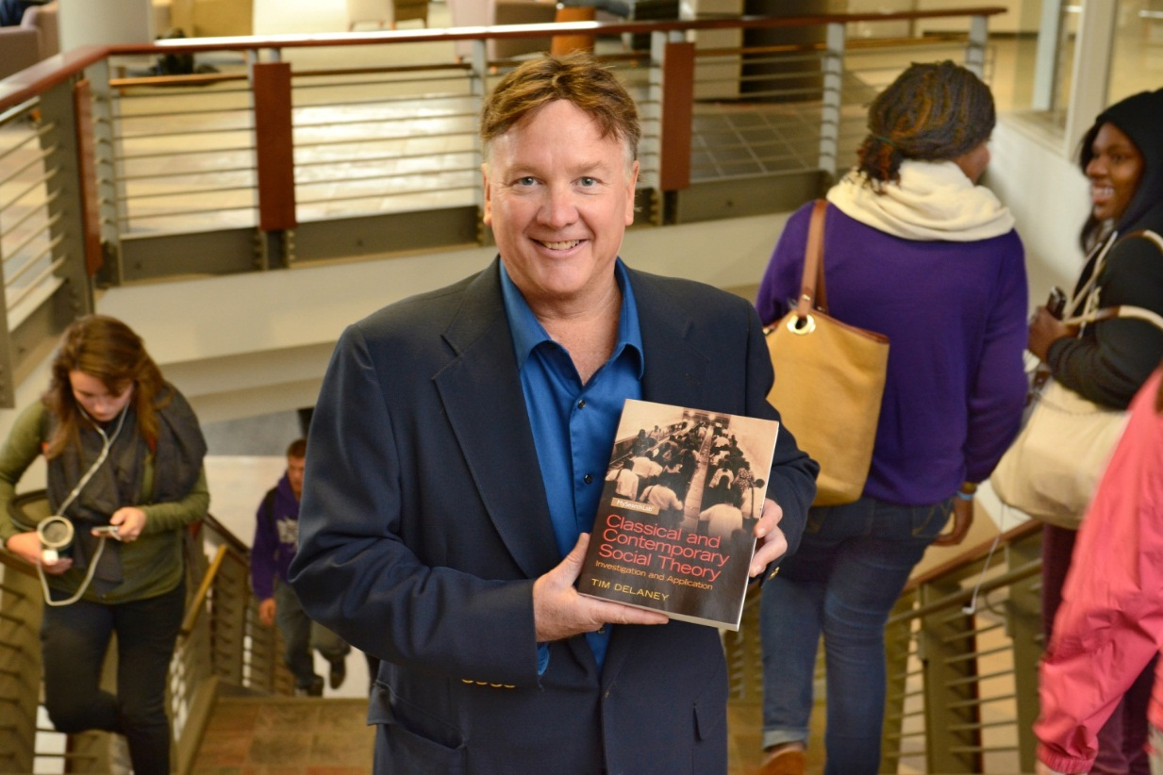
Tim Delaney
Sociology Department
Delaney, Tim. American Street Gangs. Second ed. Boston: Pearson Education, Inc., 2014. Print.
1of2

Slide 22
Tim Delaney
Sociology Department
Delaney. Tim. Classical and Contemporary Social Theory: Investigation and Application. Boston: Pearson Education, Inc., 2014. Print.
2of2

Slide 23
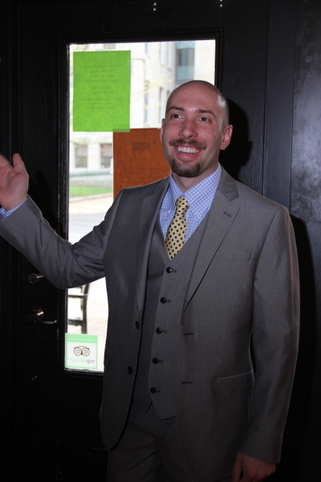
Jacob Dodd
English Department
Dodd, Jacob, screenwriter. Darkness There. Spoos Pictures, 2009. DVD.
1of2

Slide 24
Jacob Dodd
English Department
Dodd, Jacob, screenwriter. Nunna Mia e la Barca = My Grandmother and the Boat. 2007. Spoos Pictures, 2007. DVD.
2of2

Slide 25
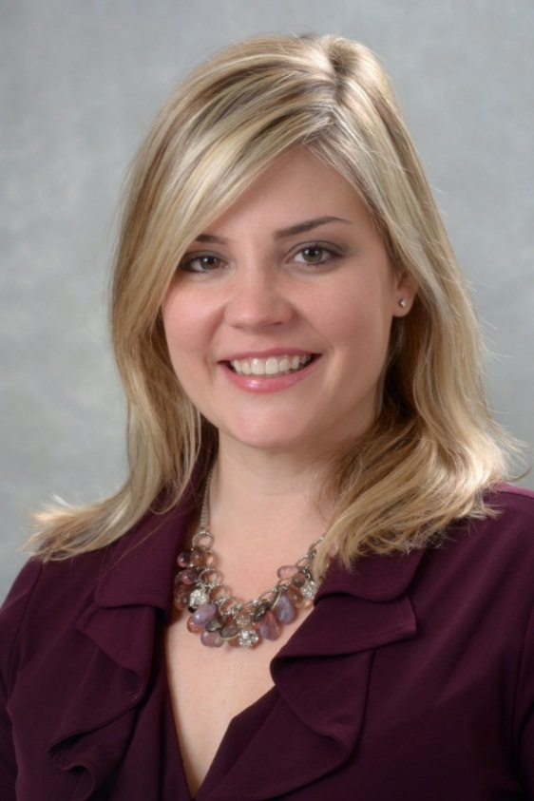
Kristen Campbell Eichhorn
Communication
Studies Department
Campbell, Laura C., et al. "Applying Transtheoretical Model to Improve Social Media Use in the Health Care Industry." American Journal of Health Studies 27.4 (2012): 236-43. Print.

Slide 26
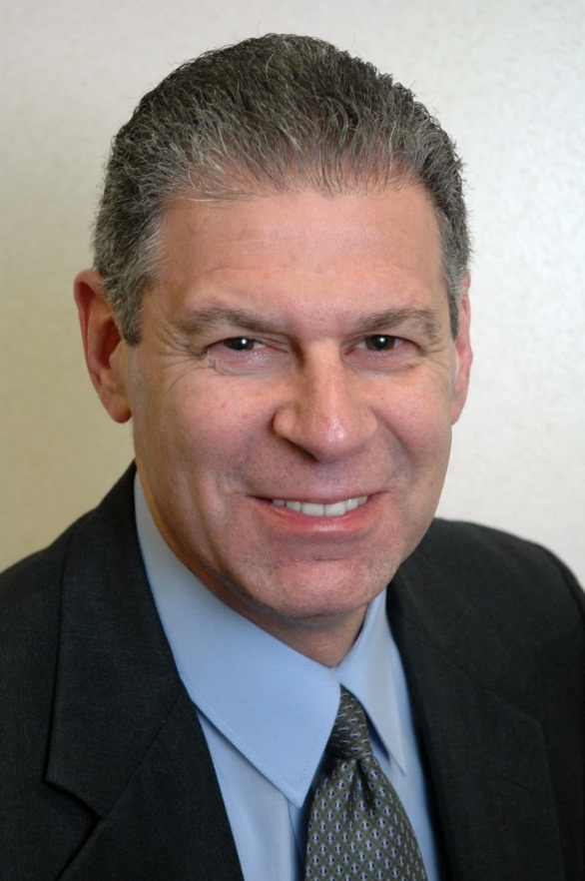
Barry Friedman
Marketing & Management
Department
Tribunella, Thomas, Barry Friedman, and Pamela Cox. "Balancing Environmental Sustainability with Economic Productivity." The BRC Academy Journal of Business 3.1 (2013): 183-214. Print.
1of7

Slide 27
Barry Friedman
Marketing & Management
Department
Friedman, Barry A., and Thomas Tribunella. "Does the International Masters of Business Administration (MBA) Employment Market Value Awareness of Social Responsibility and Environmental Sustainability?" International Journal of Business and Social Science 3.24 (2012): 12-23. Print.
2of7

Slide 28
Barry Friedman
Marketing & Management
Department
Aziz, Nergis, et al. "Entrepreneurial Motives and Perceived Problems: An Empirical Study of Entrepreneurs in Kyrgyzstan." International Journal of Business 18.2 (2013): 163-76. Print.
3of7

Slide 29
Barry Friedman
Marketing & Management
Department
Friedman, Barry A., and Paul Roodin. "In the Eye of the Beholder: The Relationship between Intern Effectiveness, Satisfaction, and Job Characteristics." The BRC Academy Journal of Education 3.1 (2012): 1-16. Print.
4of7

Slide 30
Barry Friedman
Marketing & Management
Department
Friedman, Barry A., et al. "Predictors of Students' Desire to Be an Entrepreneur: Kyrgyzstan, Georgia, and the United States." Eurasian Journal of Business and Economics 5.9 (2012): 129-40. Print.
5of7

Slide 31
Barry Friedman
Marketing & Management
Department
Aziz, Nergis, and Barry A. Friedman. "The Role of Nonprofits in the Process of Place Branding: A Case Study of Turkish Cultural Centers." Dumlupinar Universitesi Sosyal Bilimler Dergisi 38 (2013): 87-96. Print.
6of7

Slide 32
Barry Friedman
Marketing & Management
Department
Aziz, Nergis, Efstathios Kefallonitis, and Barry A. Friedman. "Turkey as a Destination Brand: Perceptions of United States Visitors." American International Journal of Contemporary Research 2.9 (2012): 211-21. Print.
7of7

Slide 33
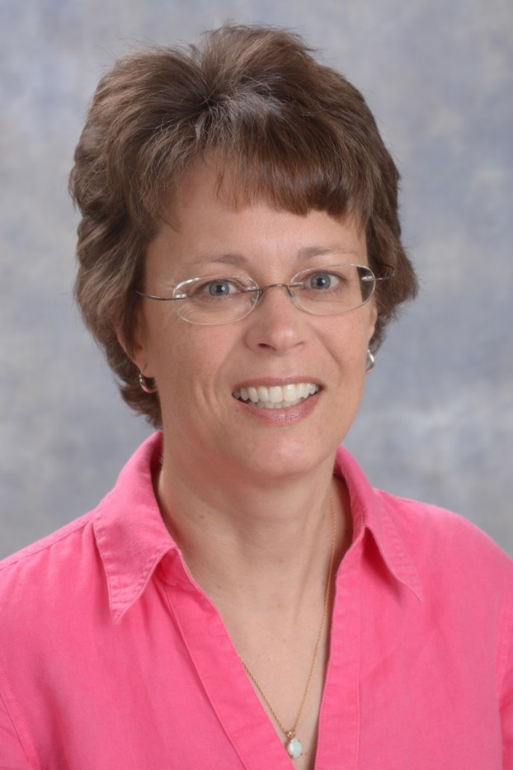
Jean Hallagan
Curriculum & Instruction Department
Hallagan, Jean E. "Preservice Mathematics Teachers' Solutions to Problems: Conversions within the Metric System." The 6th International Multi-Conference on Society, Cybernetics and Informatics (2012): n. pag. Digital file.

Slide 34
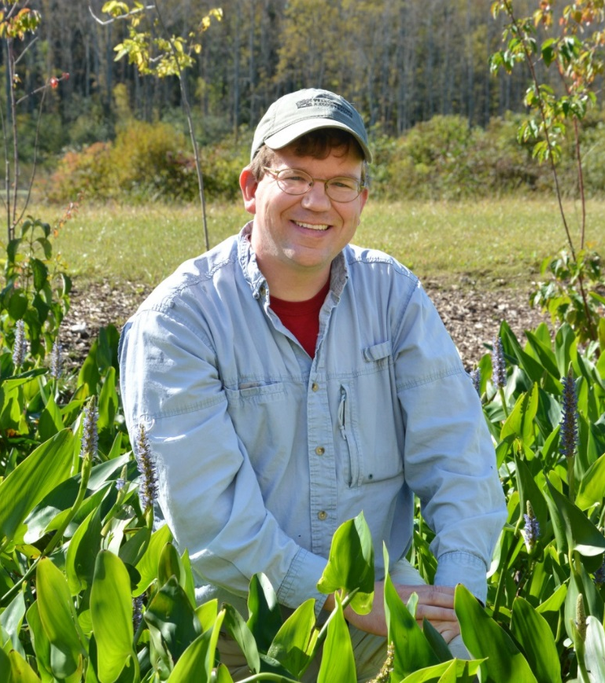
C. Eric Hellquist
Biological Sciences Department
Davis, Charles C., Melanie Gunn, and C. Eric Hellquist. "The Botanical Teaching Legacy of Edward G. Voss at the University of Michigan Biological Station." Michigan Botanist 51 (2012): 32-41. Print.
1of2

Slide 35
C. Eric Hellquist
Biological Sciences Department
Hellquist, C. Eric. Rev. of The Waterwheel Plant. Rhodora 115.962 (2013): 202-05. Print.
2of2

Slide 36
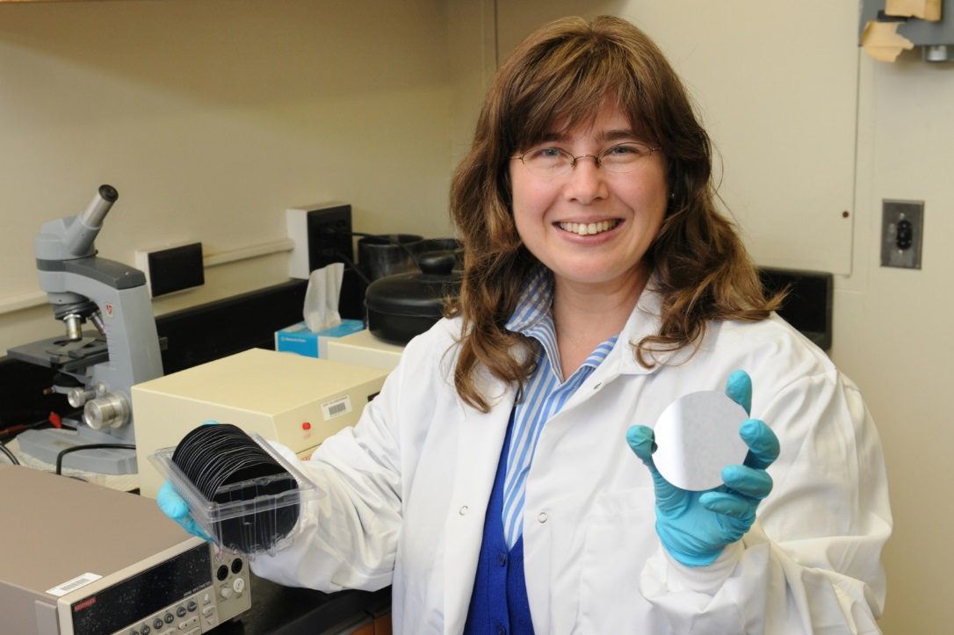
Carolina Ilie
Physics Department
Ideal, Emma, and Rhiannon Meharchand. "Carolina C. Ilie." Blazing the Trail: Essays by Leading Women in Science. N.p.: CreateSpace, 2013. 143-49. Print.

Slide 37
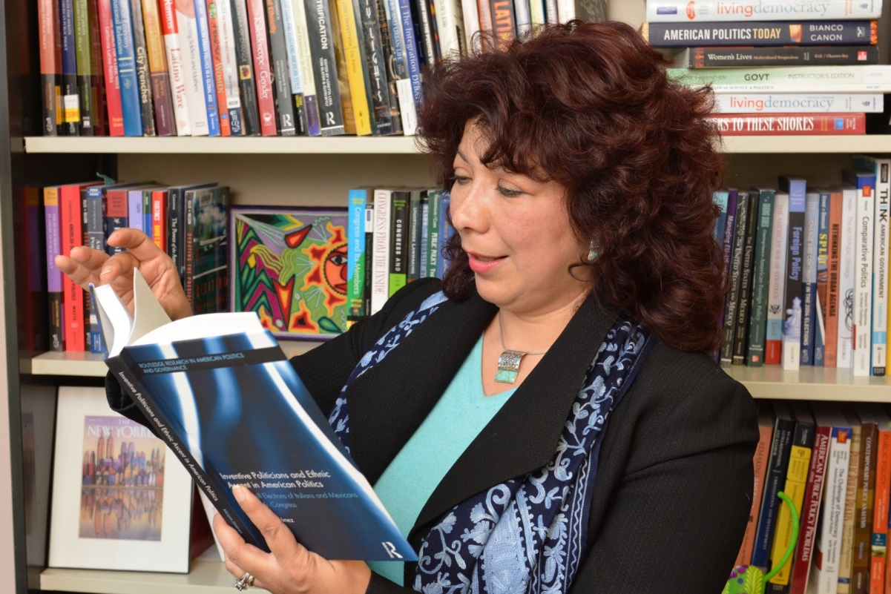
Miriam JimÉnez
Political Science Department
Jiménez, Miriam. Inventive Politicians and Ethnic Ascent in American Politics: The Uphill Elections of Italians and Mexicans to the U.S. Congress. New York: Routledge, 2014. Print.

Slide 38
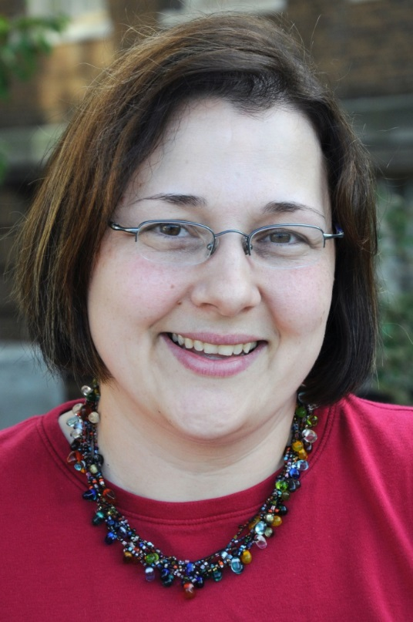
Kathryn Johns-Masten
Penfield Library
Johns-Masten, Kathryn, and Emily Thompson. "How iPods Can Do Double Duty @ Your Library." Computers in Libraries 33.6 (2013): 15-18. Print.
1of2

Slide 39
Kathryn Johns-Masten
Penfield Library
Devasagayam, Raj, Kathryn Johns-Masten, and Joseph McCollum. "Linking Information Literacy, Experiential Learning, and Student Characteristics: Pedagogical Possibilities in Business Education." Academy of Educational Leadership Journal 16.4 (2012): 1-18. Print.
2of2

Slide 40
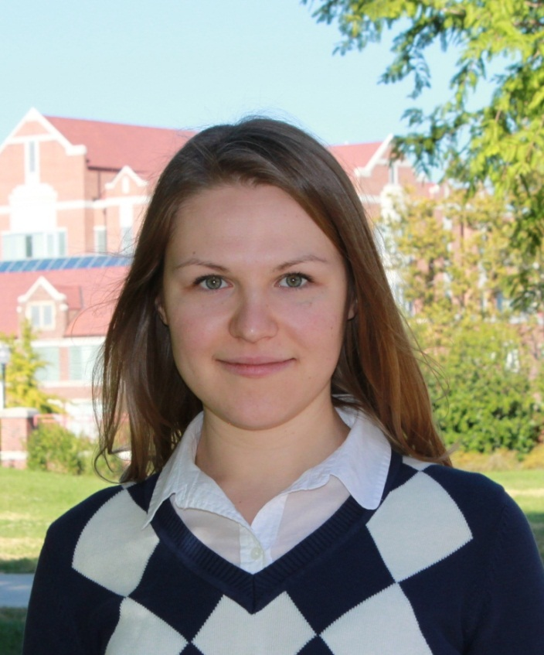
Valentina Kozlova
Economics
Department
Gritsko, Natalia, et al. "The CEO Arms Race." Southern Economic Journal 79.3 (2013): 586-99. Print.

Slide 41
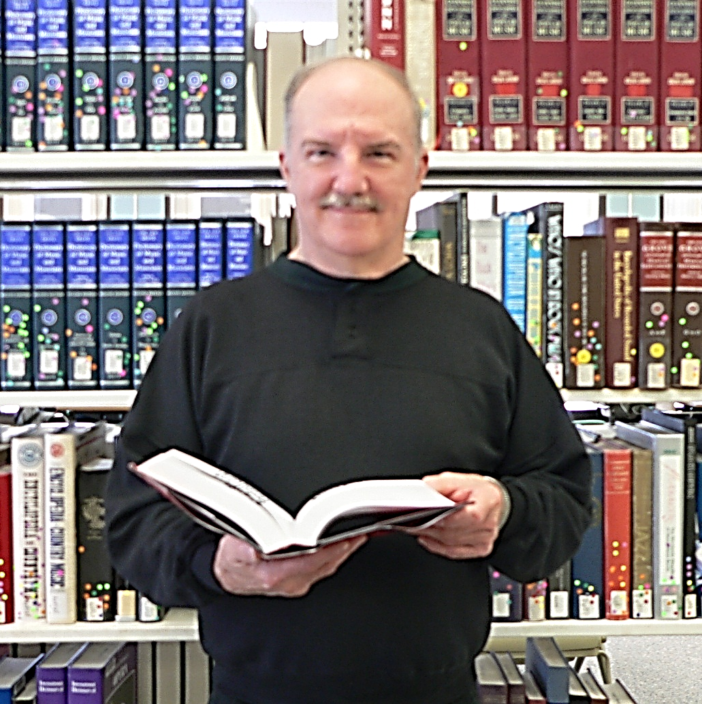
Mark Kulikowski
History
Department
Kulikowski, Mark. "A Bibliography on Polish Americans, 2006-2010." Polish American Studies 70.1 (2013): 57-72. Print.

Slide 42
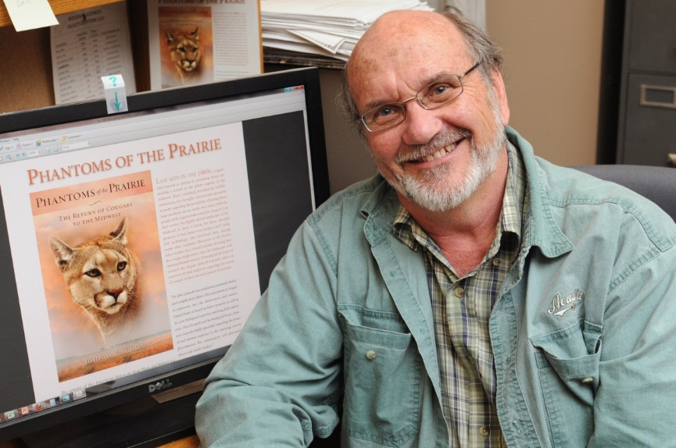
John Laundre
Biological Sciences
Department
Laundre, John W. "The Feasibility of the North-eastern USA Supporting the Return of the Cougar Puma concolor." Oryx: The International Journal of Conservation 47.1 (2013): 96-104. Print.
1of2

Slide 43
John Laundre
Biological Sciences
Department
Laundre, John, and Mike Kintigh. "South Dakota Mountain Lions." Interview by Karl Gehrke. South Dakota Public Broadcasting. South Dakota Public Broadcasting, n.d. Web. 30 May 2013. <http://listen.sdpb.org/post/south-dakota-mountain-lions>.
2of2

Slide 44
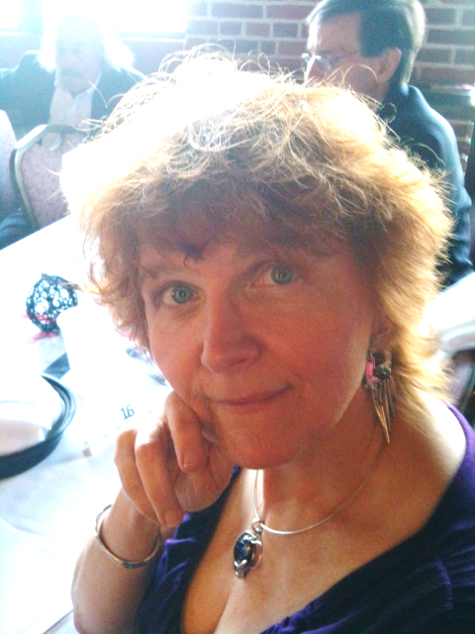
Kitty Macey
Theatre
Department
Macey, Kitty, costume des. John Cage: Sonatas and Interludes Choreographed. Waterman Theatre, Tyler Hall, Oswego. 27 Oct. 2012. Performance.

Slide 45
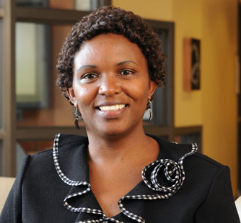
Faith Maina
Curriculum & Instruction Department
Maina, Faith, and Marcia M. Burrell. Attitudes towards Diverse Leaders: A Hybrid Technology Course for Secondary School Mathematics Pre / In-Service Teachers. Cases on Online Learning Communities and Beyond: Investigations and Applications. By Harrison Hao Yang and Shuyan Wang. Hershey: Information Science Reference, 2013. 113-33. Print.

Slide 46
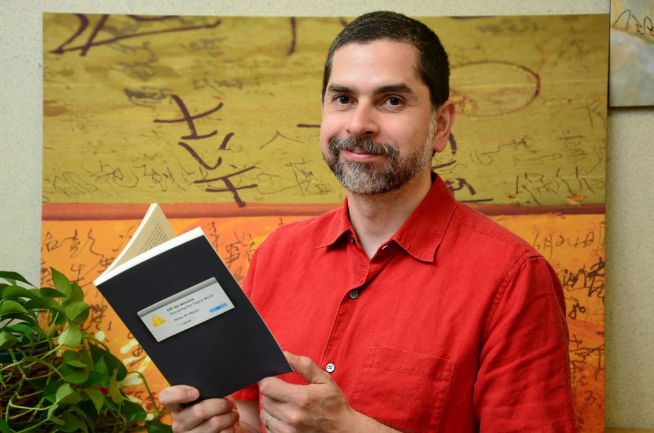
Ulises Mejias
Communication
Studies
Department
Mejias, Ulises Ali. Off the Network: Disrupting the Digital World. Minneapolis: University of Minnesota Press, 2013. Print. Electronic Mediations 41.

Slide 47
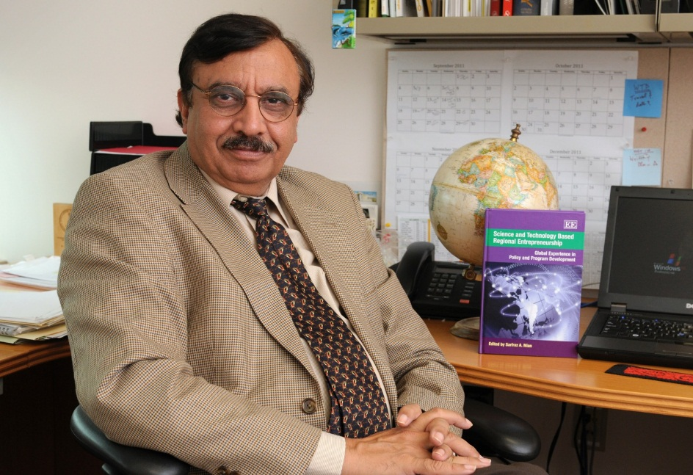
Sarfraz Mian
Marketing & Management
Department
Mian, Sarfraz, Alain Fayolle, and Wadid Lamine. "Building Sustainable Regional Platforms for Incubating Science and Technology Businesses." Entrepreneurship and Innovation 13.4 (2012): 235-47. Print.

Slide 48
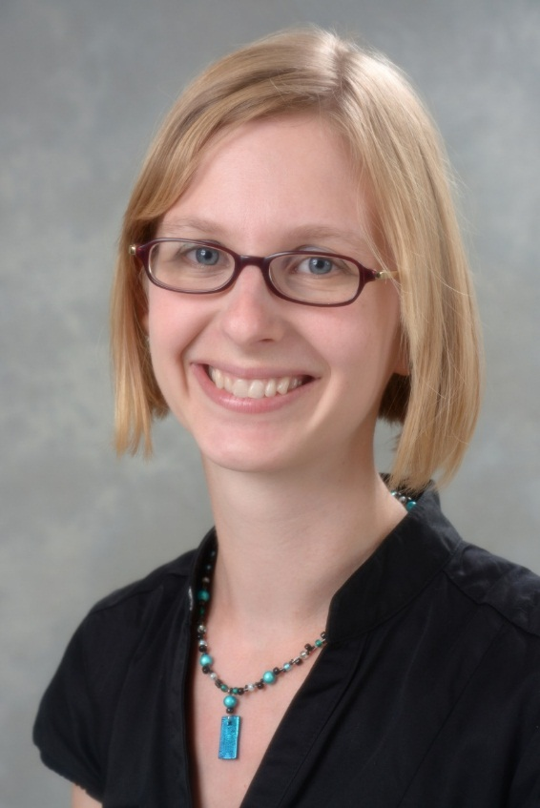
Rebecca Mushtare
Art
Department
Chesler, Giovanna, and Rebecca Mushtare. "Collaborative Media Production, Authorship and Distribution." Issues in Engaged Scholarship (2012): 16-24. Print.

Slide 49
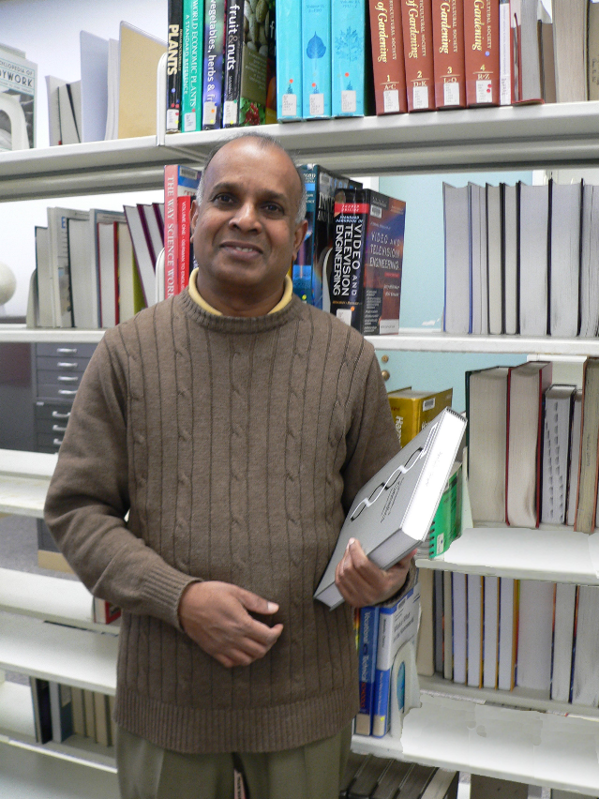
Ampalavanar Nanthakumar
Mathematics
Department
Nanthakumar, Ampalavanar, Selvanayaham Ganesalingam, and Siva Ganesh. "On Copula Based Discrimination Rule." Journal of Statistics & Management Systems (2013): 1-17. Print.
1of2

Slide 50
Ampalavanar Nanthakumar
Mathematics
Department
Nanthakumar, Ampalavanar. "On the Mixture Gaussian Copula to study the suitability of Diagnostic Tests." Sri Lankan Journal of Applied Statistics 14.2 (2013): 121-32. Print.
2of2

Slide 51
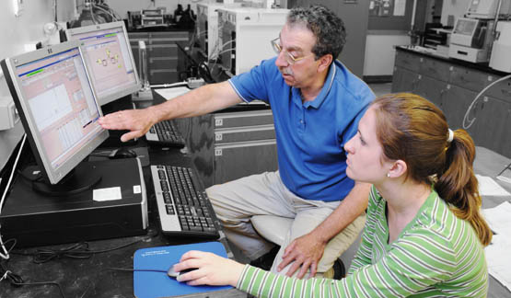
James Pagano
Chemistry
Department
Sofuoglu, Sait C., et al. "Atmospheric Concentrations and Potential Sources of PCBs, PBDEs, and Pesticides to Acadia National Park." Environmental Pollution 177 (2013): 116-24. Print.
1of5

Slide 52
James Pagano
Chemistry
Department
Crimmins, Bernard S., et al. "Environmental Mass Spectrometry in the North American Great Lakes Fish Monitoring and Surveillance Program." Australian Journal of Chemistry 66.7 (2013): 798-806. Print.
2of5

Slide 53
James Pagano
Chemistry
Department
Crimmins, Bernard S., et al. "Polybrominated Diphenyl Ethers (PDBEs): Turning the Corner in Great Lakes Trout 1980-2009." Environmental Science & Technology 46 (2012): 9890-97. Print.
3of5

Slide 54
James Pagano
Chemistry
Department
Salamova, Amina, et al. "Post-1990 Temporal Trends of PCBs and Organochlorine Pesticides in the Atmosphere and in Fish from Lakes Erie, Michigan, and Superior." Environmental Science & Technology 47 (2013): 9109-14. Print.
4of5

Slide 55
James Pagano
Chemistry
Department
Chang, Fengchih, et al. "Temporal Trends of Polychlorinated Biphenyls and Organochlorine Pesticides in Great Lakes Fish, 1999-1009." Science of the Total Environment 439 (2012): 284-90. Print.
5of5

Slide 56
Eugene Perticone, Emeritus
Counseling & Psychological
Services Department
Perticone, Eugene X. Parallel Paths to Personal Growth: The Search for Something Beyond. Bloomington: IUniverse, Inc,, 2012. Print.

Slide 57
Brett Rathbun
Earth Sciences
Department
Steiger, Scott M., et al. "Circulations, Bounded Weak Echo Regions, and Horizontal Vortices Observed within Long-Lake-Axis-Parallel-Lake-Effect Storms by the Doppler on Wheels." Monthly Weather Review 141.8 (2013): 2821-40. Print.
1of2

Slide 58
Brett Rathbun
Earth Sciences
Department
SUNY Oswego Storm Chasing and Observation Program 2013. Dir. Scott Steiger. Prod. Brett Rathbun. 2013. SUNY Oswego, 2013. DVD.
2of2

Slide 59
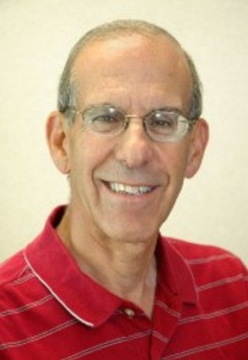
Paul Roodin
Experience-Based
Education Department
Friedman, Barry A. and Paul Roodin. "In the Eye of the Beholder: The Relationship between Intern Effectiveness, Satisfaction, and Job Characteristics." The BRC Academy Journal of Education 3.1 (2012): 1-16. Print.

Slide 60
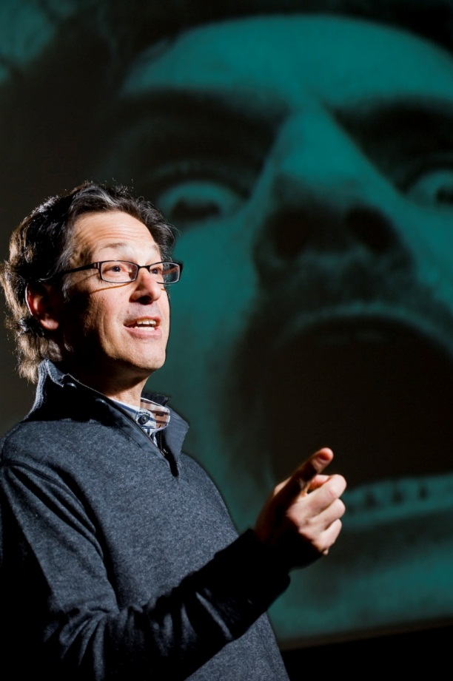
Bennet Schaber
English
Department
Schaber, Bennet. "Film Democracy: Jem Cohen @occupywallstreet." Scan: Journal of Media Arts Culture 10.1 (2013): n. pag. Digital file.

Slide 61
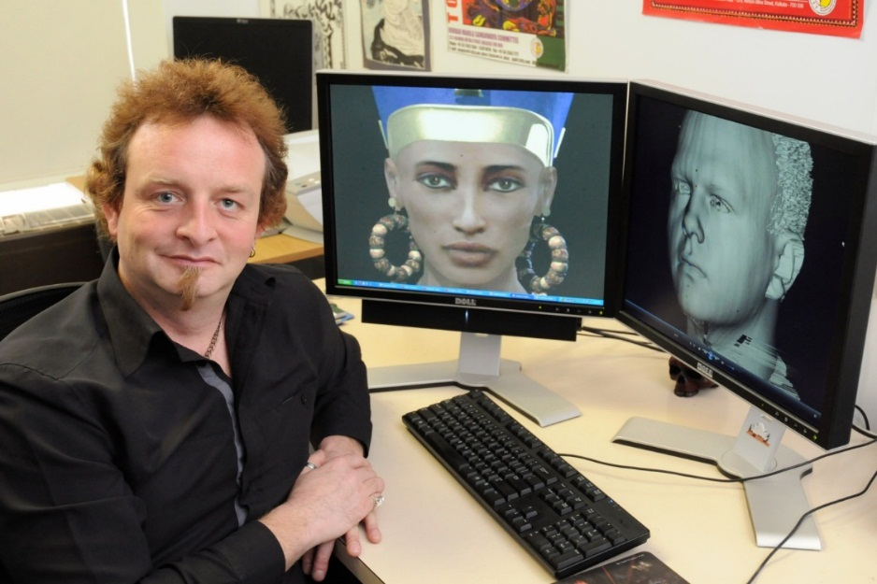
Damian Schofield
Computer Science
Department
Schofield, Damian. "Biometric Identification in the Classical World." International Association of Forensic and Security Metrology Newsletter 30 Sept. 2011: n. pag. Digital file.
1of8

Slide 62
Damian Schofield
Computer Science
Department
Schofield, Damian. “Don’t Depend on Your Eyes When Your Mind is Out of Focus: Manipulating the Viewer in the Courtroom.” International Association of Forensic and Security Metrology Newsletter 9 May 2013: n. pag. Digital file.
2of8

Slide 63
Damian Schofield
Computer Science
Department
Ivancic, Daniel, Damian Schofield, and Lisa Dethridge. “The Effects of Perspective and Presentation: User Experience in a Virtual Art Gallery.” Virtual Environments: Developments, Applications and Challenges. Ed. Stephanie Trautman and Franchesca Julien. Hauppauge: Nova, 2013. n. pag. Computer Science, Technology and Applications. Digital file.
3of8

Slide 64
Damian Schofield
Computer Science
Department
Schofield, Damian. "Mass Effect: A Chemical Engineering Application of Virtual Reality Simulator Technology." Journal of Online Learning and Teaching 8.1 (2012): 63-78. Print.
4of8

Slide 65
Damian Schofield
Computer Science
Department
Schofield, Damian, and Ken Fowle. "Technology Corner Visualising Forensic Data: Evidence (Part I)." Journal of Digital Forensics, Security and Law 8.1 (2013): 73-90. Print.
5of8

Slide 66
Damian Schofield
Computer Science
Department
Schofield, Damian, and Ken Fowle. "Technology Corner Visualising Forensic Data: Evidence Guidelines (Part 2)." Journal of Digital Forensics, Security and Law 8.2 (2013): 93-114. Print.
6of8

Slide 67
Damian Schofield
Computer Science
Department
Kern, Bryan, Tatiana Tavares, and Damian Schofield. "User Interface Evaluation Experiences: A Brief Comparison between Usability and Communicability Testing." 4th South American Congress of Interaction Design. 3 Nov. 2012. Print.
7of8

Slide 68
Damian Schofield
Computer Science
Department
Anderson, Matthew, Damian Schofield, and Lisa Dethridge. "Ways of Viewing and Interacting: User Experience in a Virtual Art Gallery." Virtual Environments: Developments, Applications and Challenges. Ed. Stephanie Trautman and Franchesca Julien. Hauppauge: Nova, 2013. n. pag. Computer Science, Technology and Applications. Digital file.
8of8

Slide 69
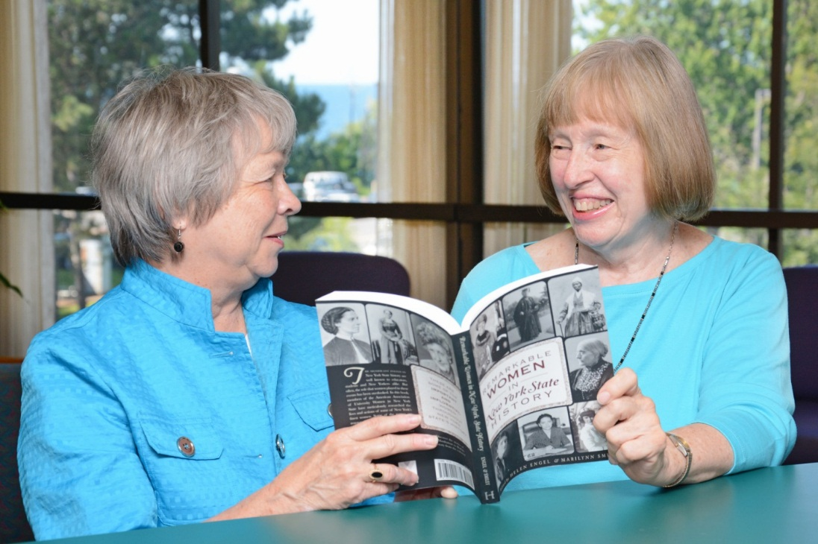
Marilynn Smiley
Music
Department
Engel, Helen, and Marilynn Smiley, eds. Remarkable Women in New York State History. Charleston: History Press, 2013. Print.

Slide 70
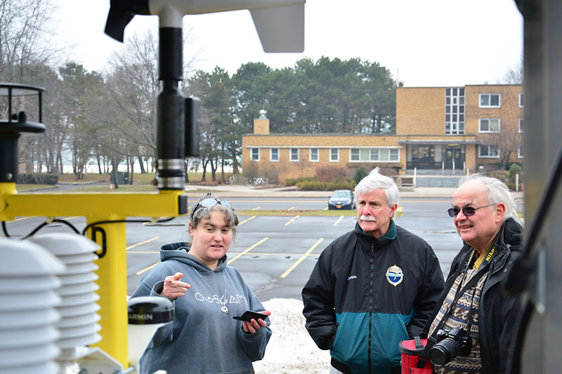
Alfred Stamm
Earth Sciences
Department
Steiger, Scott M., et al. "Circulations, Bounded Weak Echo Regions, and Horizontal Vortices Observed within Long-Lake-Axis-Parallel-Lake-Effect Storms by the Doppler on Wheels." Monthly Weather Review 141.8 (2013): 2821-40. Print.

Slide 71
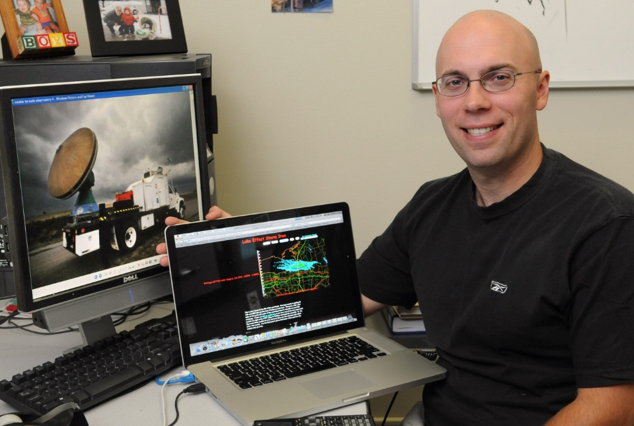
Scott Steiger
Earth Sciences
Department
Steiger, Scott M., et al. "Circulations, Bounded Weak Echo Regions, and Horizontal Vortices Observed within Long-Lake-Axis-Parallel-Lake-Effect Storms by the Doppler on Wheels." Monthly Weather Review 141.8 (2013): 2821-40. Print.
1of2

Slide 72
Scott Steiger
Earth Sciences
Department
SUNY Oswego Storm Chasing and Observation Program 2013. Dir. Scott Steiger. Prod. Brett Rathbun. 2013. SUNY Oswego, 2013. DVD.
2of2

Slide 73
Barbara Streets
Counseling & Psychological
Services Department
Streets, Barbara, perf. John Cage: Sonatas and Interludes Choreographed. Waterman Theatre, Tyler Hall, Oswego. 27 Oct. 2012. Performance.

Slide 74
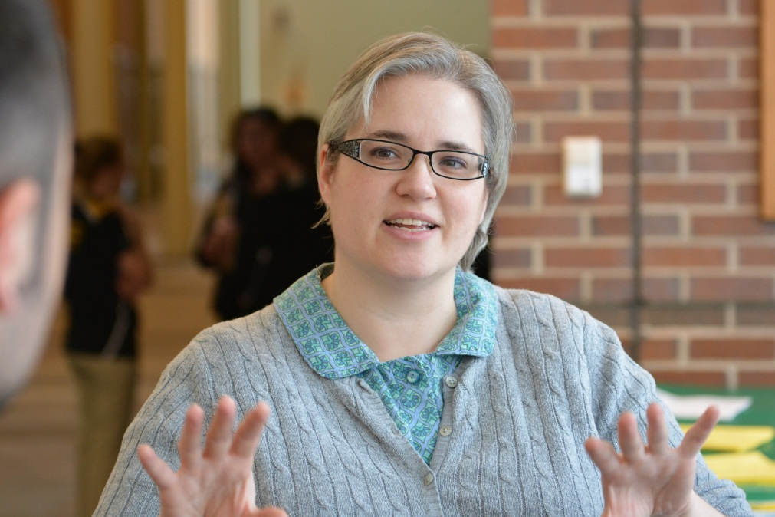
Emily Thompson
Penfield
Library
Johns-Masten, Kathryn, and Emily Thompson. "How iPods Can Do Double Duty @ Your Library." Computers in Libraries 33.6 (2013): 15-18. Print.

Slide 75
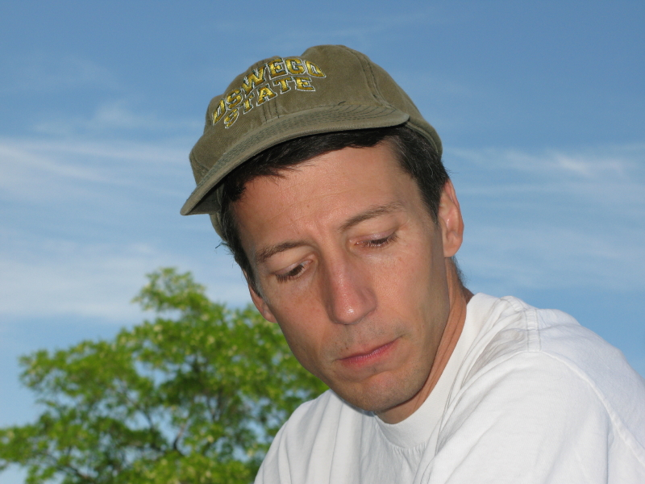
Paul Tomascak
Earth Sciences
Department
Meredith, Karina, et al. "The Lithium, Boron and Strontium Isotopic Systematics of Groundwaters from an Arid Aquifer System: Implications for Recharge and Weathering Processes." Geochimica et Cosmoschimica Acta 112 (2013): 20-31. Print.

Slide 76
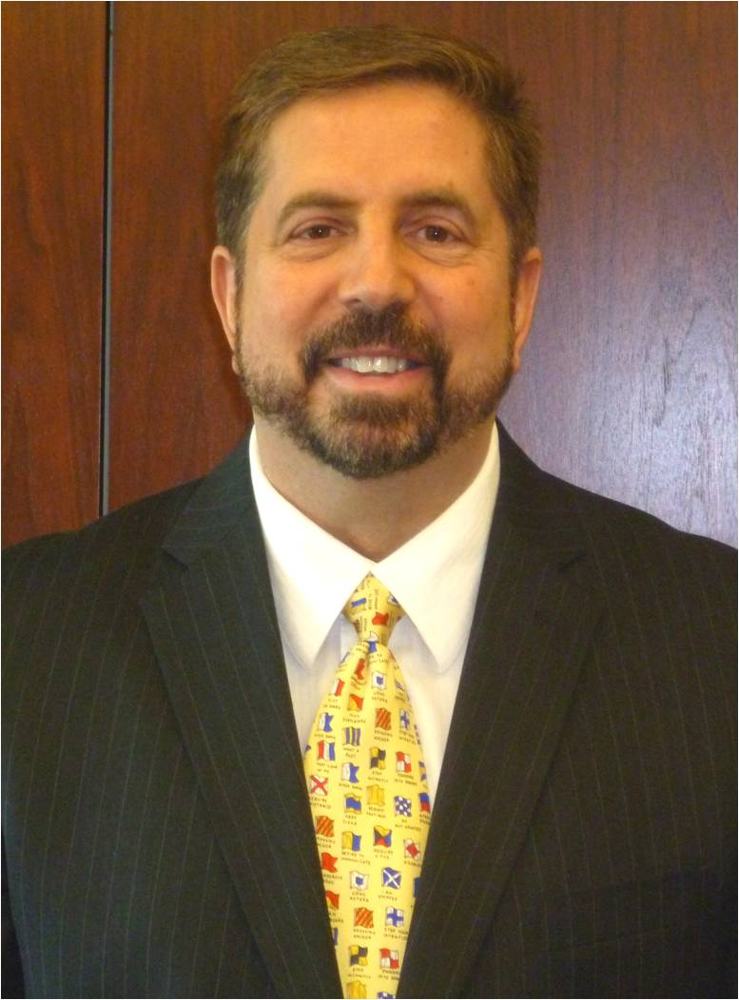
Thomas Tribunella
Accounting, Finance
& Law Department
Tribunella, Thomas, Barry Friedman, and Pamela Cox. "Balancing Environmental Sustainability with Economic Productivity." The BRC Academy Journal of Business 3.1 (2013): 183-214. Print.
1of2

Slide 77
Thomas Tribunella
Accounting, Finance
& Law Department
Friedman, Barry A., and Thomas Tribunella. "Does the International Masters of Business Administration (MBA) Employment Market Value Awareness of Social Responsibility and Environmental Sustainability?" International Journal of Business and Social Science 3.24 (2012): 12-23. Print.
2of2

Slide 78
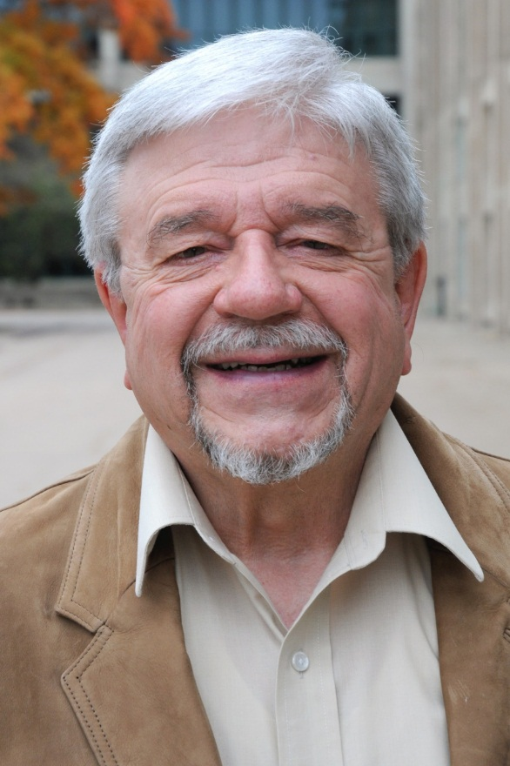
Lewis Turco, Emeritus
English Department
The Tower Journal 6.1 (2013):
http://towerjournal.com/fall_2013
"Chaucer’s Cosmology."
"Deer Crossing."
"Extracts From the Latterday
Chronicle."
"A Page of Spiders."
"Past Sounds of Singing.”
"Stagecraft."
"That Front Door."
"Yearsend."
1of5

Slide 79
Lewis Turco, Emeritus
English Department
Take Heart: Poems from Maine. Comp. Wesley McNair. Camden: Down East, 2013. Print.
"The Habitation." 88.
"The Street." 55.
2of5

Slide 80
Lewis Turco, Emeritus
English Department
Ekphrasis: Poems Speaking to Silent Works of Art. Comp. Merrill Memorial Library Arts. Yarmouth: Merrill Memorial Library, 2013. Print.
"A Page of Spiders." 6.
"Past Sounds of Singing." 16.
3of5

Slide 81
Lewis Turco, Emeritus
English Department
Turco, Lewis. “Midlife Crisis.” Trinacria: Poems, Translations, Essays, Reviews 10 (2013): 24. Print.
4of5

Slide 82
Lewis Turco, Emeritus (Writing as Wesli Court)
English Department
Trinacria: Poems, Translations, Essays, Reviews 9 (2013) Print.
"Inauguration Day 2013." : 30-31.
"Shakespearean Gnomes." :28.
"Wordsworthian Gnomes ." : 29.
5of5

Slide 83
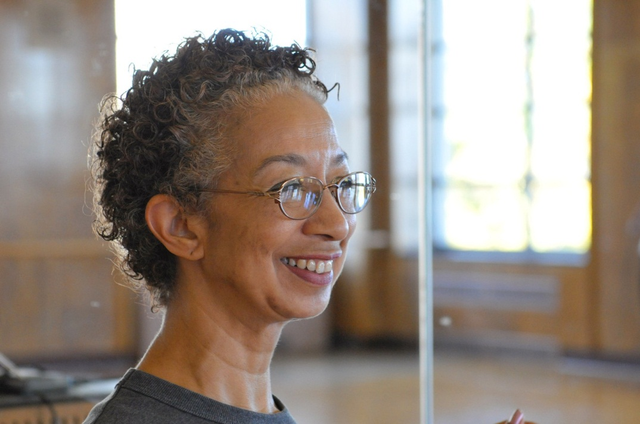
Cheryl Wilkins-Mitchell
Health Promotion
& Wellness
Department
Wilkins-Mitchell, Cheryl, chor. How Music Came to Earth. Cazenovia High School, Cazenovia. 13 July 2012. Performance.
1of3

Slide 84
Cheryl Wilkins-Mitchell
Health Promotion
& Wellness
Department
Wilkins-Mitchell, Cheryl, chor. John Cage: Sonatas and Interludes Choreographed. Waterman Theatre, Tyler Hall, Oswego. 27 Oct. 2012. Performance.
2of3

Slide 85
Cheryl Wilkins-Mitchell
Health Promotion
& Wellness
Department
Wilkins-Mitchell, Cheryl, chor. Red Trees Wrinkled Cliffs. Civic Center, Syracuse, Hochstein School Rochester, Schambach Center, Clinton, Jan Hus Presbyterian, New York. 30 Mar. 2013 – 13 Apr. 2013. Performance.
3of3

Slide 86
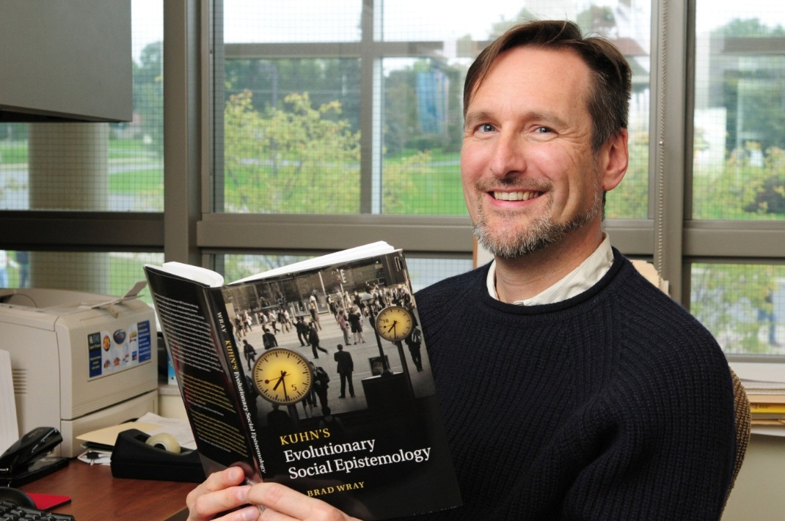
K. Brad Wray
Philosophy
Department
Arbesman, Samuel, and K. Brad Wray. "Demographics and the Fate of the Young Scientist." Social Studies of Science 43.2 (2012): 282-86. Print.
1of5

Slide 87
K. Brad Wray
Philosophy
Department
Wray, K. Brad. "The Future of 'The Structure of Scientific Revolutions.'" Topoi: An International Review of Philosophy 32.1 (2013): 75-79. Print.
2of5

Slide 88
K. Brad Wray
Philosophy
Department
Wray, K. Brad. “Social Epistemology.” The Routledge Companion to Philosophy of Science. Ed. Martin Curd and Stathis Psillos. 2nd. ed. New York: Routledge, 2013. 112-19. Print. Routledge Philosophy Companions.
3of5

Slide 89
K. Brad Wray
Philosophy
Department
Wray, K. Brad. “Thomas S. Kuhn.” Philosophy. Ed. Duncan Pritchard. 2013. N. pag. Digital file. DOI: 10.1093/OBO/9780195396577-0202
4of5

Slide 90
K. Brad Wray
Philosophy
Department
Wray, K. Brad. "Success and Truth in the Realism/anti-realism Debate." Synthese: An International Journal for Epistemology, Methodology and Philosophy of Science 190.9 (2013): 1719-29. Print.
5of5

Slide 91
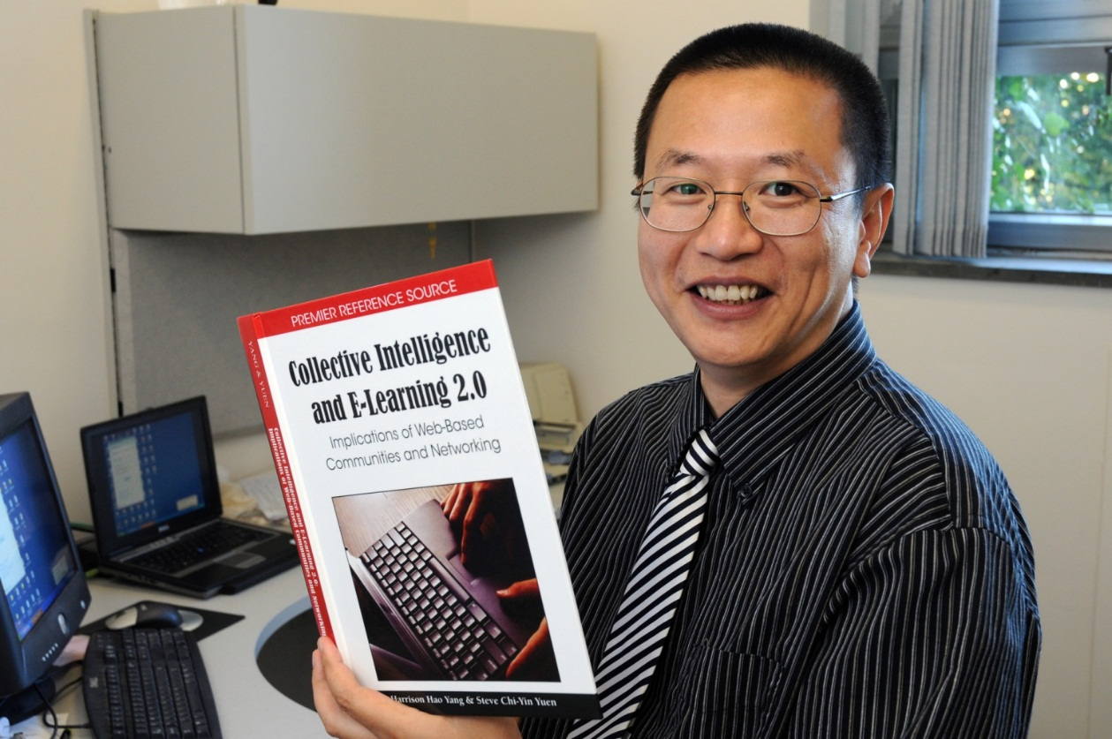
Harrison Yang
Curriculum &
Instruction
Department
Yang, Harrison Hao, and Shuyan Wang. Cases on Online Learning Communities and Beyond: Investigations and Applications. Hershey: Information Science Reference, 2013. Print.

Slide 92
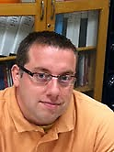
Jason Zenor
Communication
Studies Department
Zenor, Jason. "Lifting the Dover Ban: The Compromise on Press Access to Fallen Soldiers Returning from War." University of Florida Journal of Law and Public Justice 24 (2013): 97-126. Print.
1of2

Slide 93
Jason Zenor
Communication
Studies Department
Zenor, Jason. "Politics of Fear? Reception Analysis of the 'New Yorker' Obama Cover's Meaning, Effect and Editorial Decision." Operant Subjectivity: The International Journal of Q Methodology 36.1 (2012): 25-46. Print.
2of2

Slide 94
Anthony Annunziata : English
Charles A. Bishop : Anthropology/Sociology
Douglas Deal : History
David D. Faux : Technology
Virginia Fichera : Foreign Languages &
Literature
Geraldine Forbes : History
Alfred Daniel Frederick : Secondary
Education
I. David Glick : Communication Studies/
Education

Slide 95
John Kane : Economics
Joseph LeFevre : Chemistry
Mary Hong Loe : Library
Thomas B. Loe : English
Kathryn H. Martin : Biology
DeWight R. Middleton : Anthropology/
Sociology
Paul J. Morman : Dean, Arts & Sciences/
History
Lewis B. O'Donnell : Communication Studies

Slide 96
Peter Hertz-Ohmes : Foreign Languages &
Literature
Augustine Silveria, Jr. : Chemistry
M. Estelle Smith : Anthropology/Sociology
Larry Spizman : Economics
Mary Frances Stuck : Public Justice
Waduwawatte Sumathipala : Earth Sciences
Lewis Turco : English
Alvin M. Westcott : Elementary Education
Leigh Allison Wilson : English

Slide 97
Thank You
To the following sponsors
of the 25th Anniversary Reception!
President Deborah Stanley
United University Professions
Penfield Library

Slide 98
Thank You
To our Music and Art faculty
for sharing their creative talents!
Music by Oswego Jazz Project
Café Exhibit by Oswego Art Department Faculty

Slide 99
Thank You
To all who worked to produce this display.
Penfield Librarians and Staff
Jim Russell for faculty photos

Slide 100
Thank You
To ALL who have contributed to Penfield Library’s collection of scholarly and creative works
over these 25 years!

Slide 101
Want a Closer look at the 2013 contributions? Go to: www.oswego.edu/library/archives.html

