Slide 1
Display to Archives 2014
Celebrating Scholarly & Creative Activity

Slide 2
Accounting, Finance & Law
Mary Tone Rodgers
Atmospheric and Geological Sciences
Scott Steiger
Paul Tomascak
Biological Sciences
John Brunson, Emeritus
David A. Dunn
C. Eric Hellquist
James MacKenzie
Karen R. Sime

Slide 3
Chemistry
Kestutis Bendinskas
Timothy F. Braun
Fehmi Damkaci
Communication Studies
David Crider
Taejin Jung
Jason Zenor
Computer Science
Damian Schofield

Slide 4
Counseling and Psychological Services
Kristen A. Munger
Eugene X. Perticone, Emeritus
Counseling Services Center
Vincent Markowsky
Curriculum & Instruction
Amanda Fenlon
Maria S. Murray

Slide 5
Economics
David Andrews
John Kane
Lawrence Spizman
Educational Administration
Linda Rae Markert
English
Juliet Giglio
Lewis Turco, Emeritus

Slide 6
Extended Learning
Theresa Gilliard-Cook
History
Judith Wellman, Emerita
International Education and Programs
Joshua McKeown
Library
Marilyn Ochoa
Brandon West
Jane Wright, Emerita

Slide 7
Marketing and Management
Barry A. Friedman
Mathematics
Ampalavanar Nanthakumar
Elizabeth Wilcox
Modern Languages and Literatures
Peter Hertz-Ohmes, Emeritus
Music
Marilynn Smiley, Emerita
Dan Wood

Slide 8
Philosophy
Charles Echelbarger, Emeritus
Physics
Alok Kumar
Political Science
Bruce E. Altschuler, Emeritus
Lisa Glidden
Psychology
Leigh F. Bacher

Slide 9
Public Justice
Omara Rivera-Vazquez
Sociology
Tim Delaney

Slide 10
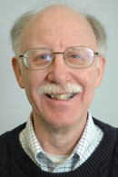
Bruce e. altschuler, emeritus
Political Science
Department
Altschuler, Bruce. Rev. of The President as Commander in Chief: An Essay in Constitutional Vision. Law and Politics Book Review 24 (2014): 210-13. Law and Politics Book Review. Web. 4 June 2014. <http://www.lpbr.net/2014/05/the-president-as-commander-in-chief.html>. (May 2014)
1of2

Slide 11
Bruce e. altschuler, emeritus
Political Science
Department
Altschuler, Bruce E., and Michael A. Genovese, eds. Shakespeare and Politics: What a Sixteenth-Century Playwright Can Tell Us about Twenty-first-Century Politics. Boulder: Paradigm, 2014. Print. (May 2014)
2of2

Slide 12
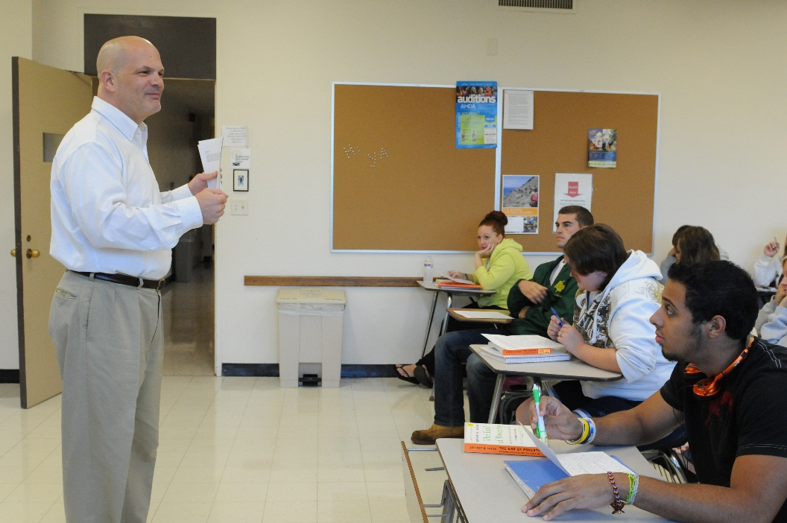
David Andrews
Economics
Department
Andrews, David. “Adam Smith’s Natural Prices, the Gravitation Metaphor, and the Purpose of Nature.” Economic Thought 3.1 (2014): 42-55. Print. (May 2014)

Slide 13
Leigh f. Bacher
Psychology
Department
Bacher, Leigh F. “Development and Manipulation of Spontaneous Eye Blinking in the First Year: Relationships to Context and Positive Affect.” Developmental Psychobiology 56.4 (2014): 783-96. Print. (May 2014)

Slide 14
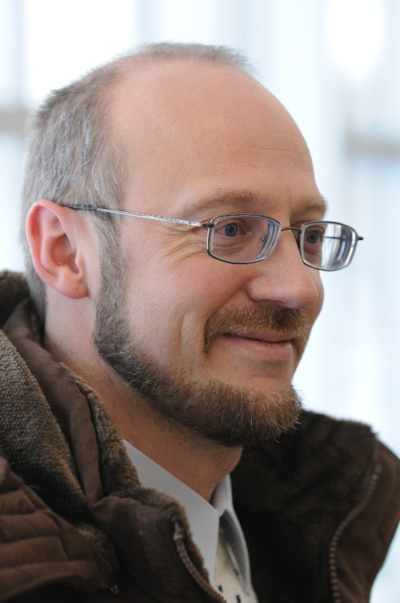
Kestutis Bendinskas
Chemistry
Department
Gump, Brooks B., et al. "Low-level Mercury in Children: Associations with Sleep Duration and Cytokines TNF-α and IL-6." Environmental Research 134 (2014): 228-32. Print. (Dec. 2014)

Slide 15
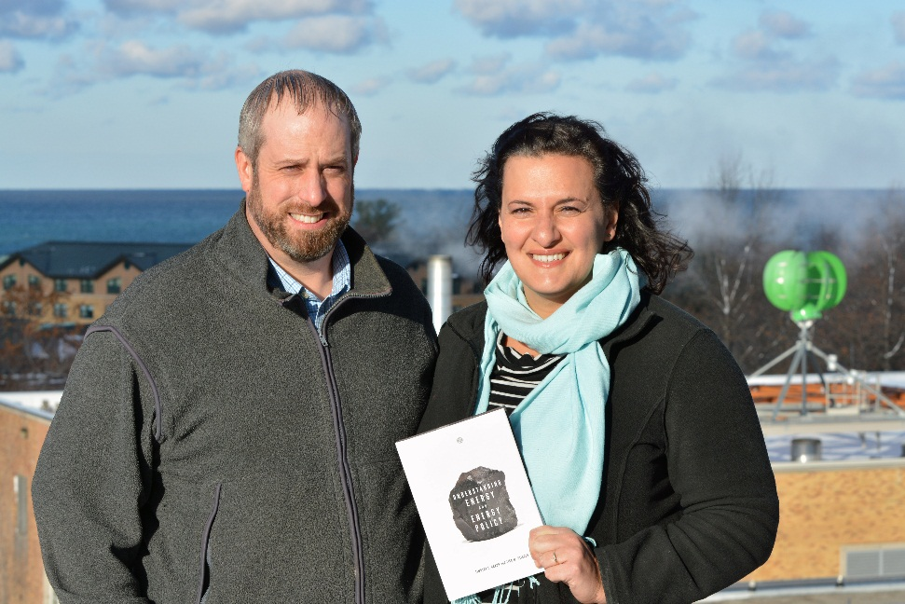
Timothy F. Braun
Chemistry
Department
Braun, Timothy F., and Lisa M. Glidden. Understanding Energy and Energy Policy. London: Zed Books, 2014. Print. (Dec. 2014)

Slide 16
John Brunson, emeritus
Biological Sciences
Department
Consort Gems of the Late Renaissance. The Oswego Recorder Consort. Prod. Dan Wood. Rec. 3 Sept. 2011. CD. The Oswego Recorder Consort is comprised of: John Brunson, Marilynn Smiley, Jane Wright, Burton Phillips. (May 2014)

Slide 17
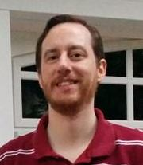
David Crider
Communication Studies
Department
Crider, David. "For Those (Men) About to Rock: Rock Radio and the Crisis of Masculinity." Journal of Radio & Audio Media 21.2 (2014): 258-71. Print. (Dec. 2014)

Slide 18
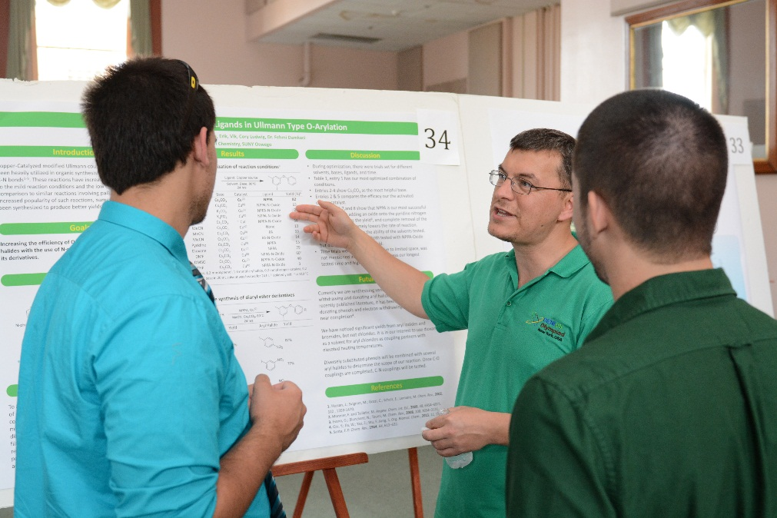
Fehmi damkaci
Chemistry
Department
Gulacar, Ozcan, Fehmi Damkaci, and Charles R. Bowman. “A Comparative Study of an Online and a Face-to-Face Chemistry Course.” Journal of Interactive Online Learning 12.1 (2013): 27-40. Print. (May 2014)
1of4

Slide 19
Fehmi damkaci
Chemistry
Department
Damkaci, Fehmi, Michelle Dallas, and Megan Wagner. “A Microwave-Assisted Friedel–Crafts Acylation of Toluene with Anhydrides.” Journal of Chemical Education 90.3 (2013): 390-92. Print. (May 2014)
2of4

Slide 20
Fehmi damkaci
Chemistry
Department
Damkaci, Fehmi, and Addam Szymaniak. “Multicomponent Heterocyclic Chemistry for Undergraduate Organic Laboratory: Biginelli Reaction with Multiple Unknowns.” Journal of Chemical Education (2014): n. pag. DOI: 10.1021/ed400390k. (May 2014)
3of4

Slide 21
Fehmi damkaci
Chemistry
Department
Damkaci, Fehmi, et al. “N-picolinamides as Ligands for Ullmann-type Homocoupling.” Tetrahedron Letters 55 (2014): 690-93. Print. (May 2014)
4of4

Slide 22
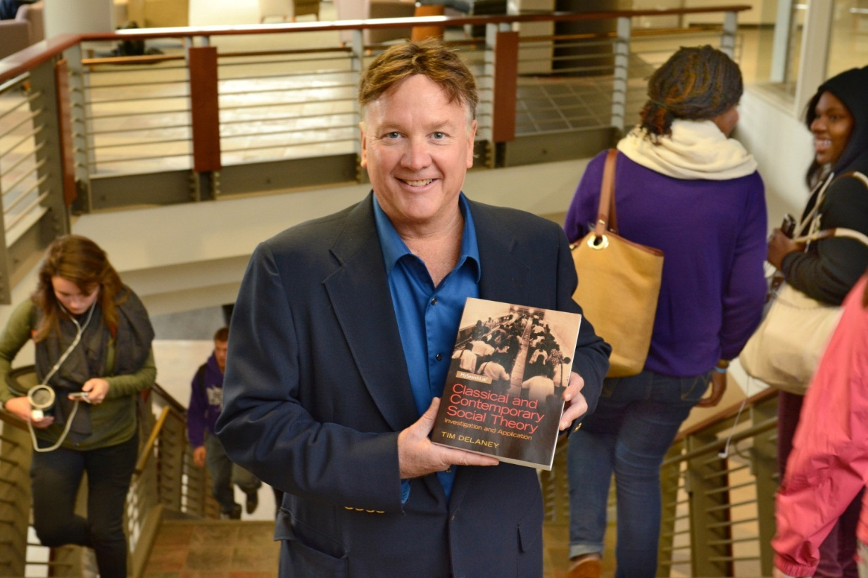
Tim Delaney
Sociology Department
Delaney, Tim, and Tim Madigan. Beyond Sustainability: A Thriving Environment. Jefferson: McFarland & Company, 2014. Print. (May 2014)

Slide 23
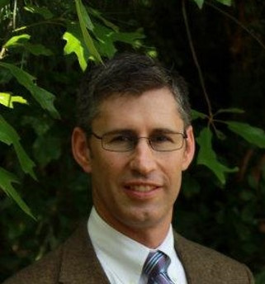
David A. dunn
Biological Sciences Department
Dunn, David A., and Carl A. Pinkert. Gene Editing. Transgenic Animal Technology: A Laboratory Handbook. Ed. Carl A. Pinkert. 3rd ed. London: Elsevier, 2014. 229-48. Print. (Dec. 2014)

Slide 24
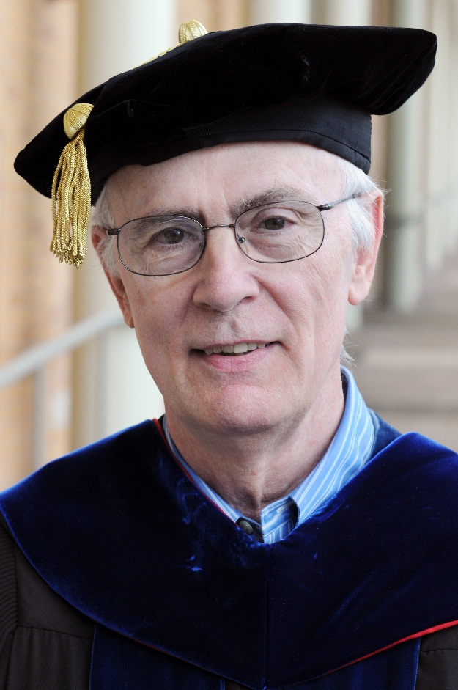
Charles Echelbarger, Emeritus
Philosophy Department
Echelbarger, Charles. "Hume on the Objects of Mathematics." European Legacy: Toward New Paradigms (2013): n. pag. Print. DOI:10.1080/10848770.2013.791433 (Dec. 2014)

Slide 25
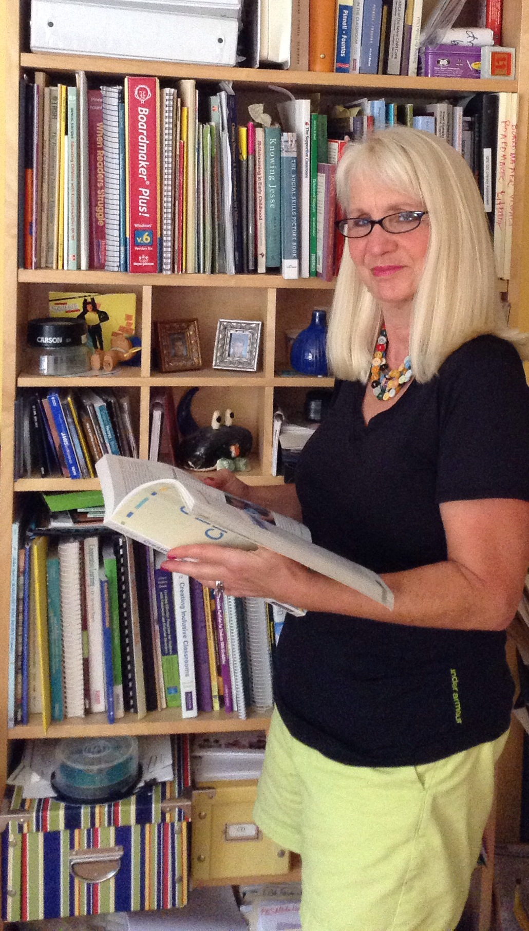
Amanda fenlon
Curriculum & Instruction Department
Fenlon, Amanda, and Lauren Fox. “I Love this Computer!” Consideration for Using Assistive Technology to Engage Middle School Students with Disabilities in Authentic Writing. Closing The Gap Dec/Jan (2013): n. pag. Web. 4 June 2014. (May 2014)

Slide 26
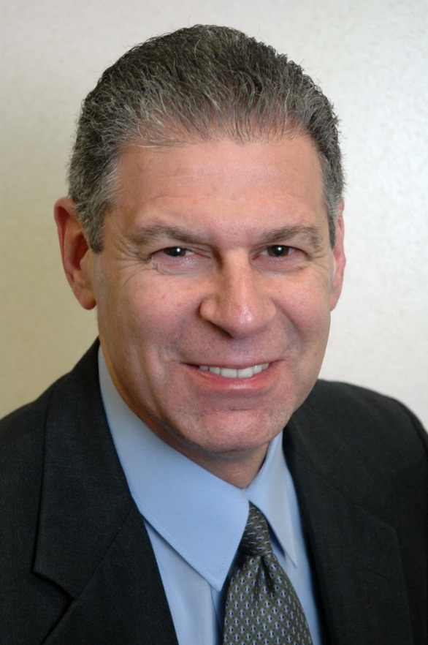
Barry friedman
Marketing & Management Department
Friedman, Barry A. "Competency Based Team Formation: An Experiential Exercise." International Journal of Humanities and Social Studies 4.9 (2014): 35-42. Print. (Dec. 2014)
1of3

Slide 27
Barry friedman
Marketing & Management Department
Friedman, Barry A. "The Relationship between Effective Governance and the Informal Economy." International Journal of Business and Social Science 5.9 (2014): 51-58. Print. (Dec. 2014)
2of3

Slide 28
Barry friedman
Marketing & Management Department
Aziz, Nergis, Efstathios Kefallonitis, and Barry A. Friedman. "Turkey as a Destination: A Study of Sensory Brand Associations." Tourism, Culture & Communication 14 (2014): 77-89. Print. (Dec. 2014)
3of3

Slide 29
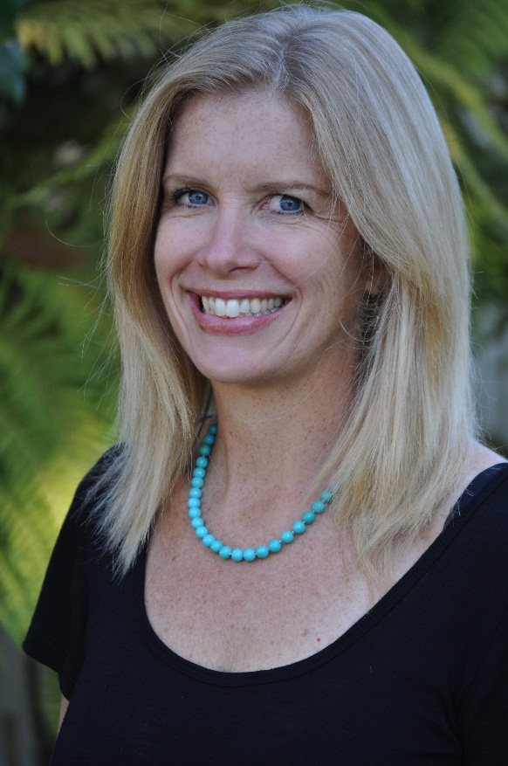
Juliet giglio
English Department
Giglio, Juliet Aires. Outlining the Screenplay. Cut to the Chase: Writing Feature Films with the Pros at UCLA Extension Writers’ Program. Ed. Linda Venis. New York: Gotham, 2013. 123-58. Print. (May 2014)

Slide 30
Theresa Gilliard-Cook
Extended Learning
Gilliard-Cook, Theresa, and Brandon West. "Authentic Learning: Creating Meaning in the Higher Ed Classroom." The EvoLLLution Dec. 2014: n. pag. Digital file. (Dec. 2014)

Slide 31
Lisa Glidden
Political Science Department
Wylie, Lana, and Lisa Glidden. "'The 'Cuban Spring' Fallacy: The Current Incarnation of a Persistent Narrative." International Journal of Cuban Studies 5.2 (2013): 140-67. Print. (Dec. 2014)
1of2

Slide 32
Lisa Glidden
Political Science Department
Braun, Timothy F., and Lisa M. Glidden. Understanding Energy and Energy Policy. London: Zed Books, 2014. Print. (Dec. 2014)
2of2

Slide 33
C. Eric Hellquist
Biological Sciences Department
Hellquist, C. Eric. Rev. of Botanical Heritage of Islands at the Brink of Niagara Falls. Journal of the Torrey Botanical Society 140.4 (2013): 523-24. Print. (May 2014)
1of2

Slide 34
C. Eric Hellquist
Biological Sciences Department
Hellquist, C. Eric, C. Barre Hellquist, and Jennifer J. Whipple. "New Records for Rare and Under-collected Aquatic Vascular Plants of Yellowstone National Park." Madrono 61.2 (2014): 159-76. Print. (May 2014)
2of2

Slide 35
Peter hertz-ohmes, emeritus
Modern Languages & Literatures Department
Hertz-Ohmes, Peter. “Deleuzian Empiricism and the Potential of Chaotic Choreographies.” Wissen wir, was ein Körper vermag? : Rhizomatische Körper in Religion, Kunst, Philosophie. Ed. Arno Bohler, Krassimira Kruschkova, and Susanne Valerie. Bielefeld: Verlag, 2014. 137-48. Print. (May 2014)

Slide 36
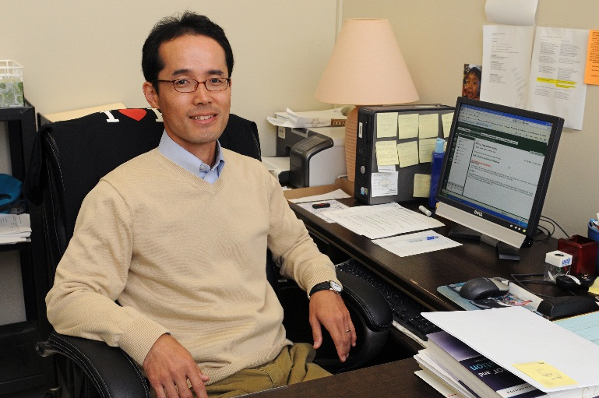
Taejin jung
Communication Studies
Department
Jung, Taejin, and Donnalyn Pompper. “Assessing Instrumentality of Mission Statements and Social-Financial Performance Links: Corporate Social Responsibility as Context.” International Journal of Strategic Communication 8 (2014): 79-99. Print. (May 2014)
1of2

Slide 37
Taejin jung
Communication Studies
Department
Pompper, Donnalyn, and Taejin Jung. "'Outnumbered yet Still on Top, but for How Long?' Theorizing about Men Working in the Feminized Field of Public Relations." Public Relations Review 39 (2013): 497-506. Print. (May 2014)
2of2

Slide 38
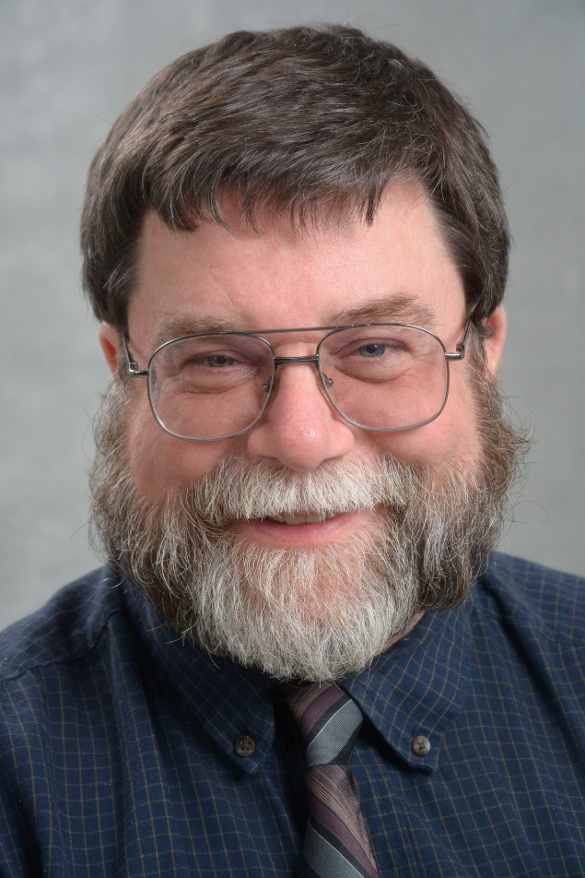
John kane
Economics
Department
Kane, John, Lawrence Spizman, and Don Donelson. “Educational Attainment Model for a Minor Child: The Next Generation.” Journal of Forensic Economics 24.2 (2013): 175-90. Print. (May 2014)

Slide 39
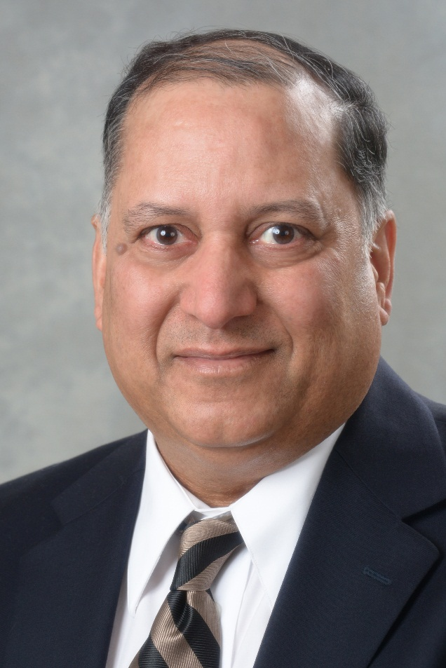
Alok kumar
Physics
Department
Kumar, Alok. Sciences of the Ancient Hindus: Unlocking Nature in the Pursuit of Salvation. N.p.: CreateSpace, 2014. Print. (Dec. 2014)

Slide 40
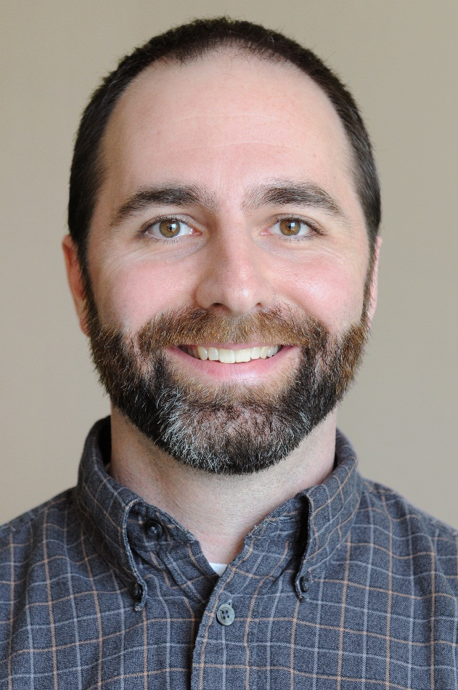
James mackenzie
Biological Sciences
Department
Gump, Brooks B., et al. "Low-level Mercury in Children: Associations with Sleep Duration and Cytokines TNF-α and IL-6." Environmental Research 134 (2014): 228-32. Print. (Dec. 2014)

Slide 41
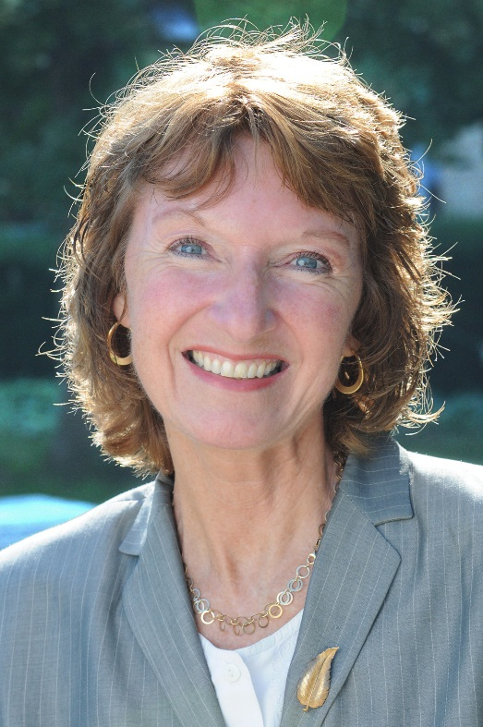
Linda rae markert
Educational Administration
Department
Markert, Linda Rae. "That Was Then! Changing Landscapes for School Building Leaders." Vanguard 43.3 (2014): 35-38. Print. (Dec. 2014)

Slide 42
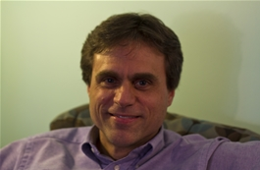
Vincent markowsky
Counseling Services Center
Markowsky, Vincent. Setting My Words Free: Inspirational Messages for Adults Who Stutter. N.p.: CreateSpace, 2014. Print. (Dec. 2014)

Slide 43
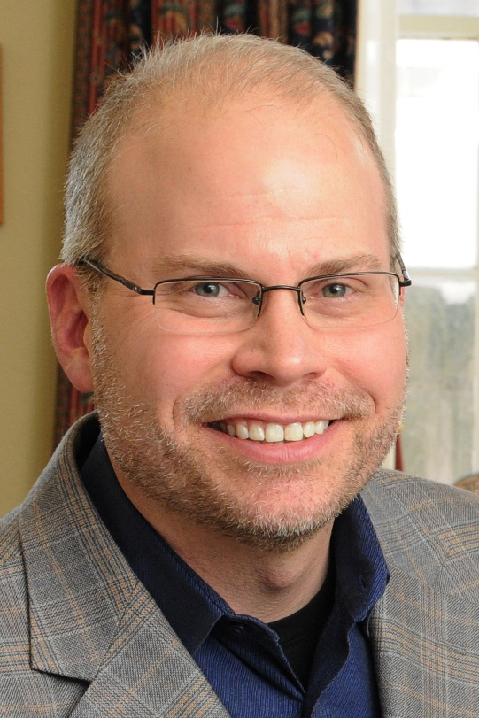
Joshua McKeown
International Education
& Programs
McKeown, Joshua. Strategic Planning for Education Abroad Programs. NAFSA's Guide to Education Abroad for Advisers and Administrators. Ed. Magnolia Hernandez, Margaret Wiedenhoeft, and David Wick. 4th ed. Washington D.C.: NAFSA: Association of International Educators, 2014. 213-26. Print. (Dec. 2014)

Slide 44
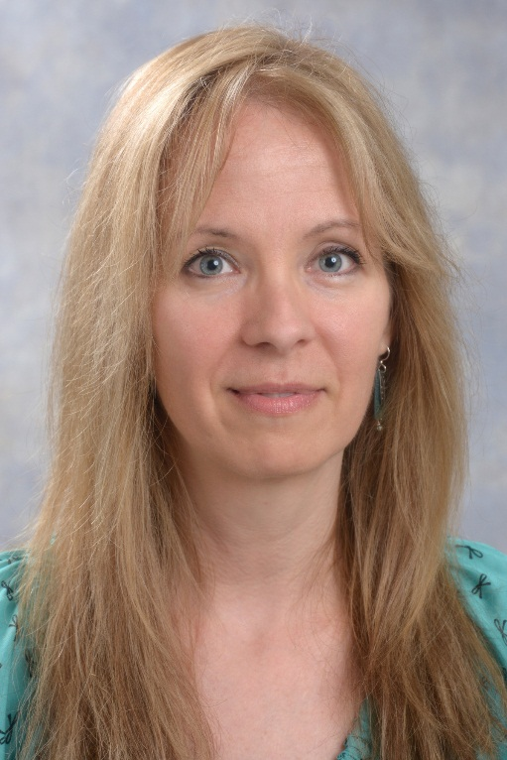
Kristen A. Munger
Counseling & Psychological Services Department
Murray, Maria S., Kristen A. Munger, and Elfrieda H. Hiebert. "An Analysis of Two Reading Intervention Programs." Elementary School Teacher 114.4 (2014): 479-500. Print. (Dec. 2014)
1of3

Slide 45
Kristen A. Munger
Counseling & Psychological Services Department
Blachman, Benita A., et al. "Intensive Reading Remediation in Grade 2 or 3: Are There Effects a Decade Later?" Journal of Educational Psychology 106.1 (2014): 46-57. Print. (Dec. 2014)
2of3

Slide 46
Kristen A. Munger
Counseling & Psychological Services Department
Munger, Kristen A., and Maria S. Murray. Text Complexity and Deliberate Practice: Common Cores of Learning. Best Practices in Adolescent Literacy Instruction. Ed. Kathleen A. Hinchman and Heather K. Sheridan-Thomas. 2nd ed. New York: Guilford, 2014. 99-119. Print. (Dec. 2014)
3of3

Slide 47
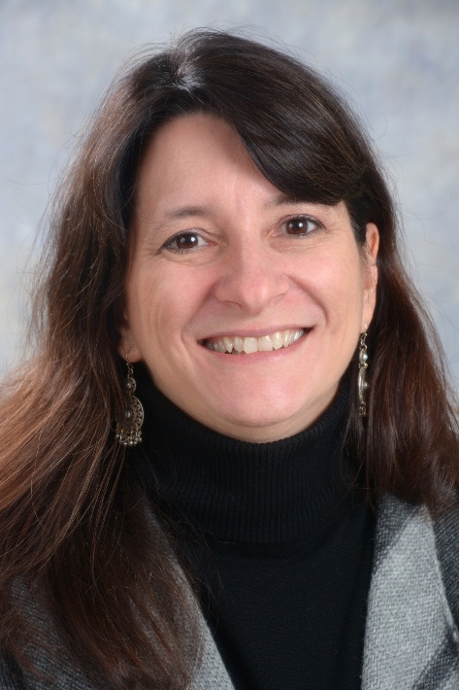
Maria S. Murray
Curriculum & Instruction Department
Murray, Maria S., Kristen A. Munger, and Elfrieda H. Hiebert. "An Analysis of Two Reading Intervention Programs." Elementary School Teacher 114.4 (2014): 479-500. Print. (Dec. 2014)
1of3

Slide 48
Maria S. Murray
Curriculum & Instruction Department
Blachman, Benita A., et al. "Intensive Reading Remediation in Grade 2 or 3: Are There Effects a Decade Later?" Journal of Educational Psychology 106.1 (2014): 46-57. Print. (Dec. 2014)
2of3

Slide 49
Maria S. Murray
Curriculum & Instruction Department
Munger, Kristen A., and Maria S. Murray. Text Complexity and Deliberate Practice: Common Cores of Learning. Best Practices in Adolescent Literacy Instruction. Ed. Kathleen A. Hinchman and Heather K. Sheridan-Thomas. 2nd ed. New York: Guilford, 2014. 99-119. Print. (Dec. 2014)
3of3

Slide 50
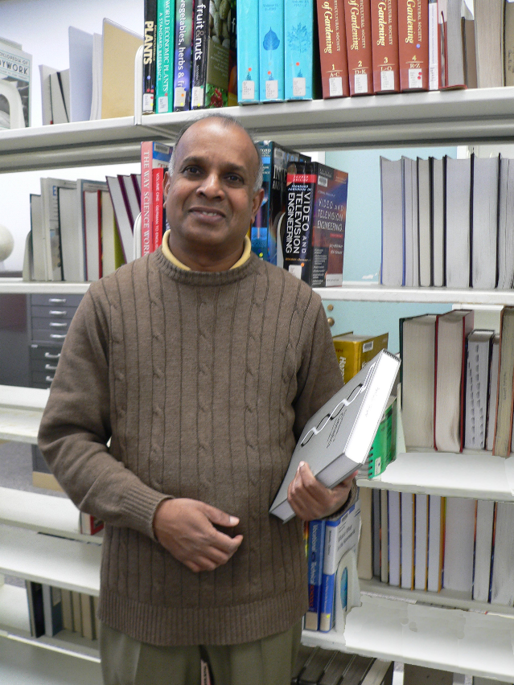
Ampalavanar Nanthakumar
Mathematics
Department
Nanthakumar, A., S. Ganesalingam, and Siva Ganesh. “On Cupola Based Discriminant Rule.” Journal of Statistics & Management Systems 13.6 (2013): 401-17. Print. (May 2014)

Slide 51
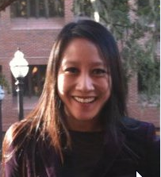
Marilyn ochoa
Penfield Library
Kumar, Swapna, Kristin Heathcock, and Marilyn Ochoa. Sustainable Embedded Librarianship to Foster Research Skills in an Online Graduate Program. Virtually Embedded: The Librarian in an Online Environment. Ed. Elizabeth Leonard and Erin McCaffrey. Chicago: Association of College and Research Libraries, 2014. 39-51. Print. (May 2014)
1of2

Slide 52
Marilyn ochoa
Penfield Library
Ochoa, Marilyn N, Laurie N. Taylor, and Mark V. Sullivan. Digital Collections Assessment and Outreach. Washington, D.C.: Association of Research Libraries, Office of Leadership and Management Services, 2014. Print. (Dec. 2014)
2of2

Slide 53
Eugene Perticone, Emeritus
Counseling & Psychological
Services Department
Perticone, Eugene X. Waldo Emerson, My Grandfather, and Me: A Novel. Bloomington: IUniverse, 2014. Print. (May 2014)

Slide 54
Omara Rivera-Vazquez
Public Justice
Department
Rivera-Vazquez, Omara. Moral Development. The Encyclopedia of Criminology and Criminal Justice. Ed. Jay S. Albanese. Vol. 4. N.p.: Wiley-Blackwell, 2014. 1486-89. Print. The Wiley Series of Encyclopedias in Criminology and Criminal Justice. (Dec. 2014)
1of2

Slide 55
Omara Rivera-Vazquez
Public Justice
Department
Rivera-Vazquez, Omara. Police Stress. The Encyclopedia of Criminology and Criminal Justice. Ed. Jay S. Albanese. Vol. 4. N.p.: Wiley-Blackwell, 2014. 1675-79. Print. The Wiley Series of Encyclopedias in Criminology and Criminal Justice. (Dec. 2014)
2of2

Slide 56
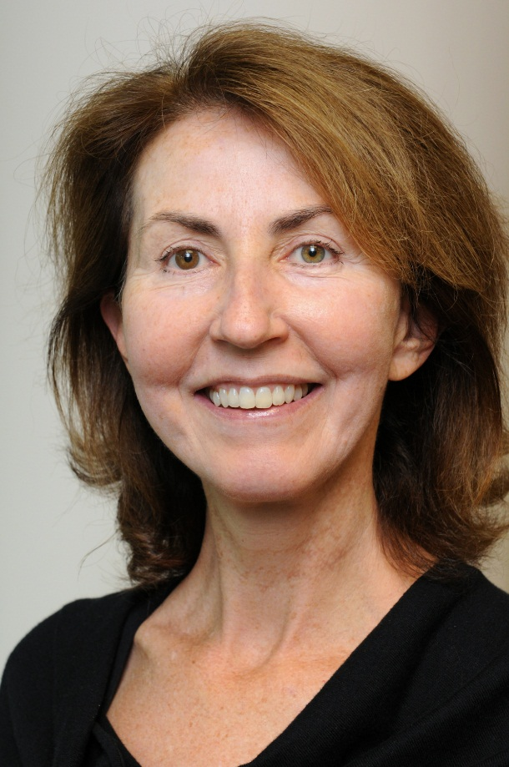
Mary tone rodgers
Accounting, Finance
& Law Department
Rodgers, Mary Tone, and James E. Payne. “How the Bank of France Changed U.S. Equity Expectations and Ended the Panic.” Journal of Economic History 74.2 (2014): 420-48. Print. (May 2014)

Slide 57
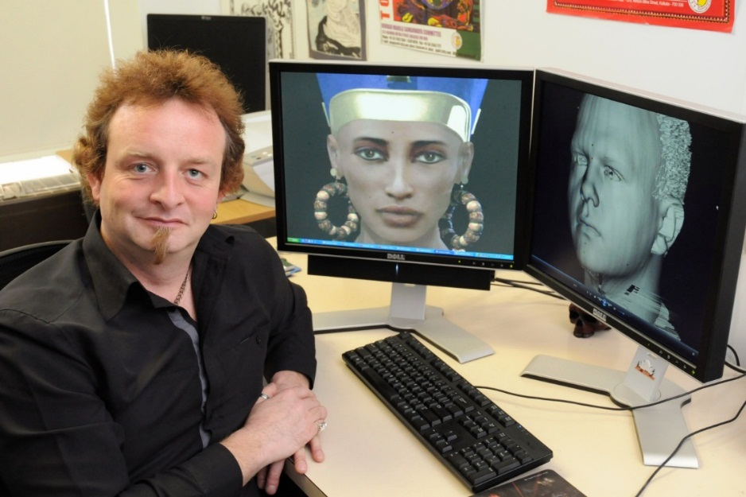
Damian Schofield
Computer Science
Department
Tanner, Patricia, Carly Karas, and Damian Schofield. “Augmenting a Child's Reality: Using Educational Tablet Technology.” Journal of Information Technology Education: Innovations in Practice 13 (2014): 45-54. Print. (May 2014)
1of2

Slide 58
Damian Schofield
Computer Science
Department
Schofield, Damian. “A Virtual Education: Guidelines for Using Games Technology.” Journal of Information Technology Education: Innovations in Practice 13 (2014): 25-43. Print. (May 2014)
2of2

Slide 59
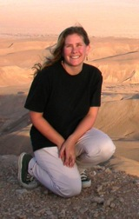
Karen r. sime
Biological Sciences
Department
Sime, Karen R., and Kent M. Daane. "A Comparison of Two Parasitoids (Hymenoptera: Encyrtidae) of the Vine Mealybug: Rapid, Non-discriminatory Oviposition Is Favored When Ants Tend the Host." Environmental Entomology 43.4 (2014): 995-1002. Print. (Dec. 2014)
1of2

Slide 60
Karen r. sime
Biological Sciences
Department
Buckner, Janet, Amy B. Welsh, and Karen R. Sime. "Evidence for Population Differentiation in the Bog Buckmoth of New York State." Northeastern Naturalist 21.4 (2014): 506-14. Print. (Dec. 2014)
2of2

Slide 61
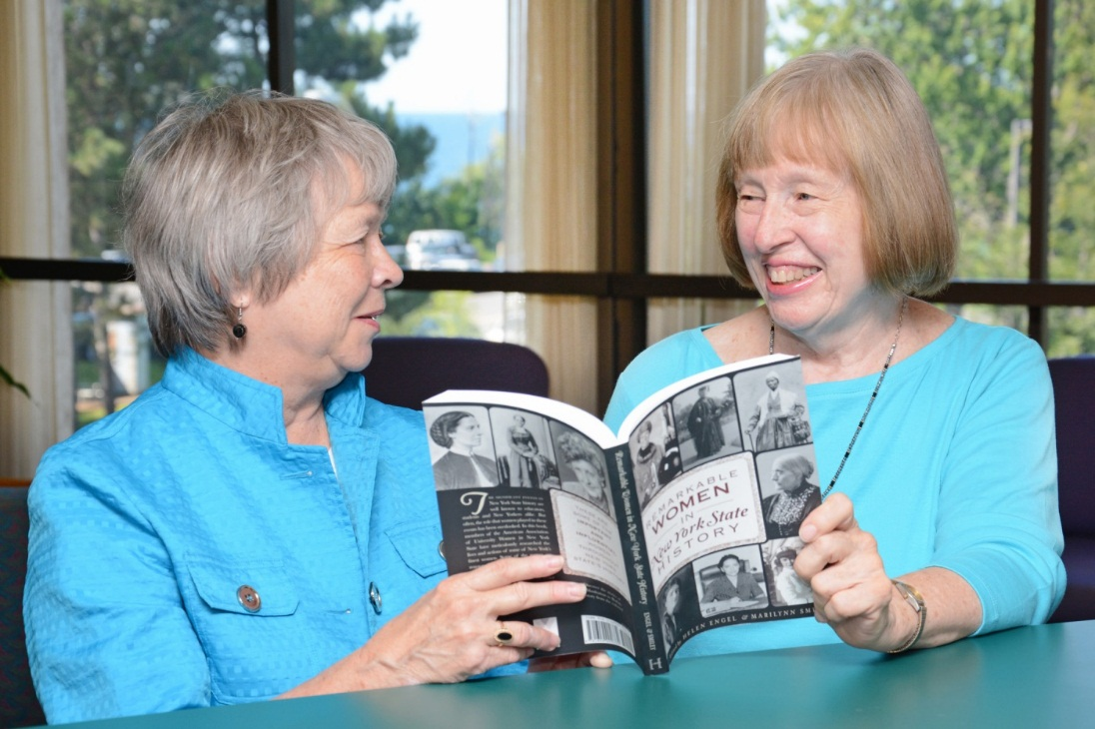
Marilynn Smiley, emerita
Music
Department
Smiley, Marilynn J. “Bartlett, James Carroll.” The Grove Dictionary of American Music. 2nd ed. Vol. 1. New York: Oxford University, 2013. 365. Print. (May 2014)
1of4

Slide 62
Marilynn Smiley, emerita
Music
Department
Consort Gems of the Late Renaissance. The Oswego Recorder Consort. Prod. Dan Wood. Rec. 3 Sept. 2011. CD. The Oswego Recorder Consort is comprised of: John Brunson, Marilynn Smiley, Jane Wright, Burton Phillips. (May 2014)
2of4

Slide 63
Marilynn Smiley, emerita
Music
Department
Smiley, Marilynn J. “Ludden, William.” The Grove Dictionary of American Music. 2nd ed. Vol. 5. New York: Oxford University, 2013. 258. Print. (May 2014)
3of4

Slide 64
Marilynn Smiley, emerita
Music
Department
Smiley, Marilynn J. “Musin, Ovide.” The Grove Dictionary of American Music. 2nd ed. Vol. 5. New York: Oxford University, 2013. 684-685. Print. (May 2014)
4of4

Slide 65
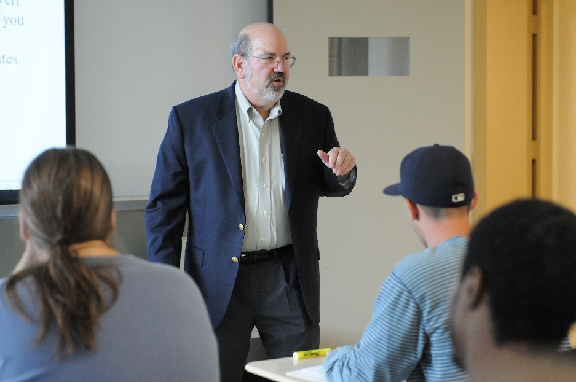
Lawrence spizman
Economics Department
Kane, John, Lawrence Spizman, and Don Donelson. “Educational Attainment Model for a Minor Child: The Next Generation.” Journal of Forensic Economics 24.2 (2013): 175-90. Print. (May 2014)

Slide 66
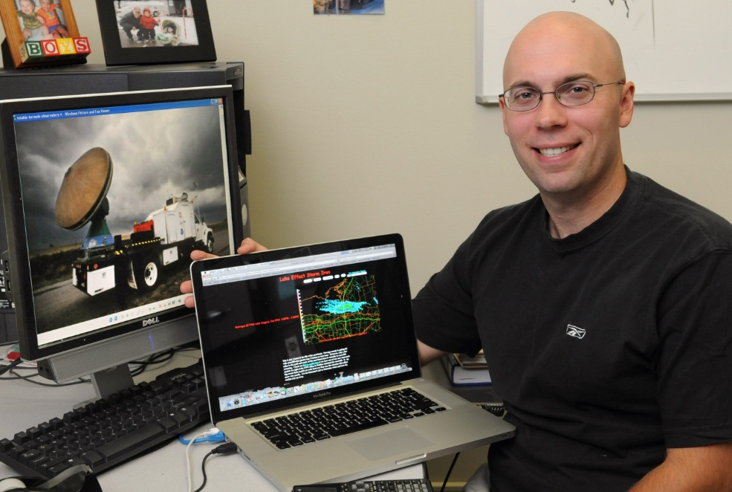
Scott Steiger
Atmospheric and Geological Sciences
Department
SUNY Oswego Storm Forecasting and Observation Program 2012. Dir. Scott Steiger. Prod. Brett Rathbun. 2012. SUNY Oswego, 2012. DVD. (May 2014)
1of2

Slide 67
Scott Steiger
Atmospheric and Geological Sciences
Department
SUNY Oswego Storm Forecasting and Observation Program 2014. Dir. Scott Steiger. Prod. Brett Rathbun. 2014. SUNY Oswego, 2014. DVD. (Dec. 2014)
2of2

Slide 68
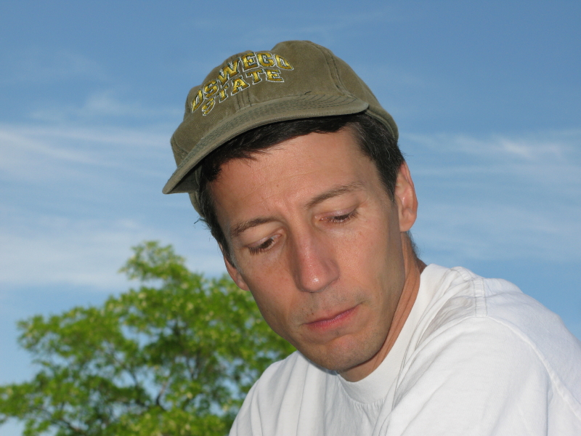
Paul Tomascak
Atmospheric and Geological Sciences
Department
Yu, Jimin, et al. "Controls on Sr/Ca in Benthic Foraminifera and Implications for Seawater Sr/Ca during the Late Pleistocene." Quarternary Science Reviews 98 (2014): 1-6. Print. (Dec. 2014)

Slide 69
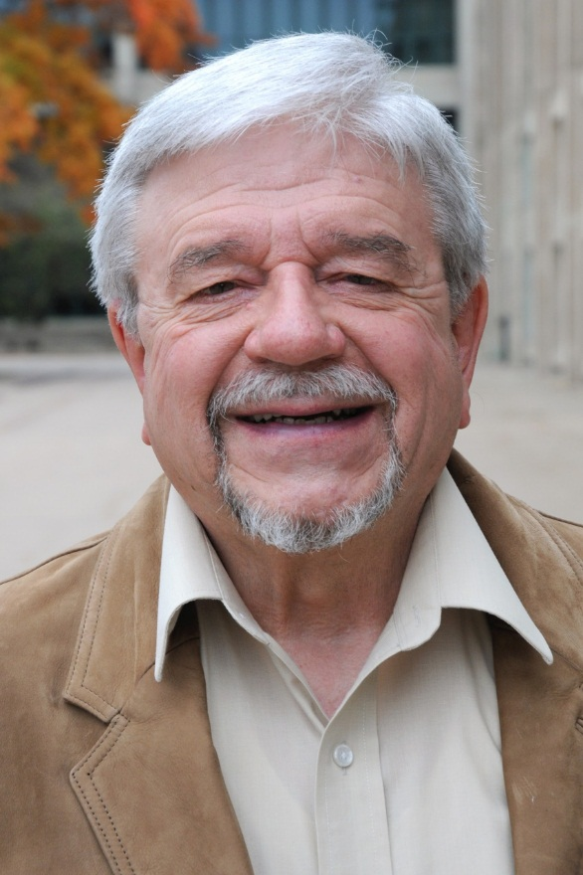
Lewis Turco, Emeritus
English Department
Turco, Lewis. The Familiar Stranger. Scottsdale: Star Cloud, 2014. Print. (May 2014)

Slide 70
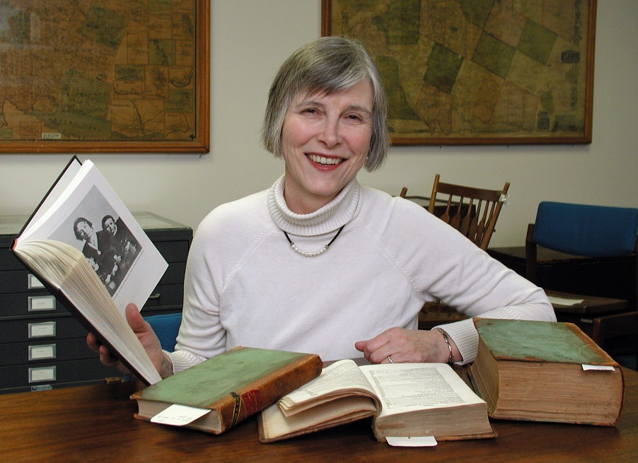
Judith Wellman, emerita
History
Department
Wellman, Judith. Brooklyn's Promised Land: The Free Black Community of Weeksville, New York. New York: New York University Press, 2014. Print. (Dec. 2014)

Slide 71
Brandon west
Penfield Library
Gilliard-Cook, Theresa, and Brandon West. "Authentic Learning: Creating Meaning in the Higher Ed Classroom." The EvoLLLution Dec. 2014: n. pag. Digital file. (Dec. 2014)

Slide 72
Elizabeth Wilcox
Mathematics Department
Wilcox, Elizabeth. "Can a Pure Mathematician Really Dig Statistics?" Math Horizons Nov. 2013: 28-29. Print. (Dec. 2014)
1of3

Slide 73
Elizabeth Wilcox
Mathematics Department
Wilcox, Elizabeth, et al. "Group Theory Session." Ohio State - Denison Mathematics Conference. Columbus Ohio. 9 May 2014. Organizer. (Dec. 2014)
2of3

Slide 74
Elizabeth Wilcox
Mathematics Department
Brewster, Ben, Peter Hauck, and Elizabeth Wilcox. "Quasi-antichain Chermak- Delgado Lattices of Finite Groups." Archiv der Mathematik 103.4 (2014): 301-11. Print. (Dec. 2014)
3of3

Slide 75
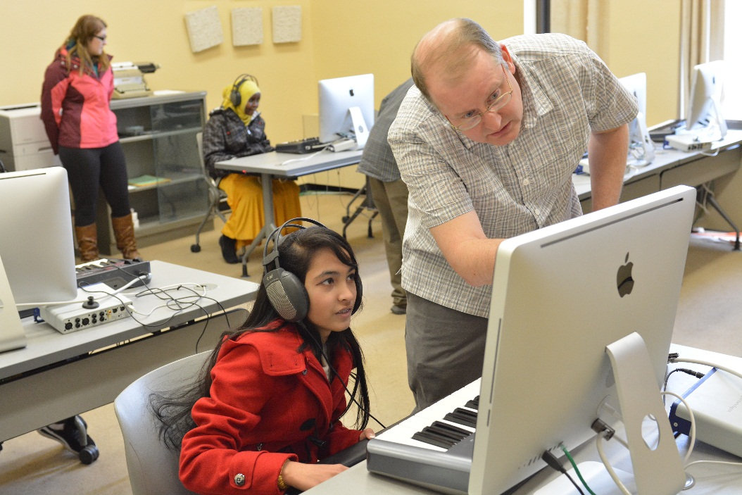
Dan wood
Music
Department
Consort Gems of the Late Renaissance. The Oswego Recorder Consort. Prod. Dan Wood. Rec. 3 Sept. 2011. CD. The Oswego Recorder Consort is comprised of: John Brunson, Marilynn Smiley, Jane Wright, Burton Phillips. (May 2014)

Slide 76
Jane wright, emerita
Penfield Library
Consort Gems of the Late Renaissance. The Oswego Recorder Consort. Prod. Dan Wood. Rec. 3 Sept. 2011. CD. The Oswego Recorder Consort is comprised of: John Brunson, Marilynn Smiley, Jane Wright, Burton Phillips. (May 2014)

Slide 77
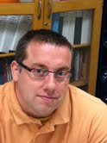
Jason Zenor
Communication Studies Department
Zenor, Jason. "Where Are Those Good Ol' Fashioned Values? Reception Analysis of the Offensive Humor on 'Family Guy.'" Operant Subjectivity: The International Journal of Q Methodology 37.1-2 (2014): 23-40. Print. (Dec. 2014)

Slide 78
Want a Closer look at the 2014 contributions? Go to: www.oswego.edu/library/archives.html

