Slide 1
Display to Archives 2015
Celebrating Scholarly & Creative Activity

Slide 2
Art
Richard Zakin, Emeritus
Atmospheric and Geological Sciences
Paul Tomascak
Biological Sciences
Jennifer Olori
Peter Rosenbaum

Slide 3
Communication Studies
Arvind Diddi
Fritz Messere, Emeritus
Brian Moritz
Jason Zenor
Computer Science
Damian Schofield
Christian Tenbergen
Counseling and Psychological Services
Barbara Streets

Slide 4
Economics
David Andrews
Said Atri
Educational Administration
Linda Rae Markert
English
Laura Donnelly
Lewis Turco, Emeritus

Slide 5
History
Luciano Iorizzo, Emeritus
Gwen Kay
Library
Michelle Bishop
Kathryn Johns-Masten
Emily Mitchell
Marketing & Management
Steven E. Abraham
Barry A. Friedman

Slide 6
Mathematics
Ampalavanar Nanthakumar
Modern Languages and Literatures
Beatriz E. Salcedo-Strumpf
Philosophy
Robert F. Card
K. Brad Wray
Physics
Shashi Kanbur
Alok Kumar

Slide 7
Political Science
Bruce E. Altschuler, Emeritus
Helen J. Knowles
Stephen J. Rosow
Psychology
Karen Wolford
Sociology
Tim Delaney
Theatre
Christopher Sanderson
Sanford Sternlicht, Emeritus

Slide 8
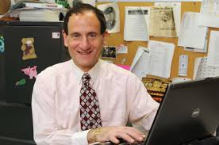
Steven e. abraham
Marketing &
Management Department
Abraham, Steven E. "The LMRDA. Another Labor Law That Benefitted Employers?" 7th Annual American Business Research Conference. Sheraton LaGuardia East Hotel, New York. 23 July 2015. Print. (Fall 2015)

Slide 9
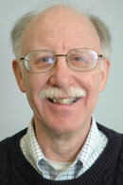
Bruce e. altschuler, emeritus
Political Science
Department
Altschuler, Bruce E. "Presidential Nostalgia." PEP Report 37.1 (2014): 3-6. Print. (Spring 2015)
1of2

Slide 10
Bruce e. altschuler, emeritus
Political Science
Department
Altschuler, Bruce E. "Is the Pentagon Papers Case Relevant in the Age of WikiLeaks?" Political Science Quarterly 130.3 (2015): 401-23. Print. (Fall 2015)
2of2

Slide 11
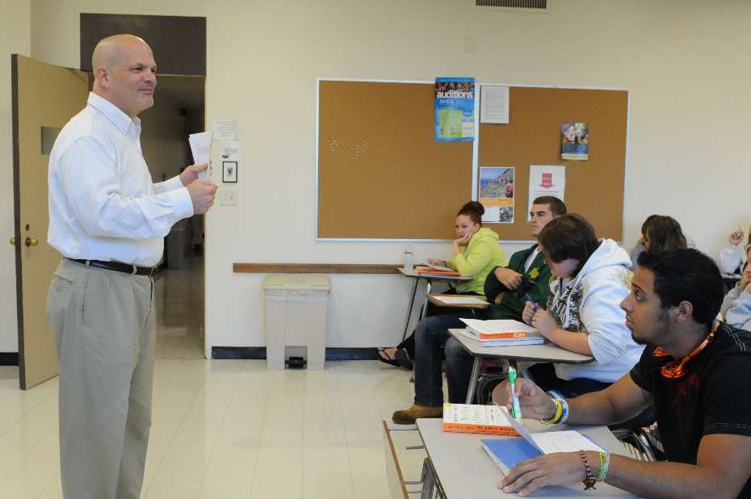
David Andrews
Economics
Department
Andrews, David. "Los Precios Naturales de Adam Smith, la Metafora de la Gravitacion y los Propositos de la Naturaleza." Debate Economico 3.9 (2014): 130-53. Print. (Spring 2015)
1of2

Slide 12
David Andrews
Economics
Department
Andrews, David. "Natural Price and the Long Run: Alfred Marshall's Misreading of Adam Smith." Cambridge Journal of Economics 39 (2015): 265-79. Print. (Spring 2015)
2of2

Slide 13
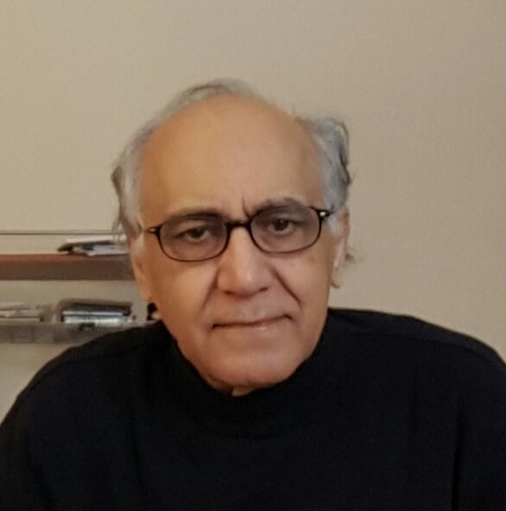
Said atri
Economics
Department
Zhu, Min, Said Atri, and Eyub Yegen. "Are Candlestick Trading Strategies Effective in Certain Stocks with Distinct Features?" Pacific-Basin Finance Journal (2015): n. pag. Science Direct. Web. 16 Dec. 2015. <http://dx.doi.org/10.1016/j.pacfin.2015.10.007>. (Fall 2015)

Slide 14
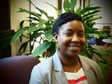
Michelle bishop
Penfield
Library
Bishop, Michelle, and Brandon West. "Using Primary Sources to Help Students Discover Their Voices in the Research Process." LOEX Quarterly 41.2 (2014): n. pag. Digital Commons@EMU. Web. 8 July 2015: <http://commons.emich.edu/loexquarterly/vol41/iss/>. (Spring 2015)

Slide 15
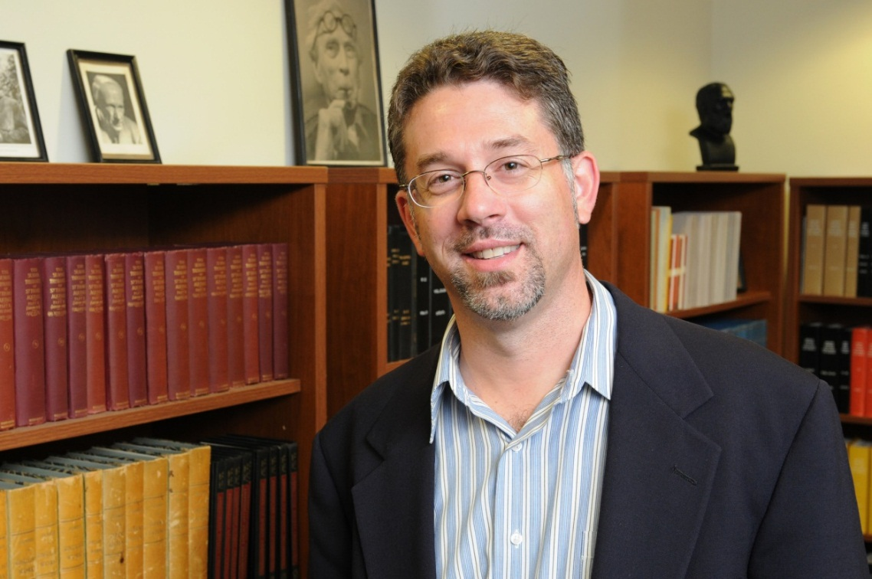
Robert f. card
Philosophy
Department
Card, Robert F. "Is There No Alternative? Conscientious Objection by Medical Students." Journal of Medical Ethics 38.10 (2012): 602-04. Print. (Spring 2015)

Slide 16
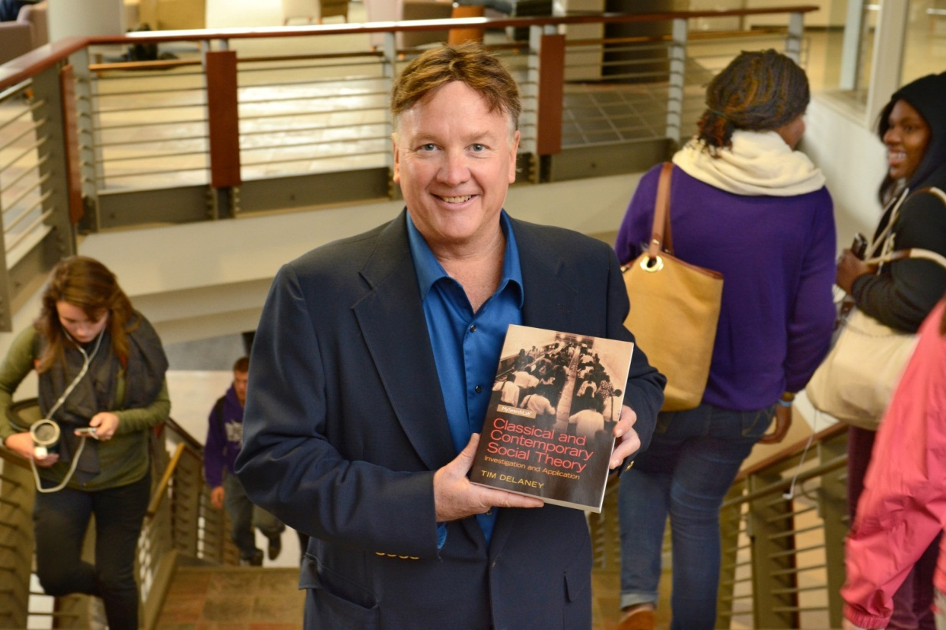
Tim Delaney
Sociology Department
Delaney, Tim, and Tim Madigan. The Sociology of Sports: An Introduction. 2nd. ed. Jefferson: McFarland, 2015. Print. (Fall 2015)

Slide 17
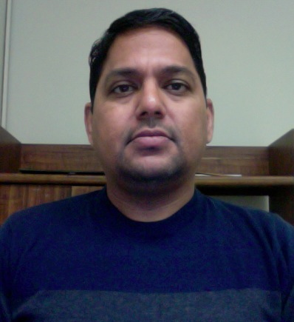
Arvind diddi
Communication Studies Department
Diddi, Arvind, Frederick Fico, and Geri Alumit Zeldes. "Partisan Balance and Bias in TV Network Coverage of the 2000, 2004, and 2008 Presidential Elections." Journal of Broadcasting & Electronic Media 58.2 (2014): 161-78. Print. (Spring 2015)

Slide 18
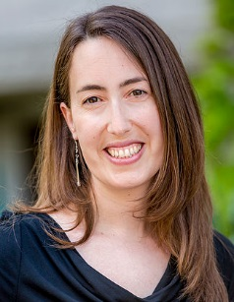
Laura donnelly
English Department
Donnelly, Laura. Watershed : Poems. San Diego, CA: Cider Press Review, 2014. Print. (Fall 2015)

Slide 19
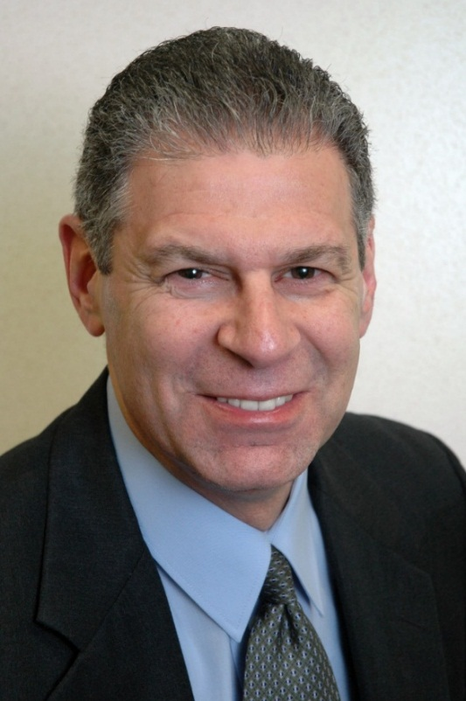
Barry a. friedman
Marketing & Management Department
Aziz, Nergis, Barry A. Friedman, and Habibe Ilhan. "The Impact of Nonprofit Organizations on the Intent to Visit Turkey: An Empirical Test Using the Theory of Planned Behavior." Place Branding and Public Diplomacy 11 (2015): 175-89. Print. (Fall 2015)

Slide 20
Luciano Iorizzo, emeritus
History Department
Iorizzo, Luciano, Italian Americana: Cultural and Historical Review. Advisory Board.(Fall 2015)

Slide 21
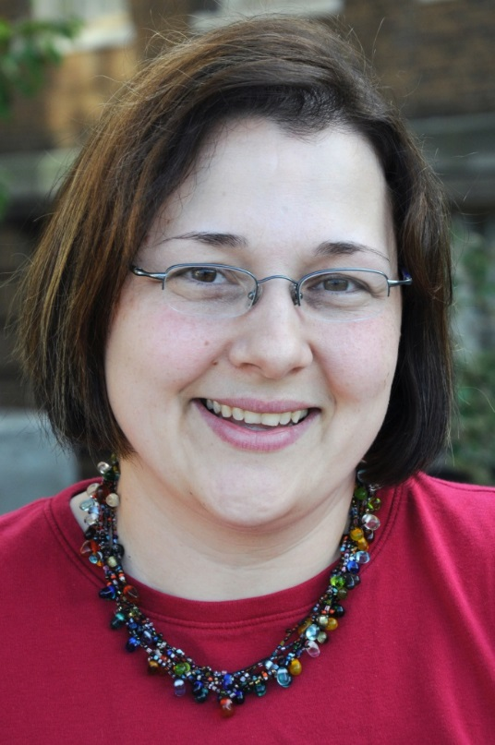
Kathryn johns- masten
Penfield Library
Mitchell, Emily, Brandon West, and Kathryn Johns-Masten. "Revitalizing Library Services with Usability Data: Testing 1, 2 3..." Computers in Libraries 35.4 (2015): 11-14. Print. (Spring 2015)

Slide 22
Shashi Kanbur
Physics Department
Nanthakumar, A., S. Kanbur, and E. Wilson. "On the Detection of Heteroscedasticity by Using CUSUM Range Distribution." International Journal of Statistics and Probability 4.3 (2015): 88-93. Print. (Fall 2015)

Slide 23
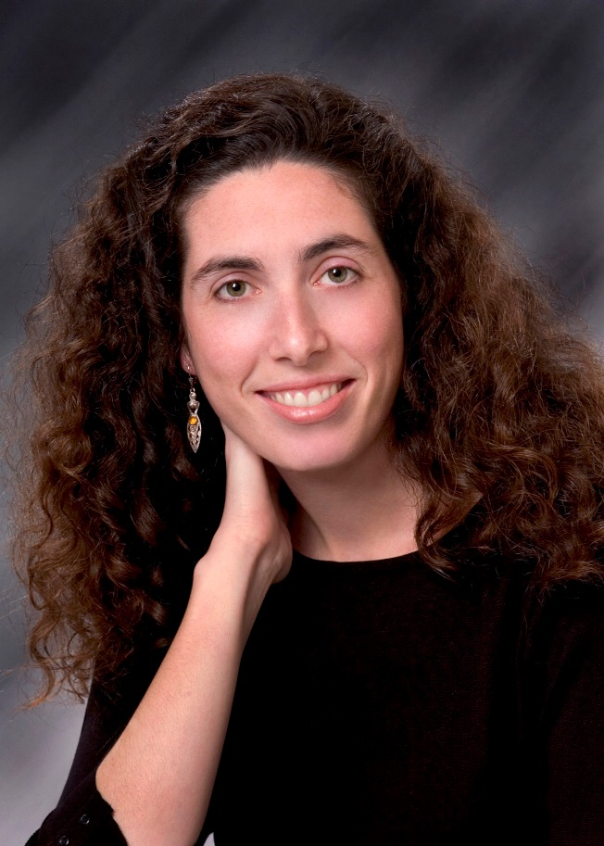
Gwen kay
History
Department
Nickols, Sharon Y., and Gwen Kay, eds. Remaking Home Economics: Resourcefulness and Innovation in Changing Times. Athens, GA: U of Georgia, 2015. Print. (Spring 2015)

Slide 24
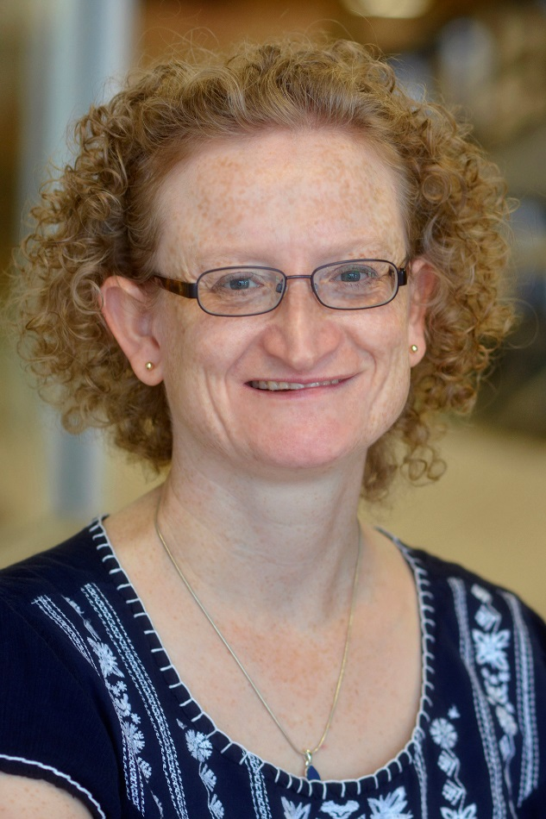
Helen J. Knowles
Political Science
Department
Knowles, Helen J., and Steven B. Lichtman, eds. Judging Free Speech: First Amendment Jurisprudence of US Supreme Court Justices. New York, NY: Palgrave Macmillan, 2015. Print. (Fall 2015)
1of2

Slide 25
Helen J. Knowles
Political Science
Department
Knowles, Helen J. "Taking Justice Kennedy Seriously: Why Windsor Was Decided 'Quite Apart from Principles of Federalism.'" Roger Williams University Law Review 20.1 (2015): 24-74. Print. (Fall 2015)
2of2

Slide 26
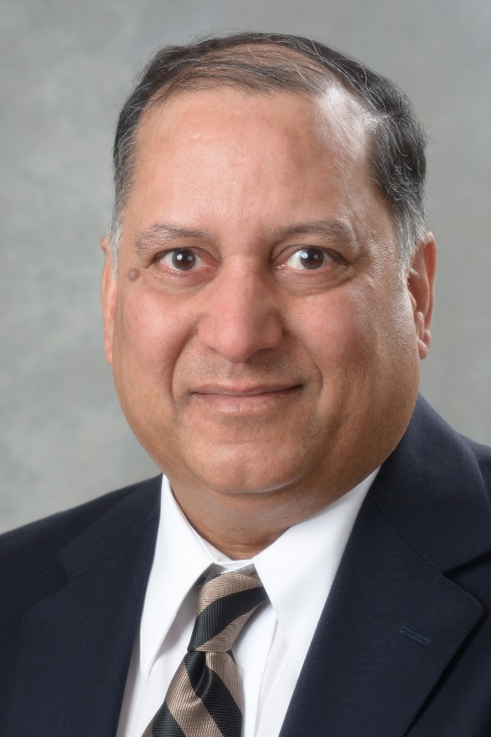
Alok kumar
Physics
Department
Montgomery, Scott L., and Alok Kumar. A History of Science in World Cultures: Voices of Knowledge. London, UK: Routledge, 2016. Print. (Fall 2015)

Slide 27
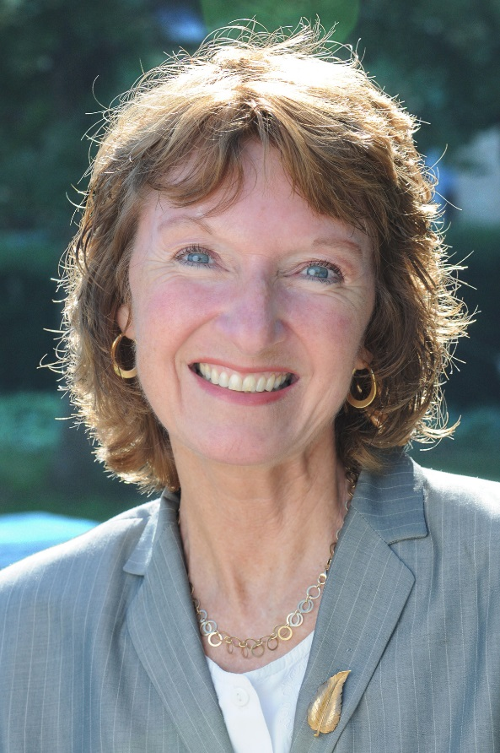
linda rae markert
Educational Administration
Department
Markert, Linda Rae, Carol Burch, and Dawn Battles. "STEM Team Mentors Lead Project Based Learning (PBL) Competitions." Vanguard 44.3 (2015): 23-25. Print. (Fall 2015)

Slide 28
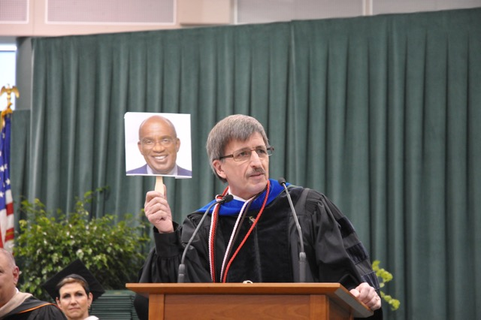
Fritz messere, emeritus
Communication Studies
Department
Hausman, Carl, et al. Modern Radio & Audio Production: Programming and Performance. 10th ed. Boston, MA: Cengage Learning, 2016. Print. (Spring 2015)

Slide 29
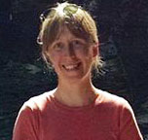
Emily mitchell
Penfield Library
Mitchell, Emily, Brandon West, and Kathryn Johns-Masten. "Revitalizing Library Services with Usability Data: Testing 1, 2 3..." Computers in Libraries 35.4 (2015): 11-14. Print. (Spring 2015)

Slide 30
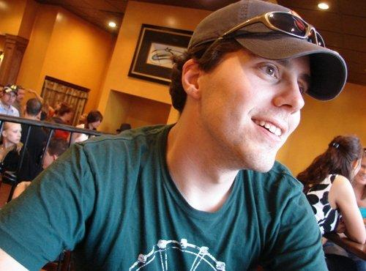
Brian Moritz
Communication Studies Department
Moritz, Brian. "The Story versus the Stream: Digital Media's Influence on Newspaper Sports Journalism." International Journal of Sport Communication 8 (2015): 397-410. Print. (Fall 2015)

Slide 31
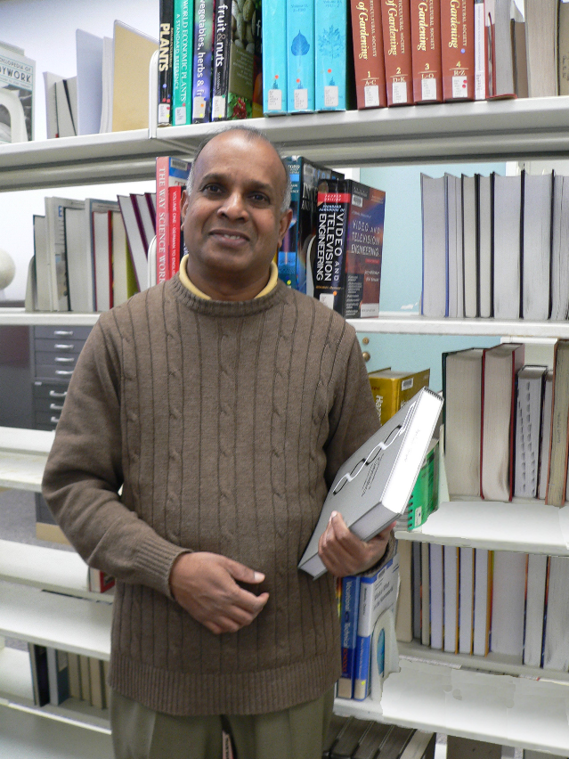
Ampalavanar Nanthakumar
Mathematics
Department
Nanthakumar, A., S. Kanbur, and E. Wilson. "On the Detection of Heteroscedasticity by Using CUSUM Range Distribution." International Journal of Statistics and Probability 4.3 (2015): 88-93. Print. (Fall 2015)

Slide 32
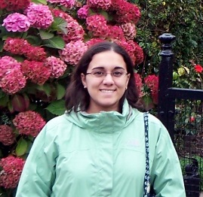
Jennifer olori
Biological Sciences Department
Frobisch, Nadia B., et al. "Deep-time Evolution of Regeneration and Preaxial Polarity in Tetrapod Limb Development." Nature 527 (2015): 231-34. Print. (Fall 2015)

Slide 33
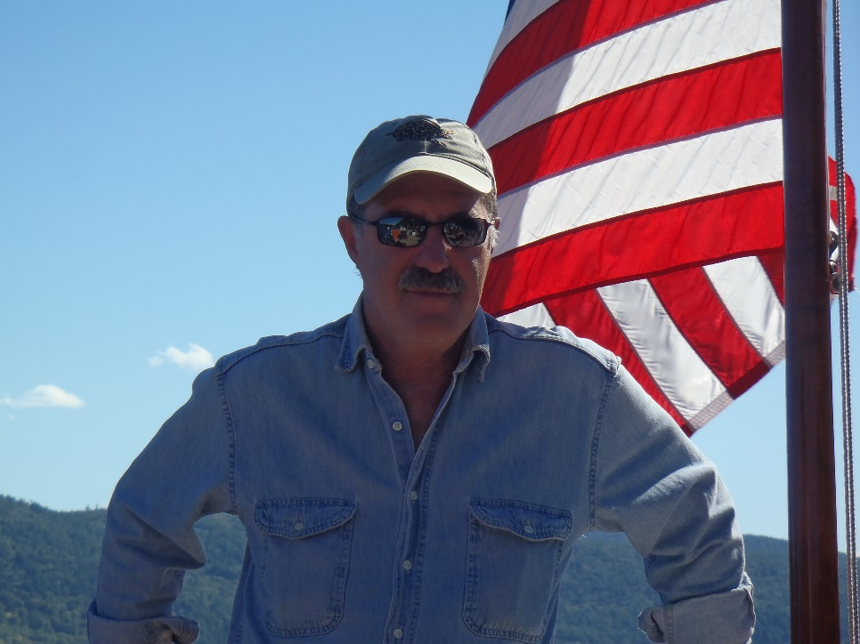
Peter rosenbaum
Biological Sciences Department
Rosenbaum, Peter A. Volpe's Understanding Evolution. [8th] ed. Columbus, OH: McGraw Hill: Create, 2016. Print. (Fall 2015)

Slide 34
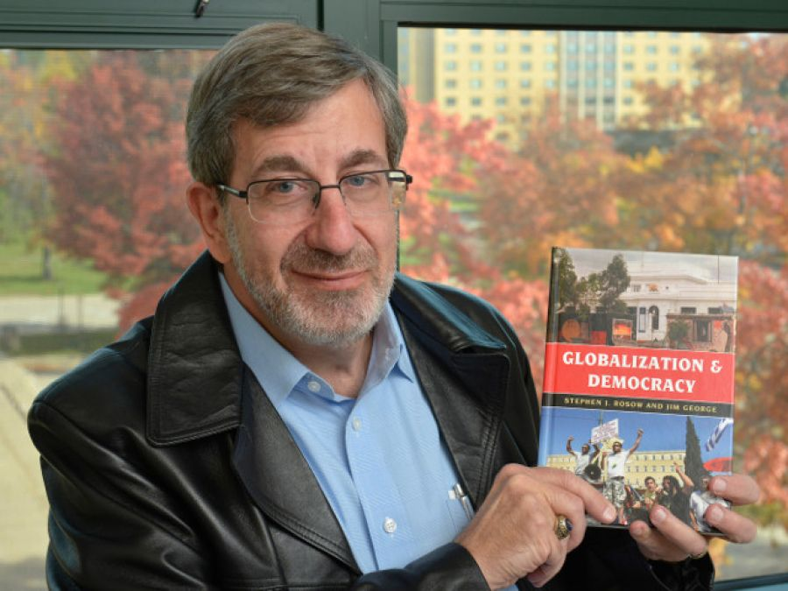
Stephen j. rosow
Political Science
Department
Rosow, Stephen J., and Jim George. Globalization and Democracy. London, UK: Rowman & Littlefield, 2015. Print. Globalization. (Spring 2015)
1of2

Slide 35
Stephen j. rosow
Political Science
Department
Rosow, Stephen J. "'Human Nature' and the Paradoxical Order of Liberalism." Human Beings in International Relations. Ed. Daniel Jacobi and Annette Freyberg-Inan. Cambridge, UK: Cambridge UP, 2015. 54-73. Print. (Spring 2015)
2of2

Slide 36
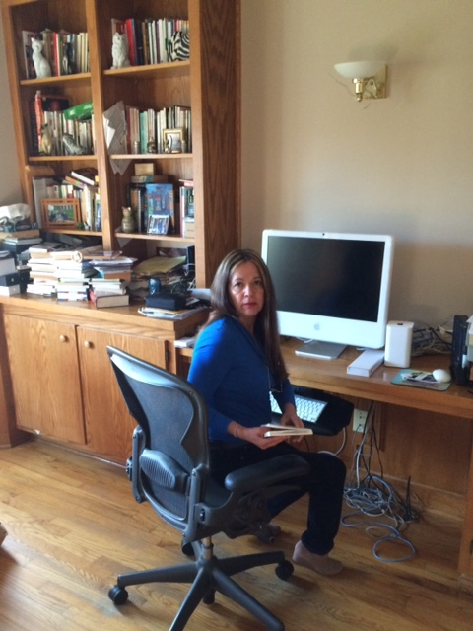
Beatriz e. Salcedo- strumpf
Modern Languages &
Literatures Department
Salcedo-Strumpf, Beatriz E. E-Mail for Lovers. 2004. Bloomington, IN: AuthorHouse, 2014. Print. (Spring 2015)

Slide 37
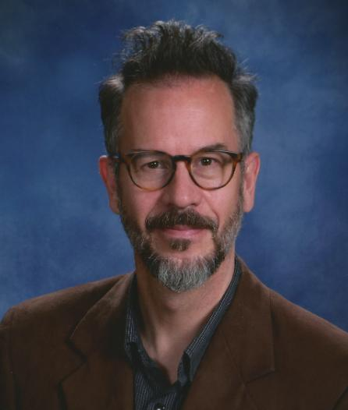
Christopher sanderson
Theatre Department
Messages. Prod. and dir. Christopher Carter Sanderson. Benjamin Heller's Loft Brooklyn. Jan. 2015. Performance. (Fall 2015)
1of2

Slide 38
Christopher sanderson
Theatre Department
Sanderson, Christopher Carter. The Too - Brief Chronicle of Judah Lowe. N.p.: Sagging Meniscus, 2015. Print. (Fall 2015)
2of2

Slide 39
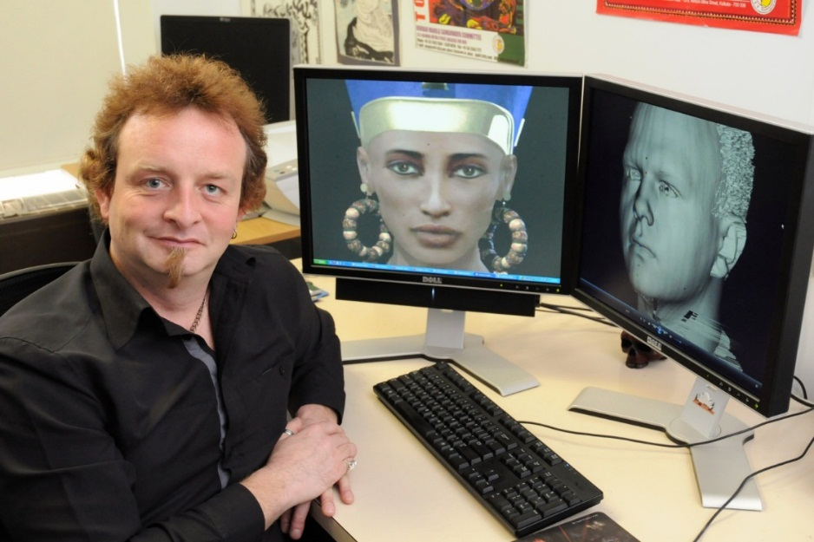
Damian Schofield
Computer Science
Department
Anderson, Matthew, Damian Schofield, and Lisa Dethridge. New Ways of Seeing: Evaluating Interactive User Experiences in Virtual Art Galleries. Analyzing Art, Culture, and Design in the Digital Age. Ed. Gianluca Mura. Hershey: IGI Global, 2015. 105-27. Print. Advances in Media, Entertainment, and the Arts (AMEA) Book Series. (Fall 2015)

Slide 40
sanford sternlicht, emeritus
Theatre
Department
Sternlicht, Sanford. August Wilson's Twentieth-century Plays: A Reader's Companion. Lubbock, TX: Texas Tech UP, 2015. Print. (Spring 2015)

Slide 41
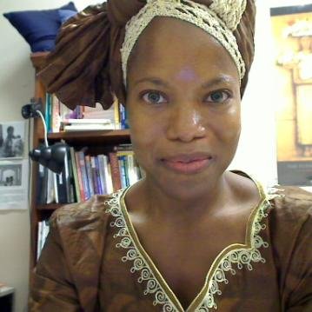
Barbara streets
Counseling & Psychological Services Department
Streets, Barbara Faye, Guerda Nicolas, and Karen Wolford. "Pause...Before Rushing In: Examining Motivations to Help in Trauma Impacted Communities Internationally." Journal of International Research and Review 4.2 (2015): 15-31. Print. (Fall 2015)

Slide 42
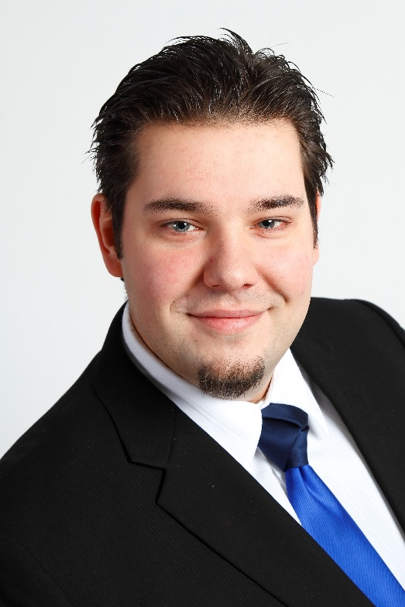
Bastian tenbergen
Computer Science
Department
Brandstetter, Veronika, et al. "Early Validation of Automation Plant Control Software Using Simulation Based on Assumption Modeling and Validation Use Cases." Complex Systems Informatics and Modeling Quarterly 4 (2015): 50-65. Print. (Fall 2015)
1of2

Slide 43
Bastian tenbergen
Computer Science
Department
Tenbergen, Bastian, Thorsten Weyer, and Klaus Pohl. Supporting the Validation of Adequacy in Requirements-based Hazard Mitigations. Requirements Engineering: Foundation for Software Quality: 21st International Working Conf., REFSQ 2015, Essen, Germany, March 23-26, 2015. Proceedings. Ed. Samuel A. Fricker and Kurt Schneider. N.p.: Springer International, 2015. 17-32. Print. Programming and Software Engineering 9013. (Fall 2015)
2of2

Slide 44
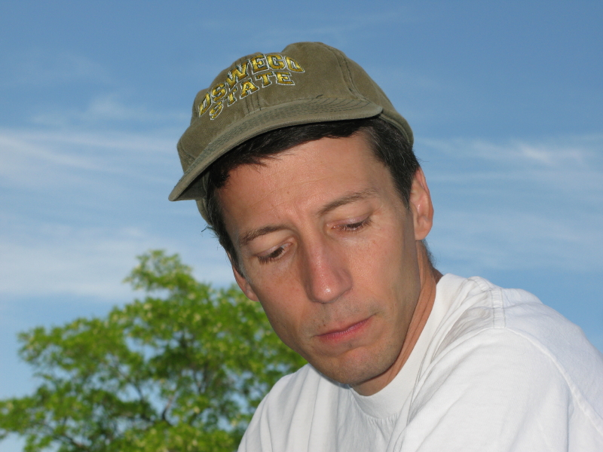
Paul tomascak
Atmospheric and Geological Sciences
Department
Tomascak, Paul B. "Lithium and Sediment: The Martinique Connection." Science Bulletin 60.12 (2015): 1136-37. Print. (Spring 2015)

Slide 45
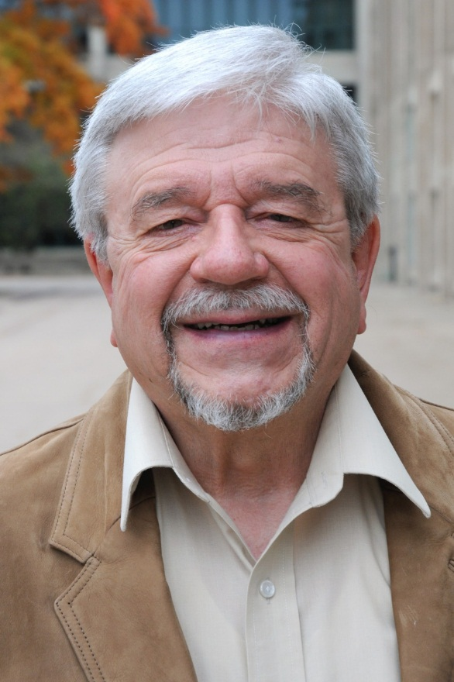
Lewis Turco, Emeritus
English
Department
Turco, Lewis. "Cursory Comment." VIA: Voices in Italian Americana 24.1&2 (2013): 86. Print. (Spring 2015)
1of13

Slide 46
Lewis Turco, Emeritus
English
Department
Turco, Lewis. "Evensong." VIA: Voices in Italian Americana 24.1&2 (2013): 85. Print. (Spring 2015)
2of13

Slide 47
Lewis Turco, Emeritus
English
Department
Turco, Lewis. "Giovanni Pascoli's Garden." Gradiva: International Journal of Italian Poetry 45 (2014): 126. Print. (Spring 2015)
3of13

Slide 48
Lewis Turco, Emeritus
English
Department
Turco, Lewis. Hero Enkidu: an Epic. New York: Bordighera, 2015. Print. VIA Folios 107. (Spring 2015)
4of13

Slide 49
Lewis Turco, Emeritus
English
Department
Turco, Lewis. "Monologue in a Bar." Baltimore Review (2014): 15. Print. (Spring 2015)
5of13

Slide 50
Lewis Turco, Emeritus
English
Department
Writing as Wesli Court:
Court, Wesli. "Friday, December 14, 2012." Measure: A Review of Formal Poetry 8.1 (2013): 57. Print. (Spring 2015)
6of13

Slide 51
Lewis Turco, Emeritus
English
Department
Writing as Wesli Court:
Court, Wesli. "Lunatickle." Measure: A Review of Formal Poetry 8.1 (2013): 53-54. Print. (Spring 2015)
7of13

Slide 52
Lewis Turco, Emeritus
English
Department
Writing as Wesli Court:
Court, Wesli. "Marvell Gnomes." Measure: A Review of Formal Poetry 8.1 (2013): 56. Print. (Spring 2015)
8of13

Slide 53
Lewis Turco, Emeritus
English
Department
Writing as Wesli Court:
Court, Wesli. "Sandy: An Octo." Measure: A Review of Formal Poetry 8.1 (2013): 55. Print. (Spring 2015)
9of13

Slide 54
Lewis Turco, Emeritus
English
Department
Turco, Lewis. "The Green Knight and the White: A Sestina." Measure: A Review of Poetry 9.1 & 2 (2014): 19-21. Print. (Fall 2015)
10of13

Slide 55
Lewis Turco, Emeritus
English
Department
Turco, Lewis. "Leavings." Trinacria: Poems, Translations, Essays, Reviews 12 (2014): 36. Print. (Fall 2015)
11of13

Slide 56
Lewis Turco, Emeritus
English
Department
Turco, Lewis. "Pro-Biz." Trinacria: Poems, Translations, Essays, Reviews 12 (2014): 37. Print. (Fall 2015)
12of13

Slide 57
Lewis Turco, Emeritus
English
Department
Turco, Lewis. "Trinity." 2 Bridges Review 3 (2013): 156-58. Print. (Fall 2015)
13of13

Slide 58
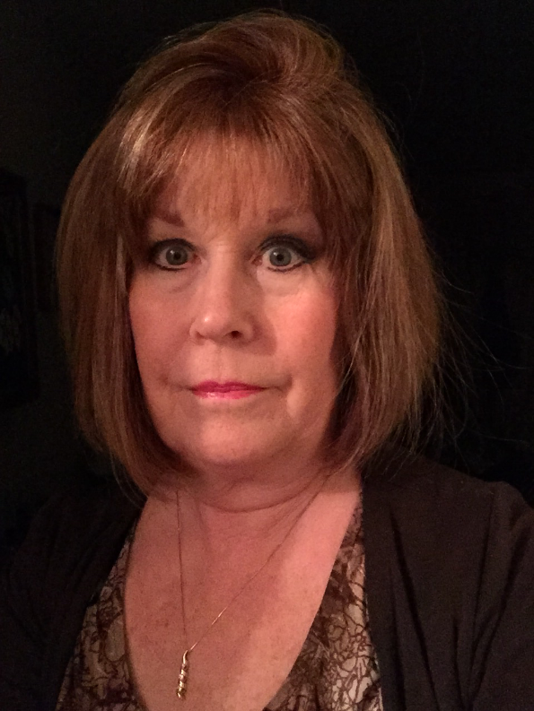
Karen wolford
Psychology
Department
Streets, Barbara Faye, Guerda Nicolas, and Karen Wolford. "Pause...Before Rushing In: Examining Motivations to Help in Trauma Impacted Communities Internationally." Journal of International Research and Review 4.2 (2015): 15-31. Print. (Fall 2015)

Slide 59
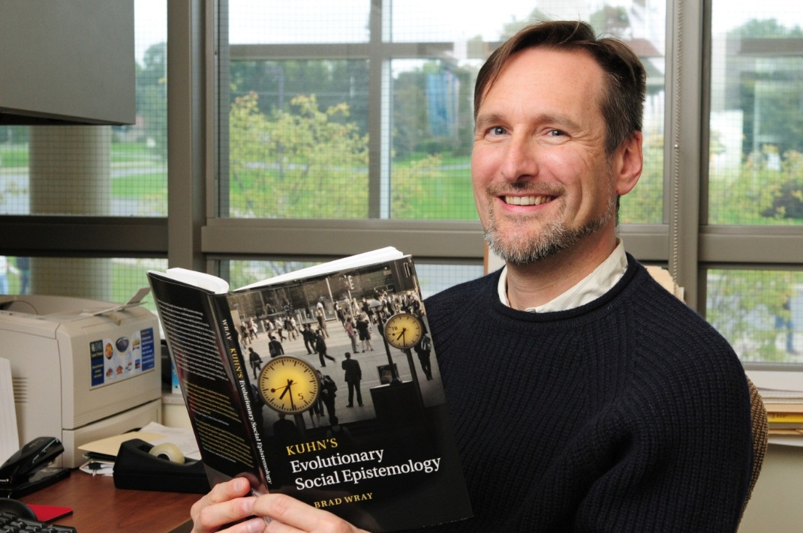
K. Brad Wray
Philosophy
Department
Wray, K. Brad. "Collaborative Research, Deliberation, and Innovation." Episteme 11.3 (2014): 291-303. Print. (Spring 2015)
1of8

Slide 60
K. Brad Wray
Philosophy
Department
Wray, K. Brad. "Epistemic Communities and Collaborative Research, History of." International Encyclopedia of the Social & Behavioral Sciences. Ed. James D. Wright. 2nd ed. Vol. 7. Oxford, UK: Elsevier, 2015. 867-72. Print. (Spring 2015)
2of8

Slide 61
K. Brad Wray
Philosophy
Department
Wray, K. Brad. Kuhn's Social Epistemology and the Sociology of Science. Kuhn's Structure of Scientific Revolutions - 50 Years On. Ed. William J. Devlin and Alisa Bokulich. Cham: Springer, 2015. pp. 167-183. Print. Boston Studies in the Philosophy and History of Science 311. (Spring 2015)
3of8

Slide 62
K. Brad Wray
Philosophy
Department
Wray, K. Brad, and Lutz Bornmann. "Philosophy of Science Viewed through the Lense of 'Referenced Publication Years Spectroscopy' (RPYS)." Scientometrics 102.3 (2015): 1987-96. Print. (Spring 2015)
4of8

Slide 63
K. Brad Wray
Philosophy
Department
Wray, K. Brad. “Older Scientists Get Their Due.” Reply to Letters. Science 346.6212 (2014): 929. Print. (Spring 2015)
5of8

Slide 64
K. Brad Wray
Philosophy
Department
Wray, K. Brad. Letter. Science 349.6251 (2015): 935. Print. (Fall 2015)
6of8

Slide 65
K. Brad Wray
Philosophy
Department
Wray, K. Brad. "The Methodological Defense of Realism Scrutinized." Studies in History and Philosophy of Science 54 (2015): 74-79. Print. (Fall 2015)
7of8

Slide 66
K. Brad Wray
Philosophy
Department
Wray, K. Brad. "Pessimistic Inductions: Four Varieties." International Studies in the Philosophy of Science 29.1 (2015): 61-73. Print. (Fall 2015)
8of8

Slide 67
Richard zakin, emeritus
Art Department
Zakin, Richard, and Frederick Bartolovic. Electric Kiln: A Guide to Clays, Glazes, and Electric Kilns. 4th ed. Westerville, OH: American Ceramic Society, 2015. Print. (Fall 2015)

Slide 68
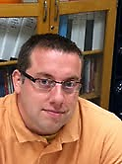
Jason zenor
Communication Studies Department
Zenor, Jason. "Shielding Acts of Journalism: Open Leaks Sites, National Security, and the Free Flow of Information." Nova Law Review 39 (2015): 365-89. Print. (Fall 2015)

Slide 69
Want a Closer look at the 2015 contributions? Go to: www.oswego.edu/library/college-archives

